Slide 1

Mini AirTour Demo
Talking Points

Slide 2
Introduction Points
Greenheck has been building energy recovery products for over 20 years
Equipment with compressors for over 10 years
Trailer overview
  Energy recovery technologies and performance
  Greenheck RV/E exposure
  Specifiable Greenheck technologies
    High turndown furnace, low sound condenser fans
  Commitment to new product development
    Remote condenser, web user interface
Notes:
-Ask how long the audience thinks we have been manufacturing energy recovery and DOAS equipment. They will be surprised we have been doing it for as long as we have.

Slide 3
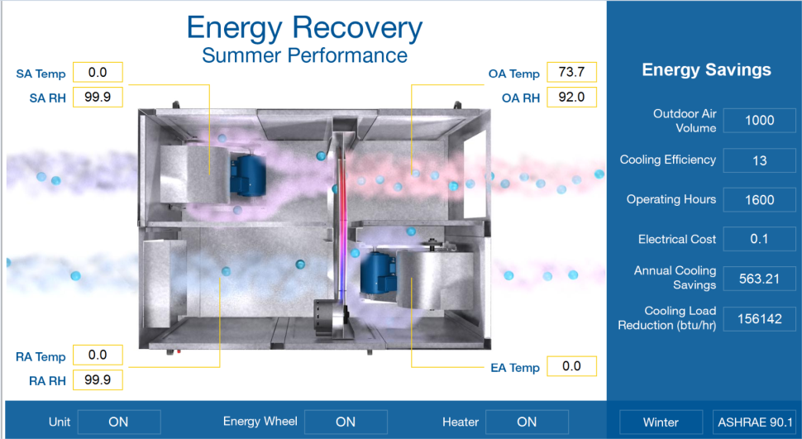
Energy Recovery Demo
Provides the ability to simulate both summer and winter operating conditions
User can enter operating hours and electrical cost to create an instant analysis of energy savings
Demo creates an annual energy savings as well as a capacity reduction
Notes:
Explain layout of the unit itself. Sheet metal divider with side by side airstreams.
-There are filters in both air streams protecting the wheel.

Slide 4
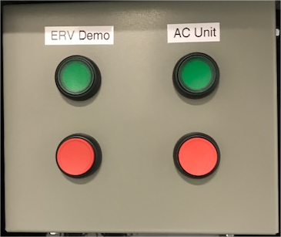
Energy Recovery Demo
Turn demo on using push button
Turn on AC unit if outdoor air temperature is greater than 70F
On the computer desk top open ERV Demo
Turn on energy recovery unit. (Keep energy wheel off)
Turn electric heater on right away to get entering air temperature to 95°F
As the system is getting up to temperature explain how the demo is simulating a warm summer day
Turn on the energy wheel with the group feeling the air temperature change
Notes:
-This is a total enthalpy device, so it will transfer both sensible and latent energy. That is important to point out for the different conditions that could be seen throughout the year.
-Once the electric heater and AC unit have created enough of a temperature differential, have the audience put their hands in front of the discharge location.
-Turn the wheel on with their hand in front so they can feel the temperature change. Ask how quickly they feel it.

Slide 5
Energy Recovery Demo Continued
Highlight energy savings and cooling load reduction on demo screen
Click on ASHARE 90.1 button and show the enthalpy recovery ratio
Energy code requires 50% minimum effectiveness. This is a performance metric and is driven by the amount of exhaust volume available.
  More exhaust, higher ratio
  Less exhaust, lower ratio
Notes:
-An energy recovery wheel is typically between 70-80% effective (enthalpy recovery ratio). This effectiveness results in a cooling capacity reduction of 3-4 tons per 1,000 CFM.

Slide 6
Energy Recovery Demo Talking Points
Benefits of energy recovery
  Reduces outdoor air cooling load.
    Rule of thumb: 3-4 tons / 1,000 CFM
  Reduces heating and cooling energy consumption.
    Energy savings shown on screen
  Reduces variability of air conditions entering the cooling and heating device.
  Conforms with ASHRAE Standard 90.1 and IECC.
Notes:
It’s always important to point out that it will operate in both summer and winter conditions. Energy transfer is the same regardless of airstreams, warm air transfers to cooler air and high humidity transfers to airstreams of lower humidity. This will give you a predictable range entering your cooling and heating device which will give you more precise temperature control and protect your equipment from too much cycling.

Slide 7
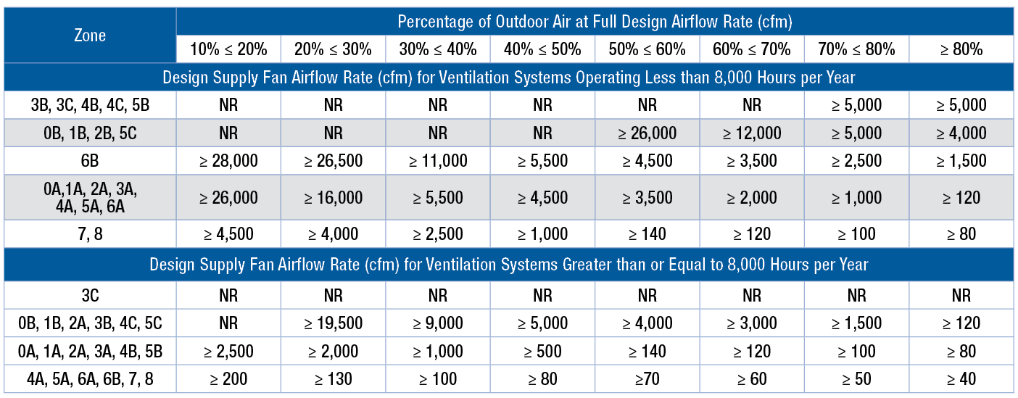
ASHRAE 90.1-2016
Table 6.5.6.1 Energy Recovery Requirement (IP)
Energy recovery device must be at least 50% effective!
Notes:
Example. A 45% outdoor air system in zone 1A requires energy recovery anytime the total supply volume for that system is greater than 4,500 CFM.
If energy recovery is required per ASHRAE because of this chart, the device MUST be at least 50% effective.

Slide 8
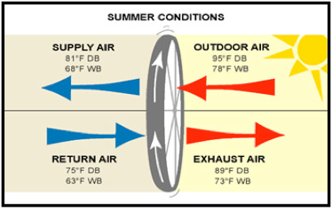
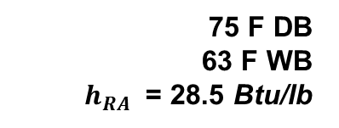
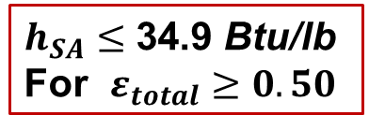

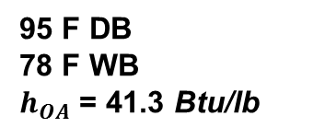
Enthalpy Recovery Ratio - ASHRAE 90.1
Exhaust-Air Energy Recovery (6.5.6.1)
$h_{SA}≤$ 34.9 Btu/lb
For $ε_{total}≥0.50$
95 F DB
78 F WB
$h_{OA}$ = 41.3 Btu/lb
75 F DB
63 F WB
$h_{RA}$ = 28.5 Btu/lb
$ε_{total}=\frac{h_{OA}−h_{SA}}{h_{OA}−h_{RA}}≥0.50$
  “A 50% percent enthalpy recovery ratio shall mean a change in the enthalpy of the outdoor air supply equal to 50% of the difference between the outdoor air and exhaust air enthalpies at design conditions.”
Be careful of this!
Notes:
This formula looks at enthalpy, not just sensible or latent effectiveness. Look at the OA enthalpy vs the SA enthalpy and compare it to the OA enthalpy vs the RA enthalpy. To simplify this, it is looking at the reduction you are getting vs the total reduction you could get based on the current return air.

Slide 9
Energy Wheel Talking Points
Greenheck has used Airxchange polymer energy wheels with silica gel desiccant for 20 years
Greenheck uses for the following reasons
  Highest performing device on market (70-80% effective)
  Easy to maintain and service
    Removable segments
    Washable with mild detergent solution
  Long life time
    Still have equipment operating from 20 years ago
Notes:
-The polymer material is a plastic like material doing the sensible energy transfer.
-The silica gel is a chemically embedded process not just a topical application which increases the longevity of the latent energy transfer.
-70-80% effectiveness, 3-5% cross leakage rating.
-Because the polymer material is like plastic, it can get wet. Combining water with a mild detergent (dawn dish soap, fantastic, 409, etc..) and soaking that wheel segment is how you will want to clean it. We recommend cleaning that every 3-5 years but that does depend on applications as well as proper filter maintenance.
-AHRI 1060 certification gives us a third party stamp of approval. Every energy recovery device from Greenheck will have an AHRI certificate associated with it showing performance, effectiveness, cross leakage, etc.

Slide 10
Total Energy Core
Expands Greenheck’s product offering
Benefits
  Total enthalpy core
  No moving parts
  Smaller footprint
  Low cross leakage
Unbiased design assistance on which energy recovery technology is best for your system
Fiber or polymer membrane energy cores available
Notes:
As the exiting room air and the fresh outside air pass through the core, they are kept separate by partition plates made of a specially processed paper. It allows the transmission of temperature and humidity but prevents the passage of air. The idea for this technology was sparked when an engineer, watching his daughter play, rolled a sheet of paper into a tube and then blew air through it. He noticed that the heat of her breath was transferred through the paper to his hand.
-Cores can handle a face velocity of ~350 FPM while wheels can handle ~750 FPM. Because of this, cores are most popular in smaller CFM applications (2,500 CFM and below). The larger the airflow, the faster the footprint increases with the core.
-50-60% effectiveness, 0-1% cross leakage

Slide 11
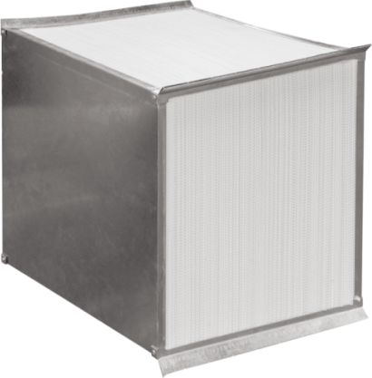
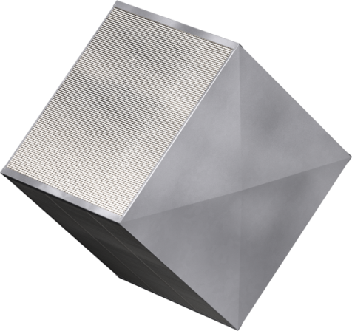
Total Energy Core
Fiber vs. Polymer
Fiber Membrane (-FM) | Polymer Membrane (-PM)
AHRI 1060 Certified
Sensible & Latent Energy Transfer
0-1% EATR
Vacuum Cleanable | Washable
50-60% ERR | 55-65% ERR
Notes:
The Polymer Membrane core is going to be much like the wheel as far as that plastic like material. The Polymer core will provide an increase in effectiveness, decrease in pressure loss, and will also allow for washable cleaning.

Slide 12
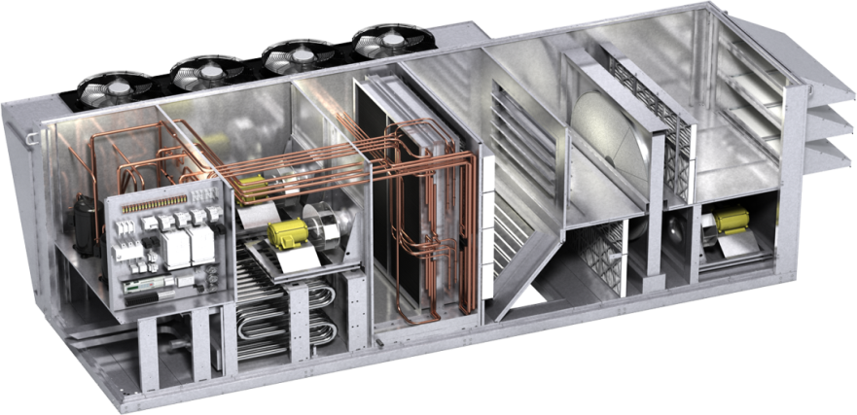
Greenheck Solution-Model RV(E)
DOAS / VAV Applications
Performance range
  1,000 to 18,000 CFM
Construction Features
  2” R13 foam double wall
  Direct-drive plenum fans
  with VFD
Cooling options
  DX cooling up to 70 tons
  Chilled Water/Remote Condenser
Heating options
  Indirect Gas/Hot Water/Electric
Controls
  Stand alone microprocessor
  BACnet/Modbus/LonWorks capable
  Fully programmed from factory
  Standard web user interface
Notes:
On the opposite side of the trailer there is an RV/E replica with all of the standard and selectable offerings you will see with that unit.

Slide 13
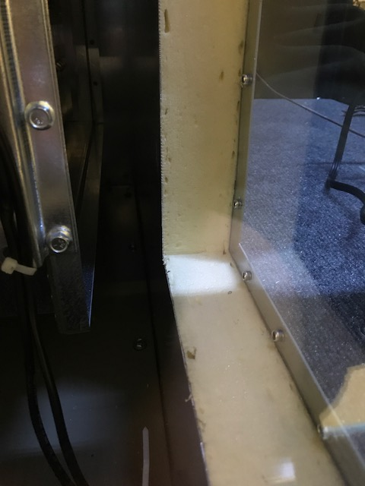
RV and RVE Overview
Feature: Standard 2” R13 foam construction
Benefit: Reduces thermal losses and cabinet condensation
Notes:
-Reduces thermal losses and cabinet condensation
-Fully insulated cabinet, including roof and base
-Double wall design protects the insulation from microbial growth

Slide 14
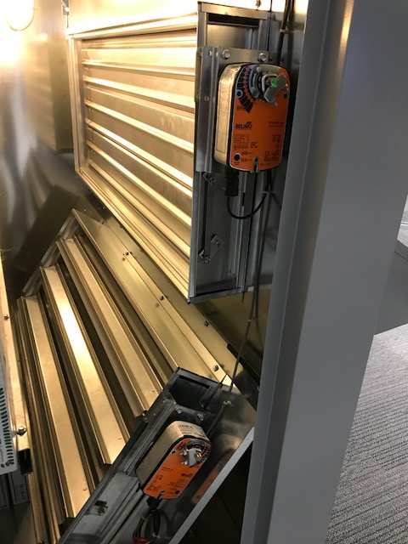
RV and RVE Overview
Feature: 100% outdoor air or return air capabilities with full economizer
Benefit: RV and RVE products are designed to fit many applications
  Schools
  Hotels
  Conference centers
  Gymnasiums
  Locker rooms
Notes:
VAV, SZVAV, Constant volume and a number of different control sequences for full damper modulation come as options with our controller.

Slide 15
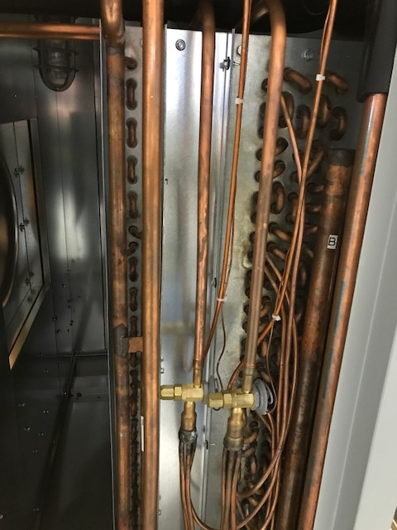
RV and RVE Overview
Feature: modulating hot gas reheat coil with 6” of coil separation
Benefit: neutral air discharge for dehumidification applications. Eliminates energy wasting moisture carry over
Notes:
Not all of our competitors offer this coil separation so they have the risk of adding humidity back into the air because of moisture carry over

Slide 16
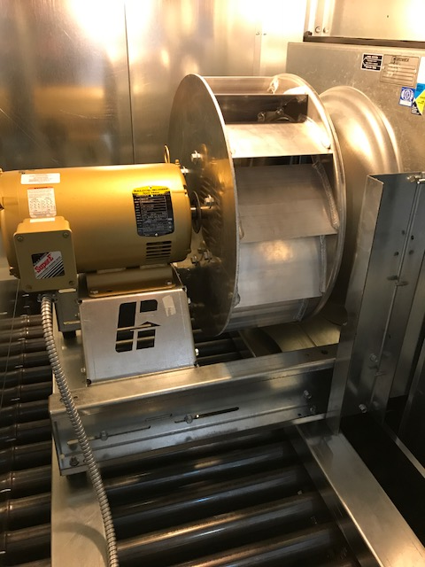
RV and RVE Overview
Feature: Direct drive plenum fans with VFD’s up to 18,000 CFM
Benefit: Ease of initial airflow balance. No belt maintenance

Slide 17
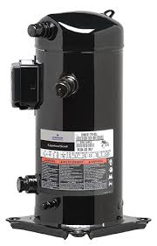
RV and RVE Overview
Feature: modulating capacity and speed compressors up to 70 tons
  Standard, Digital, and Inverter compressor offerings
Benefit: precise temperature control for varying air conditions
Notes:
15-20% part load efficiency increase (IEER) from a digital to inverter compressor.

Slide 18
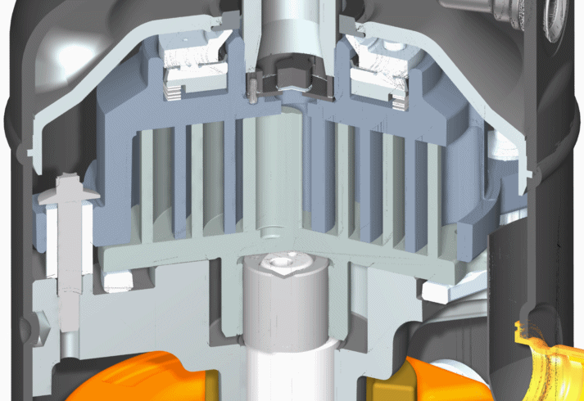
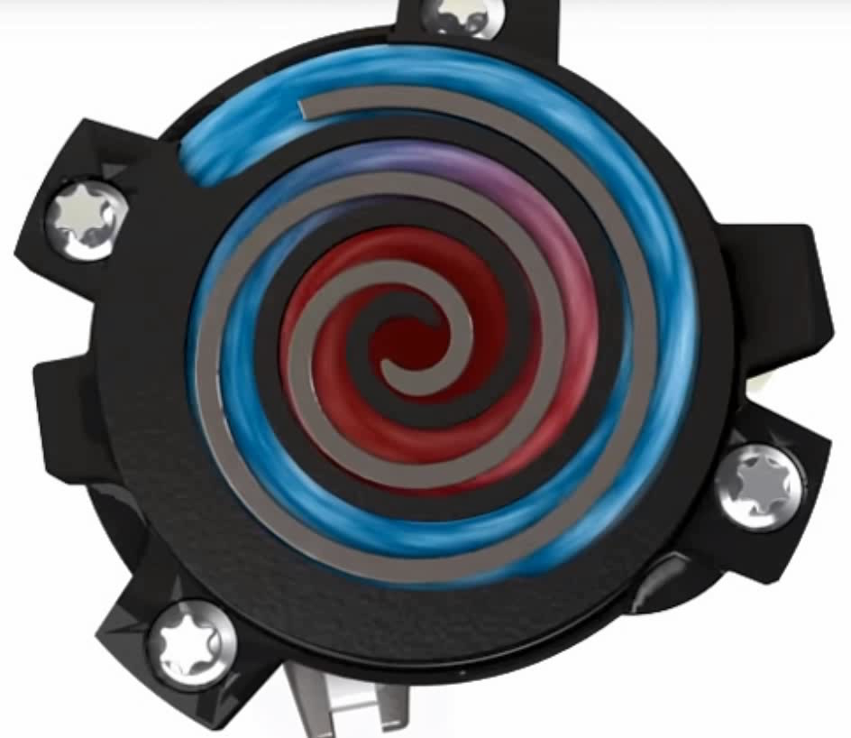
Digital Scroll vs. Inverter Scroll
Unloaded state: Scrolls separate
  No compression, motor and scrolls still rotate
Loaded state: Scrolls join
  Operates at full capacity
Unload/load based cooling demand
Refrigerant flow varies with motor speed
  AC motor with VFD
Controls to stay within compressor envelope and meeting cooling/dehumidification demand

Slide 19
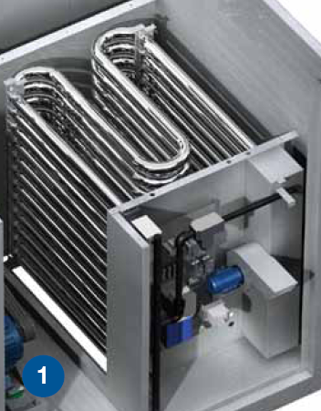
RV and RVE Overview
Feature: Indirect gas fired furnaces up to 1,200 MBH
Benefit: 16:1 modulation for precise temperature control. Improves system performance
Notes:
Standard turndown is 4:1, with high turndown options up to 16:1.
Ex: Furnace is sized for an 80 degree temp rise. With a 4:1 turndown the minimum temp rise you will get is 20 degrees. This could result in furnace cycling/less precise temperature control especially in part load conditions. A 16:1 turndown would result in a 5 degree minimum temp rise for much tighter temperature control
The high turndown option is especially important in applications with varying air volumes. As design airflow is cut in half, the temp rise of the furnace doubles which means even less control at the standard 4:1 turndown.

Slide 20
High Turndown Talking Points
Greenheck’s 16:1 modulation is industry leading
Using two modulating valves provides seamless modulation
Traditional high turndown furnaces use a on/off value and a modulating valve so there are dead band areas
Provides improved discharge control regardless of airflow and temperature
Reduces furnace cycling and increases furnace longevity.

Slide 21
Unit Overview Talking Points
Greenheck’s RV and RVE can be used in many applications
Features like modulating fans, compressors, and furnaces provide exceptional unit control and superior energy efficiency.

Slide 22
RV/E Applications

Slide 23
Educational Facilities
RV and RVE units are great for educational facilities
Commonly used as 100% outdoor air units that meet ventilation requirements and provide dehumidification
Ability to modulate cooling, heating, and fans make these units ideal for the high outdoor air demands of education facilities

Slide 24
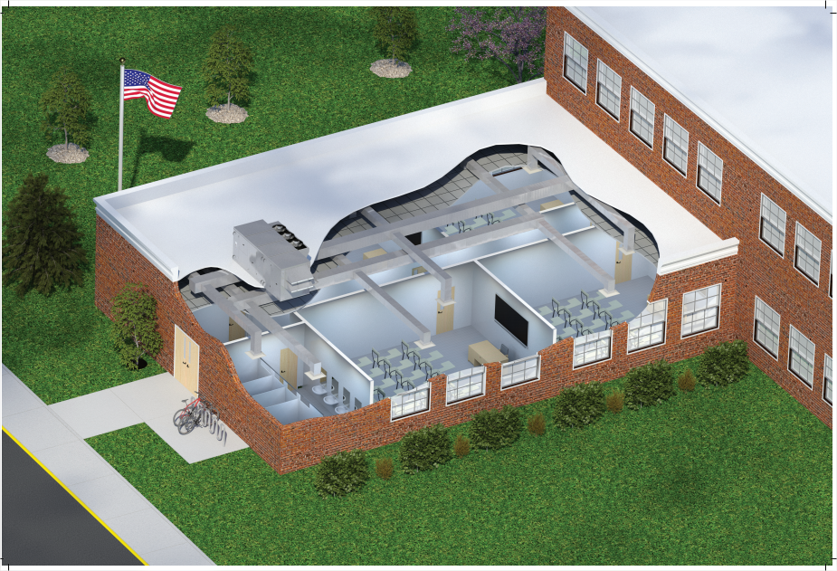
Class Room Wing Example
RVE unit exhausting from both the classrooms and restrooms while supplying ventilation air
Decoupled 100% outdoor air units are increasing in popularity

Slide 25
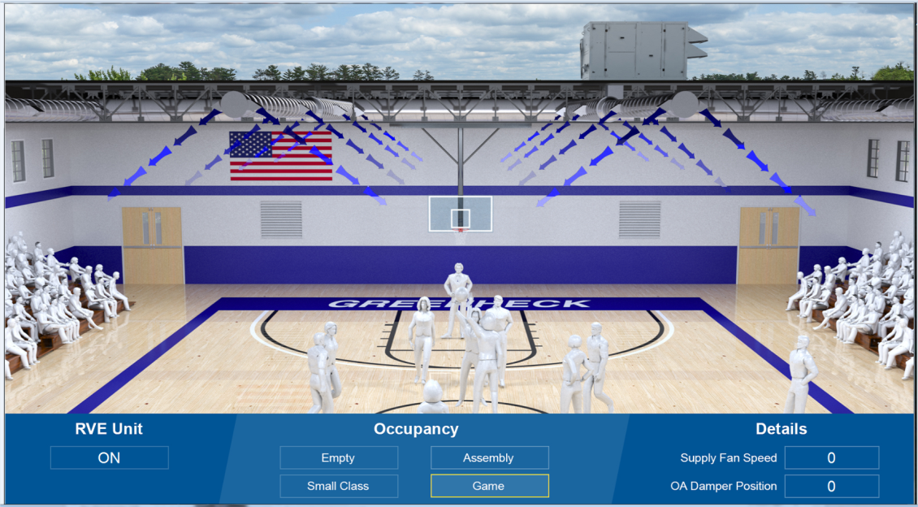
Gymnasium Demo
Demo showcases the RV and RVE’s ability to handle different ventilation requirements
Includes single zone VAV sequence were the supply fan modulates to maintain zone temperature

Slide 26
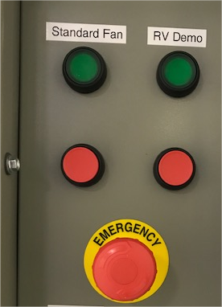
Gymnasium Demo
Turn Demo On
Open Gym Demo on computer desktop
Turn unit on with demo
Four examples
  Empty (in-between classes)
    Fans, dampers, and cooling at a minimum position
  Gym Class (Minimum occupancy)
    Fans, dampers, and cooling slightly above minimums
  School assembly (intermediate occupancy)
    Fans, dampers, and cooling at intermediate position
  Basketball game
    Fans, dampers, and cooling at maximum position
Notes:
Greenheck’s microprocessor controller has all of the built in sequences for this type of installation
Single zone VAV fan control
CO2 sensor damper control
Room temperature control for heating/cooling
Simple “plug and play” system
Modulating fans, compressors, and furnaces make the RV and RVE ideal for these installations

Slide 27
Gymnasium Demo Talking Points
Greenheck’s microprocessor controller has all of the built in sequences for this type of installation
  Single zone VAV fan control
  CO2 sensor damper control
  Room temperature control for heating/cooling
Simple “plug and play” system
Modulating fans, compressors, and furnaces make the RV and RVE ideal for these installations

Slide 28
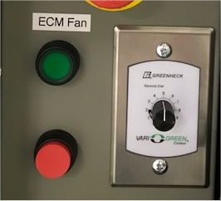
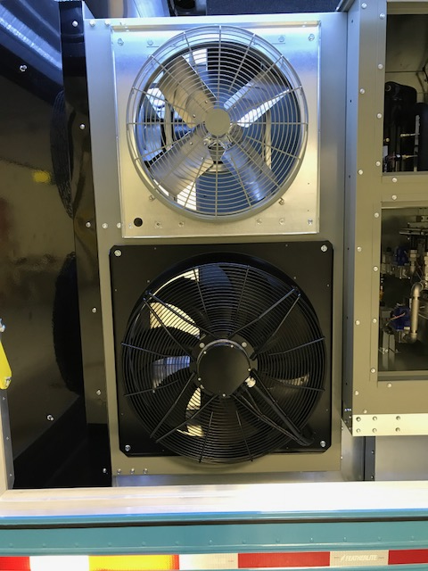
Low Sound Demo
This demo features a side by side comparison of a standard condenser fan and a low sound fan.
Start the standard condenser fan first. Most manufactures are using this type of fan design.
  Notice the quick and audible noise created by the fan
Shut off the first fan and start the low sound fan.
  This fan has an EC motor which features soft start and is much quieter!
Additionally use the modulating dial to adjust the fan speed. Discuss the benefits of using a modulating pressure control for improved sound performance and reheat performance
Notes:
Low-sound condensing fans
standard on all RV(E) products
Swept blade design reduces sound
Reduces sound by 5-8 dBA per fan
Reduces perceived noise by ~50%
Optional Modulating Head
Pressure Control
EC Motors on lead condensing fan
More reheat capacity at part-load conditions
Quieter system as the condenser fan speed is based upon system demand

Slide 29

Low Sound Fan Talking Points
Low-sound condensing fans
standard on all RV(E) products
  Swept blade design reduces sound
  Reduces sound by 5-8 dBA per fan
  Reduces perceived noise by ~50%
Optional Modulating Head
Pressure Control
  EC Motors on lead condensing fan
  More reheat capacity at part-load conditions
  Quieter system as the condenser fan speed is based upon system demand

Slide 30
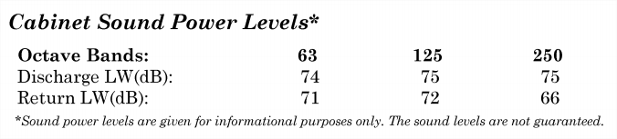
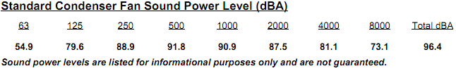
Low Sound Talking Points
Sound levels are important for equipment placement
  Industry has been slow to provide quality data for entire systems, notice “for informational purposes only”

Slide 31
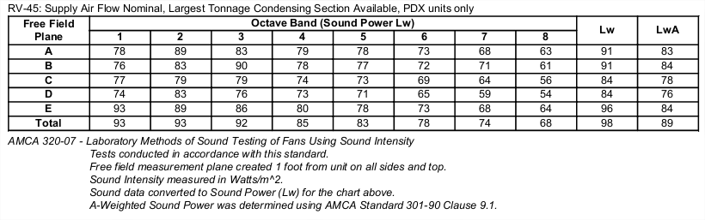
Low Sound Talking Points
Greenheck provides 5 planes of sound information
Tested in AMCA certified sound labs
Allows for confidence in equipment placement

Slide 32
Controls
Turn RV Demo On
Open Google Chrome and use Web UI bookmark
Highlight that Greenheck programs all of its own controls
Controls are flexible and can easily be adjusted by changing a few screens
Notes:
Explain that we have all of our sequences and logic built into the controller. It comes configured based on how it was selected, but if things need to change (ex: changing supply fan control from constant volume to duct pressure control) we can change a few screens and tie in the correct sensors and the unit will operate as it should.

Slide 33
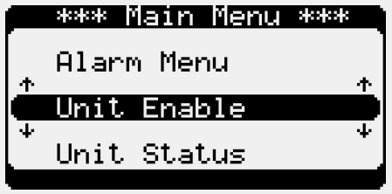
Controls
Menu’s are easy to understand and navigate
Submittals show all sequence of operations and BMS points list tailored to the selected unit
Notes:
All controls are programmed and tested in-house
Sequences are designed for our units and components
We use feedback from YOU to make our controls better
Each version update we include new sequences/features that YOU have helped us create with your feedback.
Our in-house service team offers full technical support!
Our all encompassing technical support team covers both the mechanical and control components

Slide 34
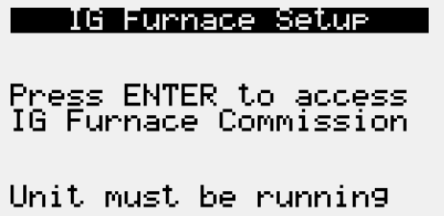
Controls
Built in furnace commissioning guide for easy start up!
Provides step by step guidance to ensure proper start up

Slide 35
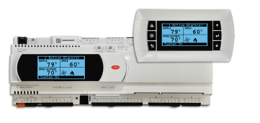
Controls Talking Points
All controls are programmed and tested in-house
  Sequences are designed for our units and components
We use feedback from YOU to make our controls better
  Each version update we include new sequences/features that YOU have helped us create with your feedback.
Our in-house service team offers full technical support!
  Our all encompassing technical support team covers both the mechanical and control components

Slide 36
Controls Talking Points
Unit is programmed from the factory based on the selection.
Sequences are easy to adjust in case something is missed or needs to be changed in the field
Simple to navigate menus for startup and servicing
Full BMS integration for both monitoring and control

Slide 37
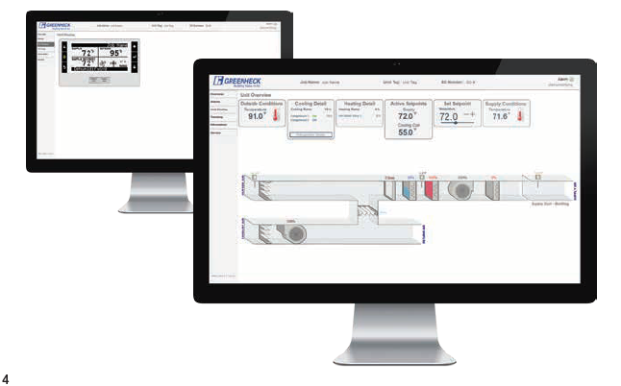
NEW! Web User Interface NEW!
The web user interface is a standard feature and can be accessed through the building network with a simple Ethernet connection.

Slide 38
Web User Interface
Overview screen graphic. This will highlight the unit as it was designed and configured from factory. This screen provides current status of the unit and allows the user to adjust temperature setpoints.
Alarm Screen. Explain that this screen allows the user to view current alarms as well past alarms that have been cleared.
Trending Screen. This screen allows the user to trend defined monitoring points. The user can also run a trend for a set period of time and download the trending data to spreadsheet.
Information screen. Provides user with DOAS contact support information and the controller IOM.
Live Trend button. Shows an active trend with standard monitoring points of unit.
Unit Display button. This screen is a mimic of the unit controller screen. Allows the user to fully access the unit for monitoring and setpoint changes.

Slide 39

eCAPS
The computer is connected to Wi-Fi so eCAPS can be pulled up to showcase how easy it is to select a Greenheck RV or RVE product
Ask them for information on airflow and temperature to make a selection

Slide 40
eCAPS Talking Points
Greenheck is making equipment selections easy
Only manufacturer providing this type of selection
Two easy steps to get unit information
  Heating/cooling capacities
  Electrical
  Weight
  Dimensions
Easiest way to get engineers to specify Greenheck RV and RVE products!
Notes:
Greenheck is making equipment selections easy
Only manufacturer providing this type of selection
Two easy steps to get unit information
Heating/cooling capacities
Electrical
Weight
Dimensions
Easiest way to get engineers to specify Greenheck RV and RVE products!

Slide 41
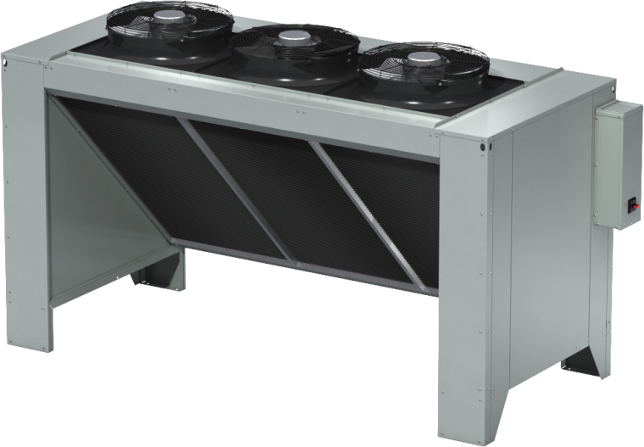
Remote Condenser
Greenheck is now offering a remote condenser up to 30 tons on RV and RVE products
Modulating hot gas reheat capabilities
Compressors and reheat coil are all factory installed and tested
Cost saving installations
Notes:
25’ of rise, 100’ of equivalent line run
Keeping the compressor indoors simplifies installation
Greenheck pipes and wires hot gas reheat at the factory
Reduces contractor installation and start up time
Contractor just needs to connect the systems and charge the system
Factory provided controls are all set for operation!
Complete package from one manufacturer

Slide 42
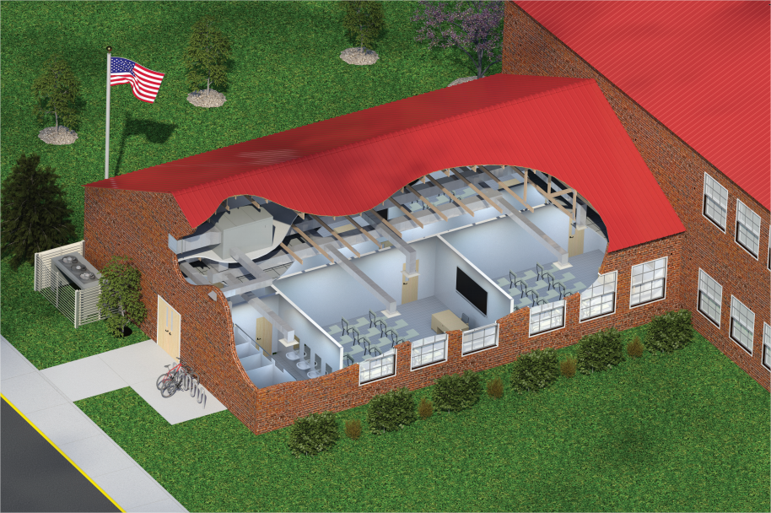
Remote Condenser Example
Great for standing seam metal roof applications

Slide 43
Remote Condenser Talking Points
25’ of rise, 100’ of equivalent line run
Keeping the compressor indoors simplifies installation
  Greenheck pipes and wires hot gas reheat at the factory
Reduces contractor installation and start up time
  Contractor just needs to connect the systems and charge the system
  Factory provided controls are all set for operation!
Complete package from one manufacturer

Slide 44
Closing Talking Points
Greenheck continues to expand its heating and cooling products!
Greenheck has invested significantly in this business!
  Five manufacturing locations (WI, NC, MN, CA and OK)
  Psychrometric lab for year round performance testing
Greenheck has products that fit your applications!
Notes:
Offer to bring them up to Schofield, WI for product demonstrations, plant tours, and Wisconsin fun!
Thank you for continually using Greenheck and building value in air!

Slide 45


The mission of Greenheck is to be the market leader in the development, manufacture and worldwide sale of quality air moving and control equipment with total commitment to customer service.

