Slide 1
Greenheck Fan Corporation
Corporate Overview
Welcome

Slide 2
Our Vision
To be the market leader in the development, manufacture and worldwide sales of quality air-moving and control equipment with a total commitment to customer service.

Slide 3
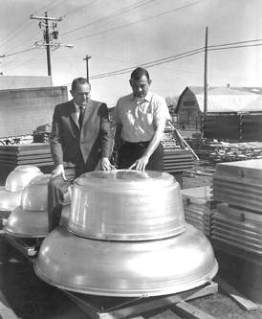
Greenheck History
Founded in 1947 by Bernie and Bob Greenheck
Sheet metal business
First air movement product was rotary turbine

Slide 4
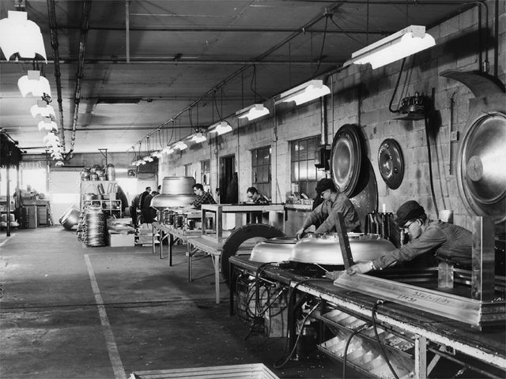
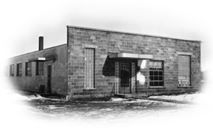
Greenheck History
Facility 1, Schofield, WI
  3000 Sq. Ft.
  Three Employees

Slide 5
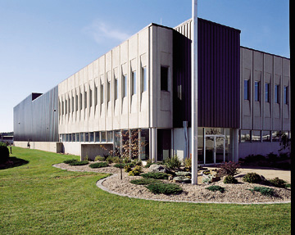
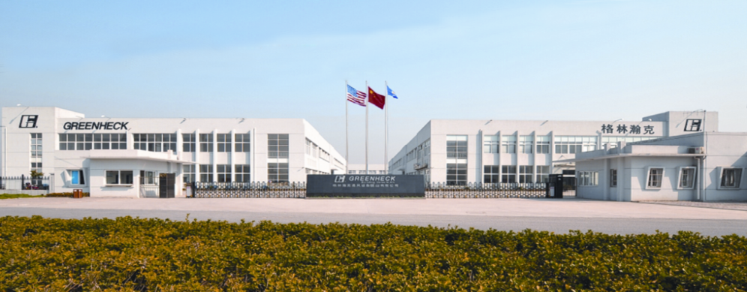
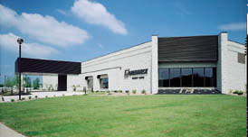
Greenheck Today
2800+ employees
Over 1.9 million sq. ft. of manufacturing space
Growing International presence
Jim McIntyre

Slide 6
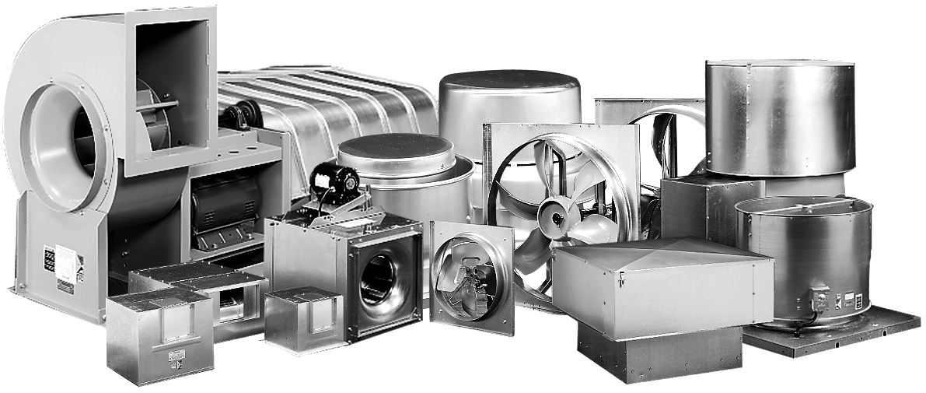
Air Movement Products

Slide 7
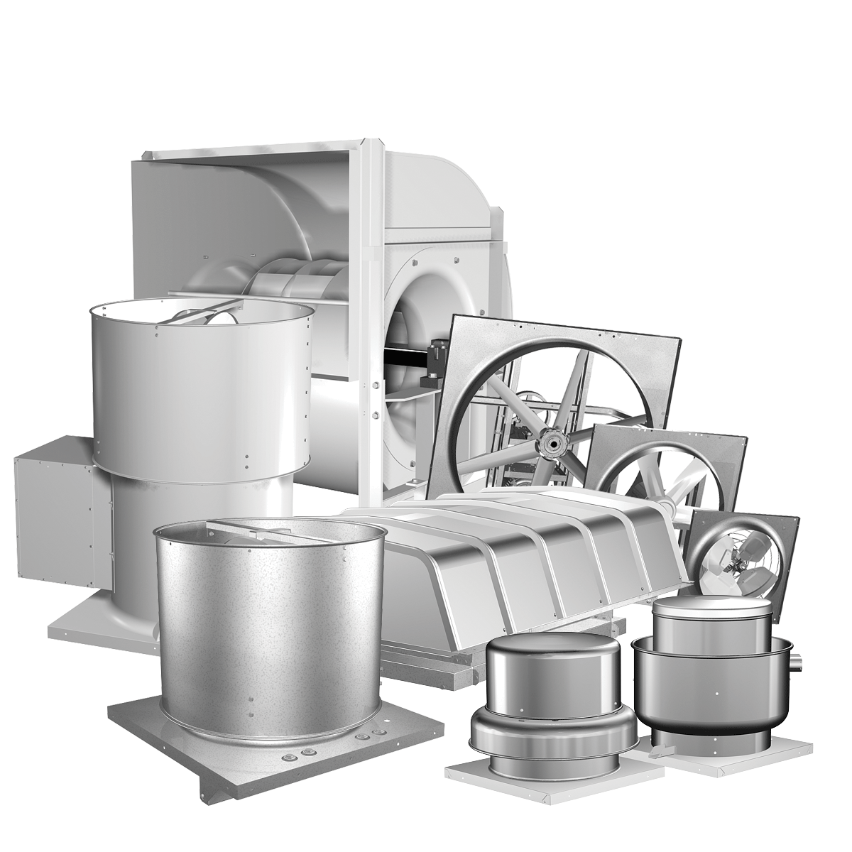
Fans and Ventilators
Greenheck’s first product in ventilation equipment
Market leader
Largest product line
Commercial, institutional, and industrial markets

Slide 8
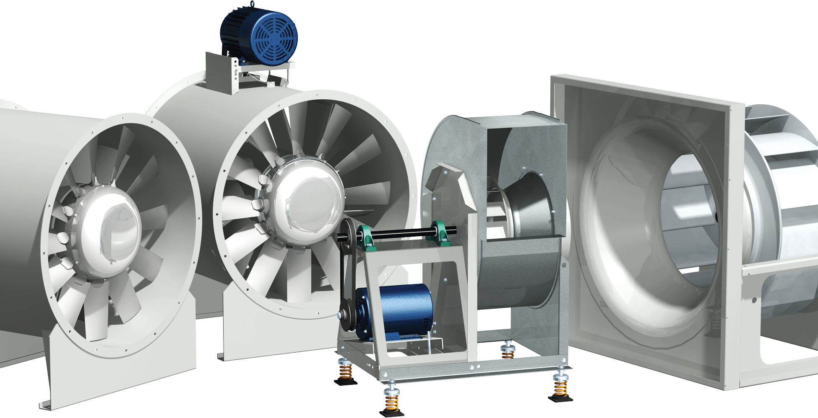
Centrifugal, Vane Axial and Industrial
Centrifugal market
  Hospitals, schools, stores, large office buildings
Axial market
  Industrial space ventilation, fume hood exhaust, smoke Removal and paint booth exhaust

Slide 9
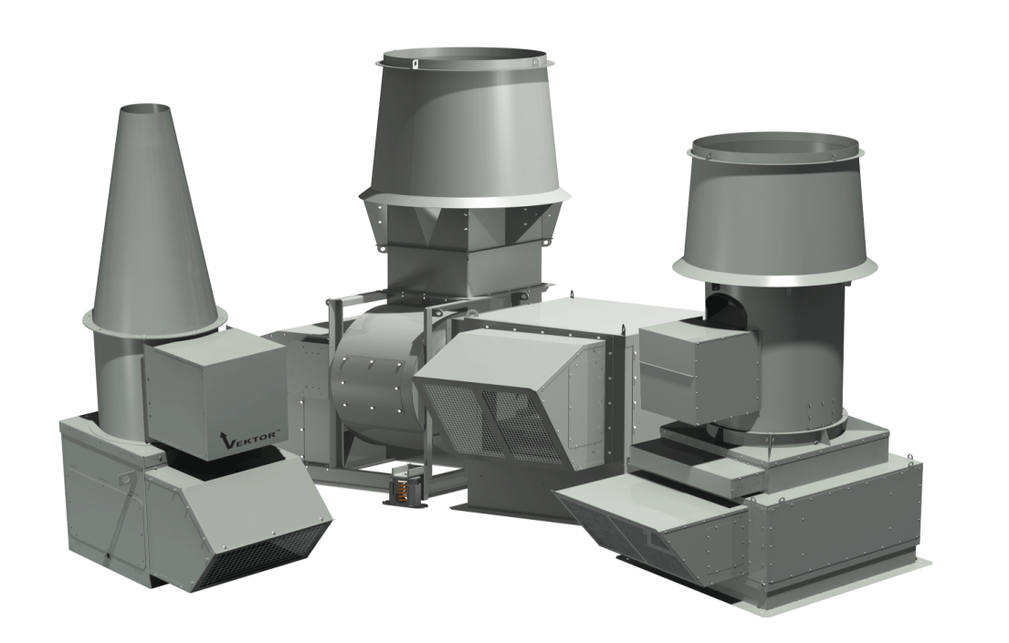
Lab Exhaust Systems
Vektor lab exhaust products remove hazardous or noxious fumes from laboratories
Applications
      Hospitals
      University labs
      Pharmaceutical companies
      Biotech companies
      Research facilities

Slide 10
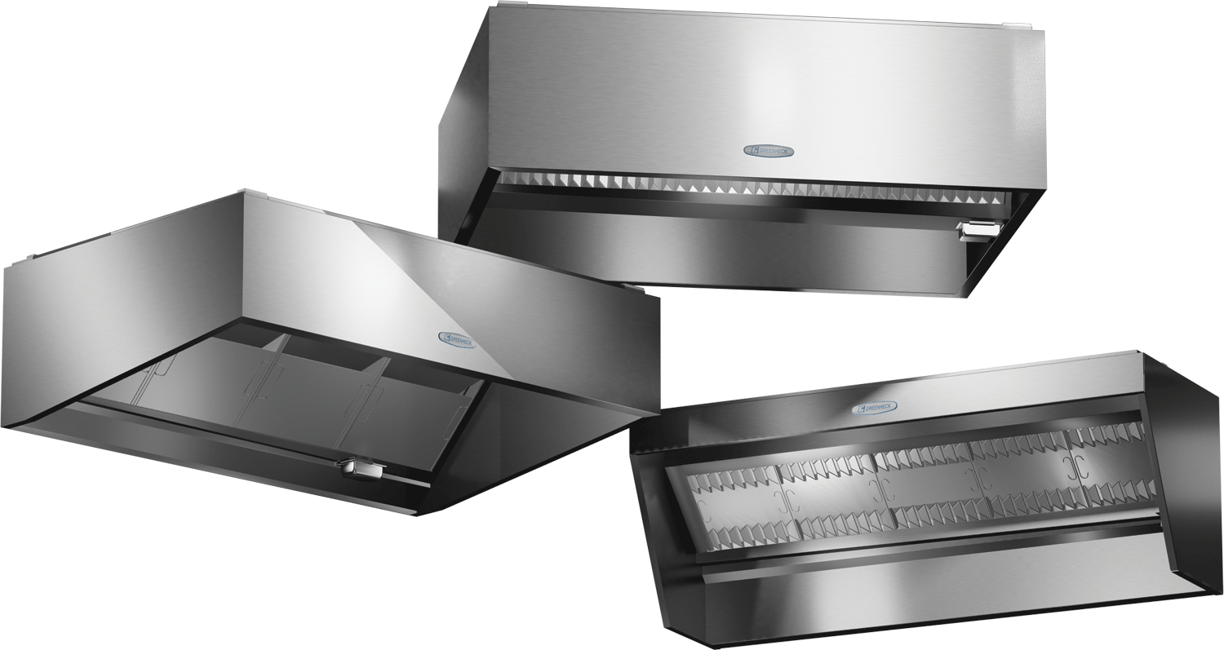
Kitchen Ventilation Systems
Single source supplier of complete kitchen systems engineered to work together
  Hoods
  Utility fans
  Make-up air units
  Fire suppression systems
Custom size and style

Slide 11
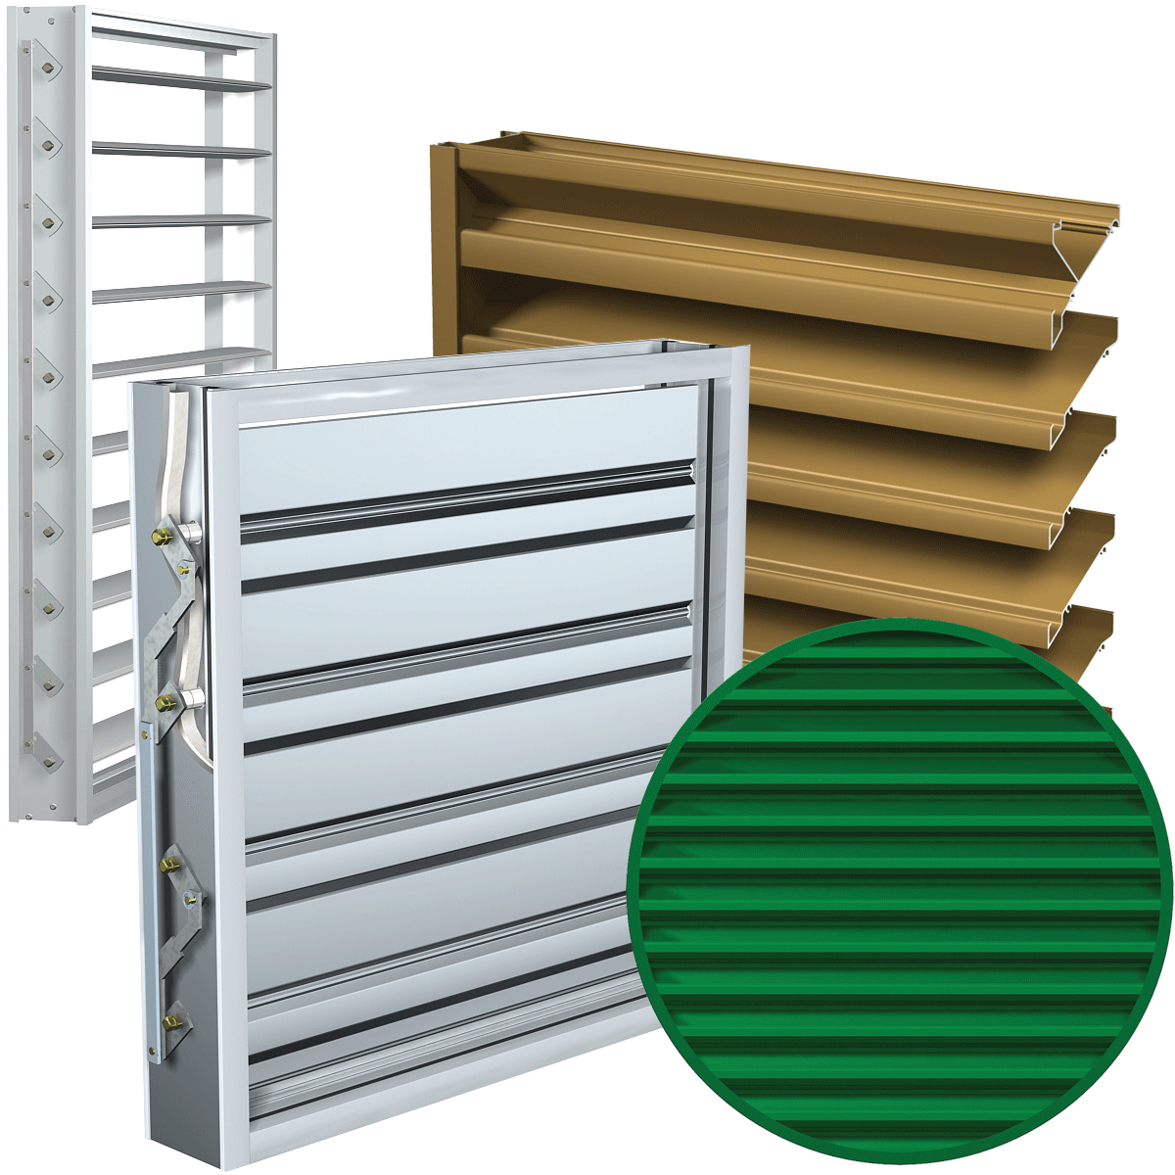
Air Control and
Architectural Products

Slide 12
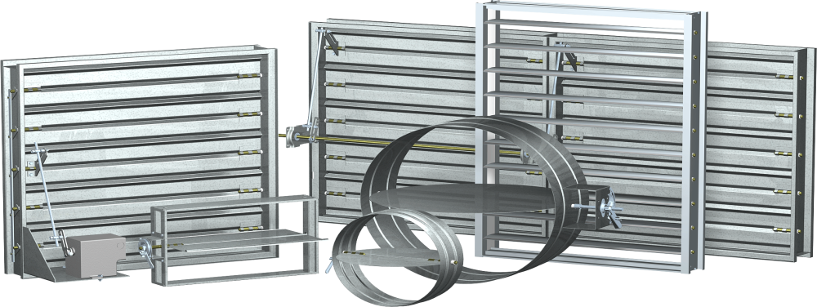
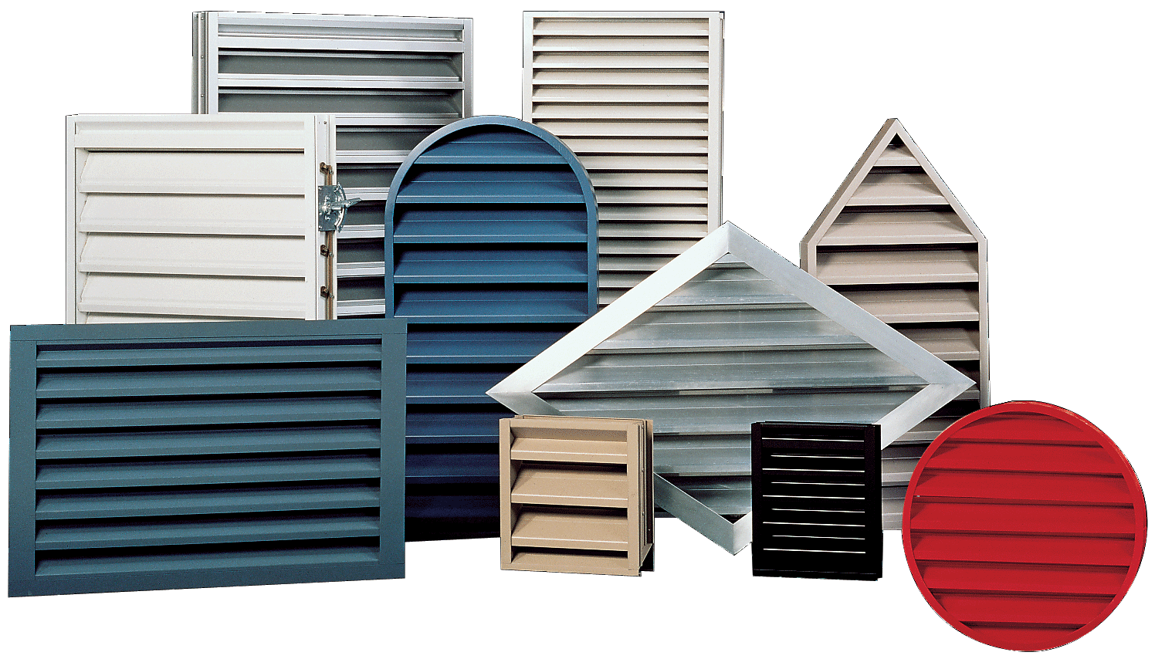
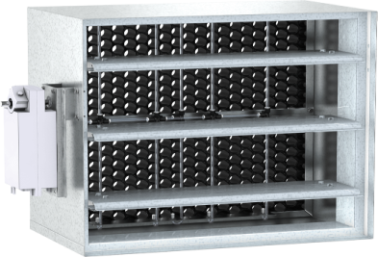
Dampers and Louvers
Dampers
  Backdraft
  Control
  Fire / smoke life safety
  Insulated
Louvers
  Mechanical
  Architectural
  Any shape, size and color

Slide 13
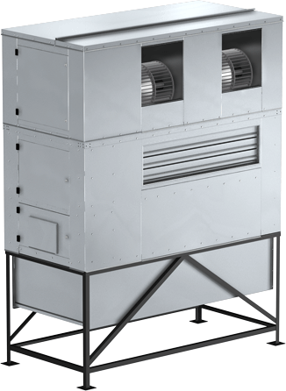
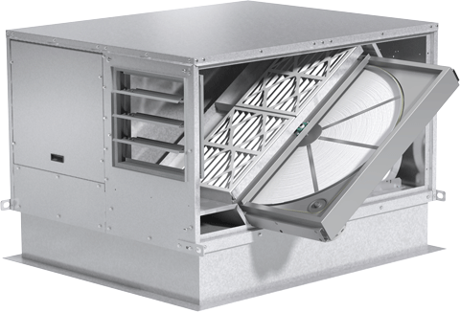
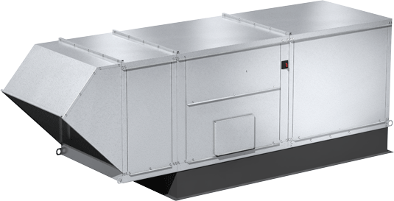
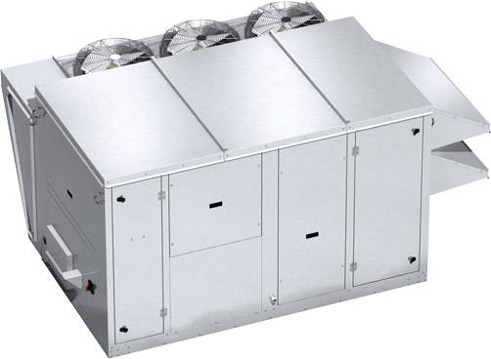
Tempered Air Products

Slide 14
Energy Recovery
Applications requiring high percentage outdoor air
Reduce first cost by reducing air conditioning tonnage
Reduces annual operating costs by reducing heating / cooling loads
Improved humidity levels

Slide 15
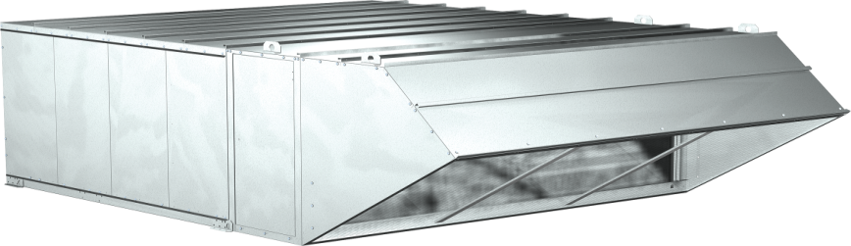
Make-Up Air
Industrial, commercial, kitchen applications
Heating options
  Direct and indirect fired gas; steam, hot water, and electric
Cooling options
  Evaporative, direct expansion coil, and chilled water coil cooling options

Slide 16
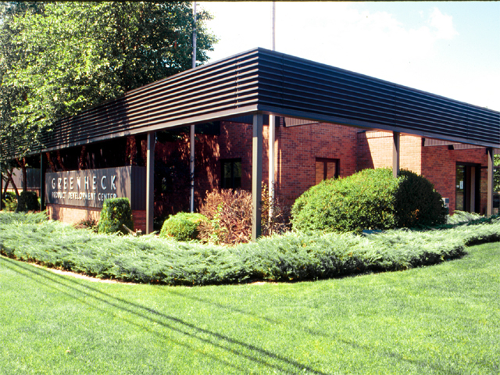
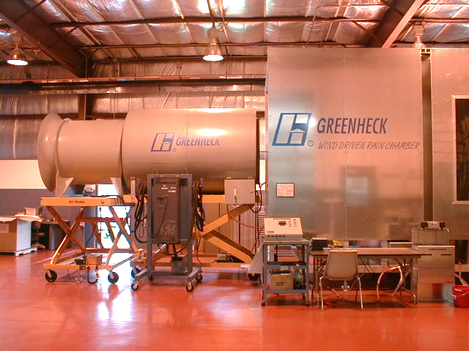
Engineering Design and Testing
65,000 sq. ft.
Five engineering facilities that include:
  Aerodynamic testing
  Wind-driven rain
  Energy transfer
  Extended life analysis
  UL fire testing
  UL motor heat testing
  Purchased component testing

Slide 17
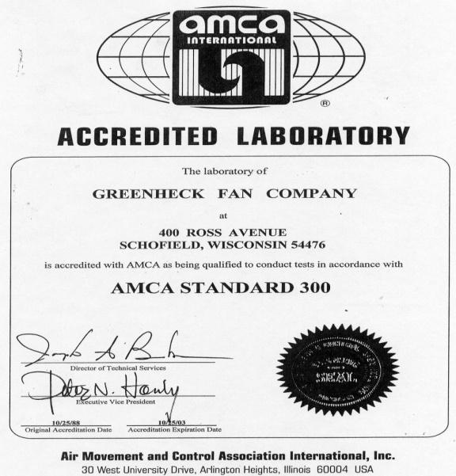
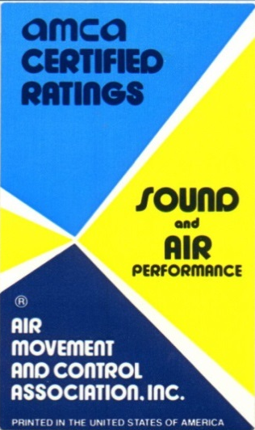
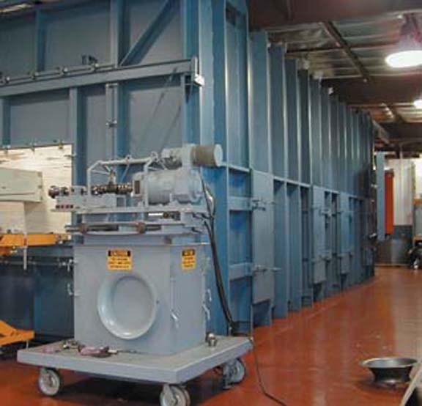
AMCA Certification
Greenheck has four AMCA accredited air chambers and one sound chamber

Slide 18
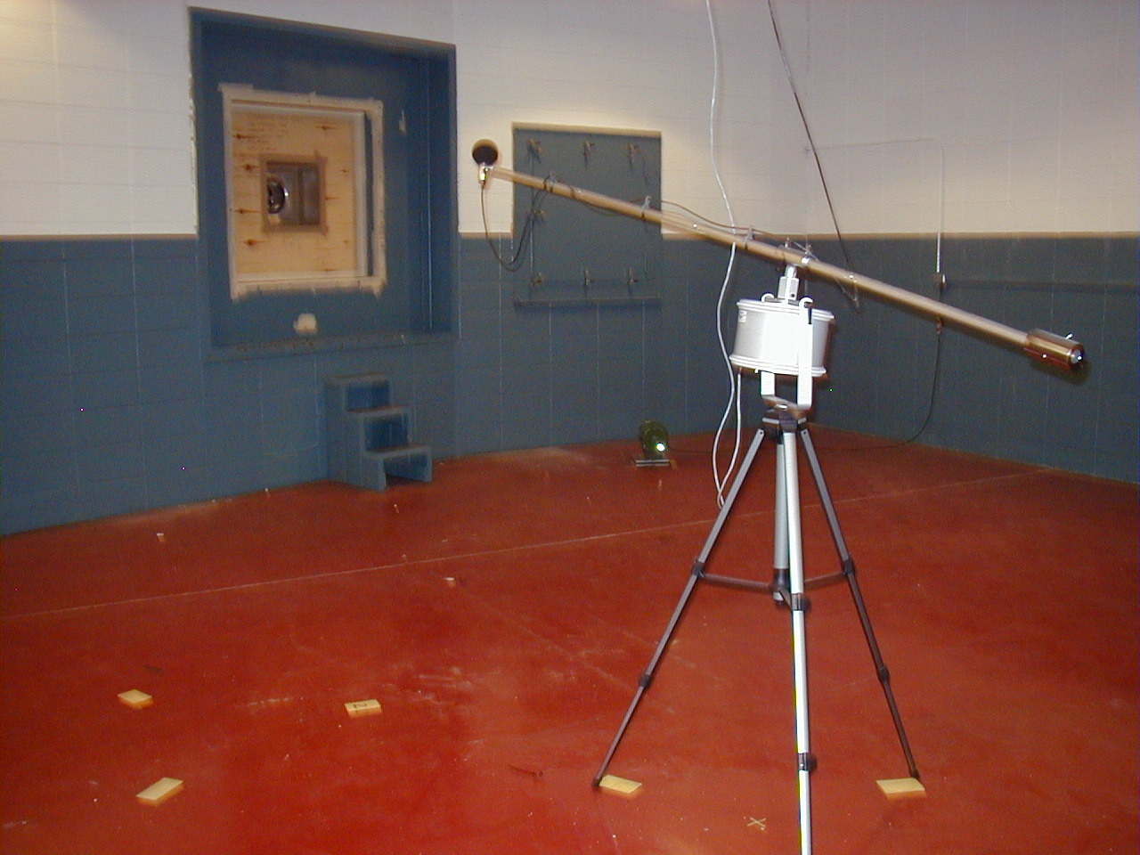
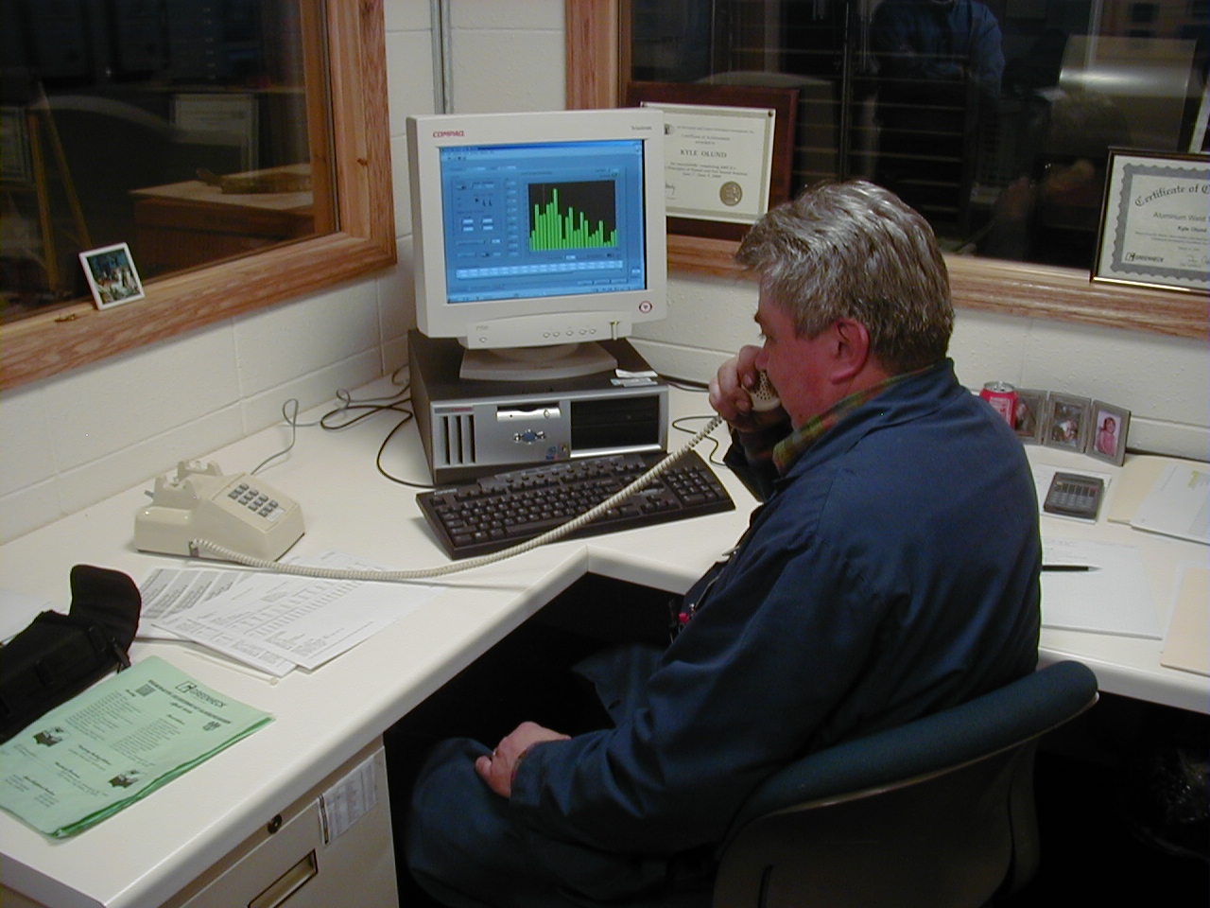
Sound Testing
Reverberant sound room located at Greenheck
1 of only 16 AMCA accredited sound labs in the world

Slide 19
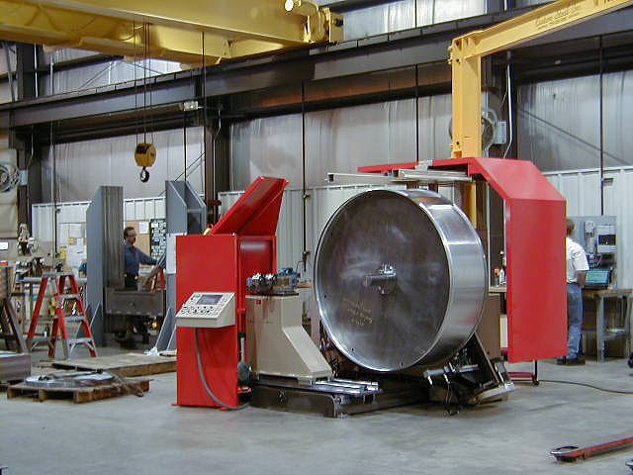
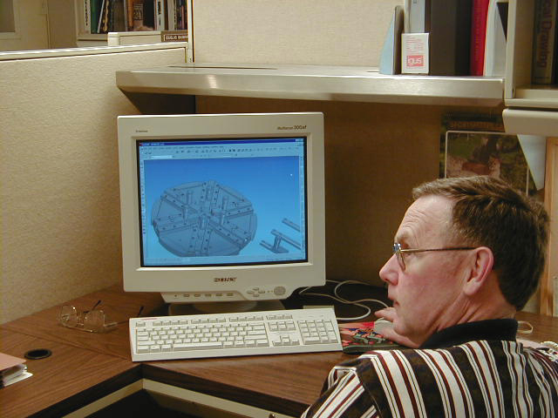
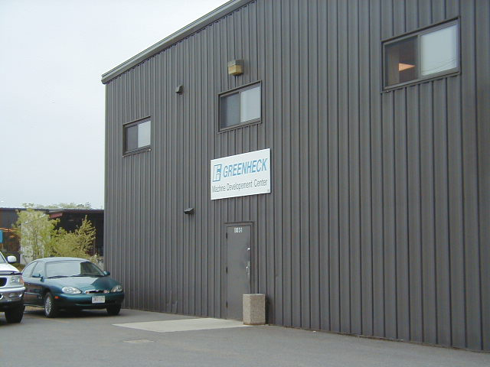
Machine Development Center

Slide 20
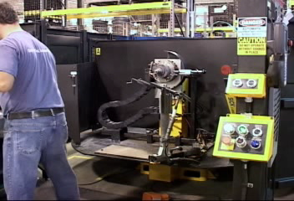
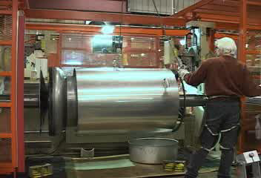
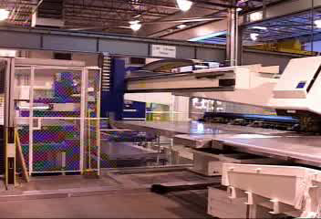
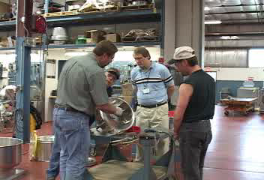
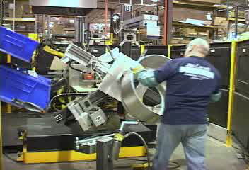
Investment in New Equipment
Delivering Value
Robotic Wheel Welding
3rd CUBE Spinning Lathe
3rd IBS Machine
TIME Training
Robotic CUBE Cap Welding

Slide 21

Worldwide Representation
US and Canada - Over 175 rep offices and other channels
Over 70+ offices internationally and expanding
  Mexico
  South America
  Caribbean
  Middle East
  Asia

Slide 22
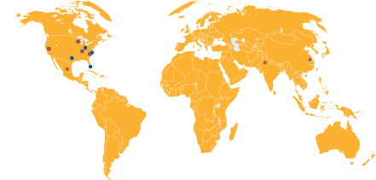
Manufacturing and Distribution
Manufacturing
  Schofield, WI
  Frankfort, KY
  Kings Mountain, NC
  Sacramento, CA
  Saltillo, Mexico
  Kunshan, China
  Delhi NCR Region, India
  St. Paul, MN (Innovent)
  Sommerville, TN
Domestic Distribution
  Schofield, WI
  Sacramento, CA
  Dallas, TX
  Miami, FL
  Greensboro, NC
International Distribution
  China
  Mexico
  India

Slide 23
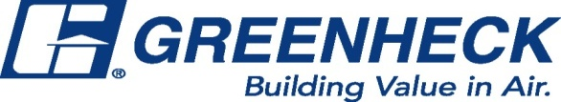

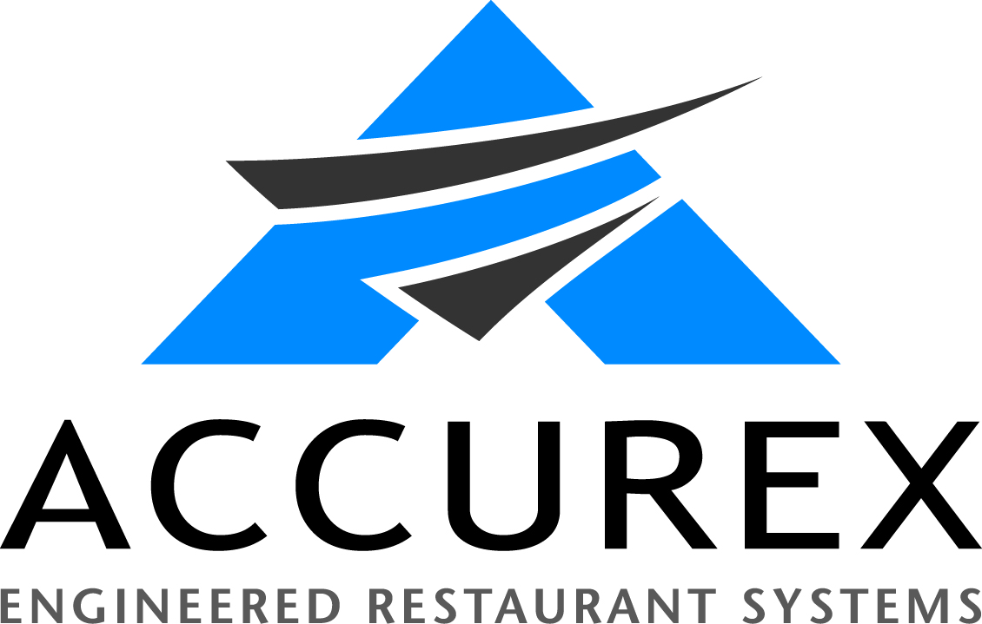




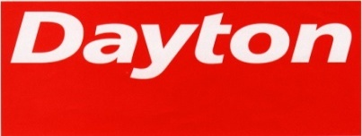
Our Brands and Private Label
Brands
Private Label
Private Label

Slide 24

The mission of Greenheck is to be the market leader in the development, manufacture and worldwide sale of quality air moving and control equipment with total commitment to customer service.

