Slide 1

eCAPS
Connecting the Dots
For the best value fan selections
Notes:
eCAPS is Greenheck’s new web-based software that specifically designed for engineers. This program allows for quick, easy selections of fan products with enough information required to fill an equipment schedule.

Slide 2
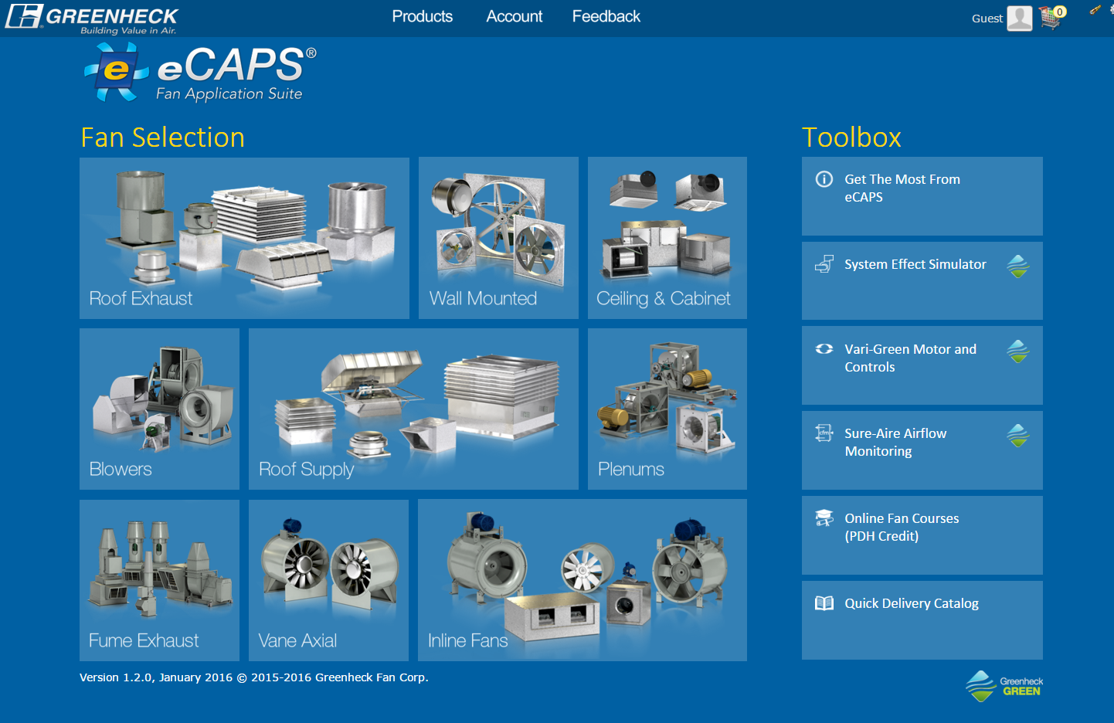
Engineer picks type of fan, not the model
Notes:
eCAPS is specifically designed for consulting engineers to provide the best value fan selection without any knowledge of product model names. In this example, a product family of inline fans is selected, and by entering a simple selection criteria of airflow and static pressure, the performance of all fans that fit the selection criteria will be displayed to the user for comparison and selection.

Slide 3
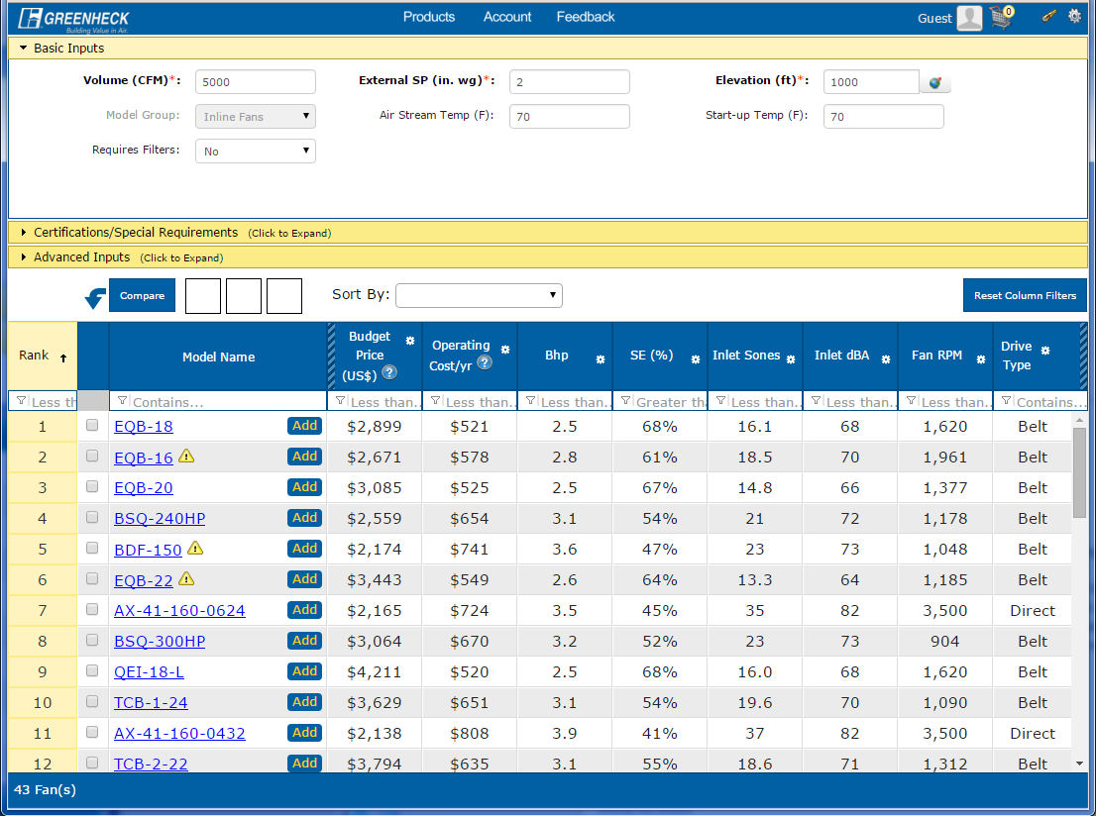
Rank formula is 50% weighted on budget price and 50% weighted on performance (efficiency & sound)
EQB offers very high efficiency at an economical first cost
Notes:
This example shows a selection at 5,000 CFM, 2” of external static pressure, and an elevation of 1,000 FT. A total of 43 fans across several models fit the selection criteria, but Greenheck has included a ranking calculation that factors in performance (best measured by brake horsepower) and sound (inlet sones) as well as a budget price. In this example, and EQB-18 was ranked as the top fan as it’s BHP was the lowest (highest efficiency impeller) as well as a lower sound value and budget price of $2900. This offers an engineer the best value selection across all inline fan models.

Slide 4
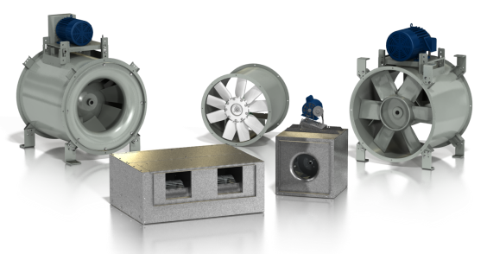
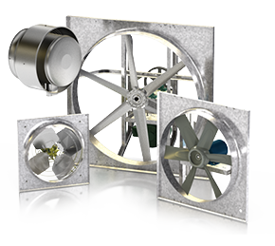

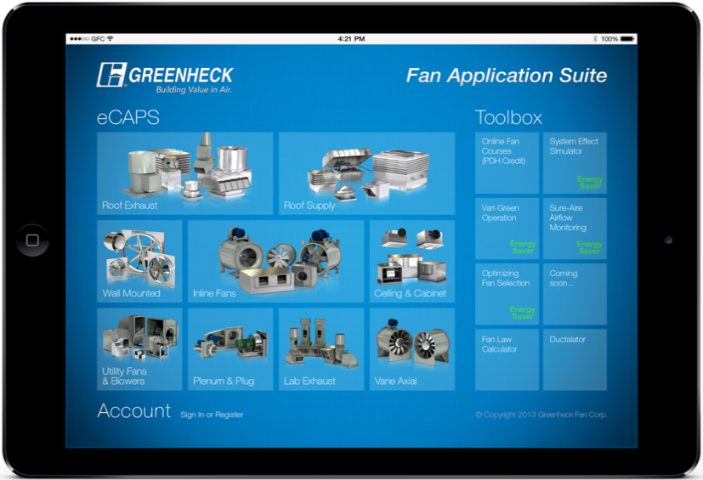

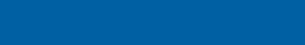
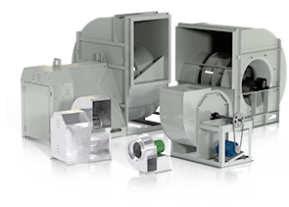
This works for Any Fan Selection!
Application
Requirements
Inline
Find the Best Value fan that meets all requirements (energy efficient and fits in the budget)
airflow
pressure
sound level
elevation
eCAPS
Wall
certifications
Fan Application Suite
Utility Fans & Blowers
clean or dirty air
fan inlet and outlet conditions
Notes:
All that is required is knowledge of the application (inline vs. wall vs. roof exhaust vs. etc), performance requirements, special certifications (grease exhaust or smoke requirements), and eCAPS will find the most efficient and budget-friendly fan for the application.

Slide 5
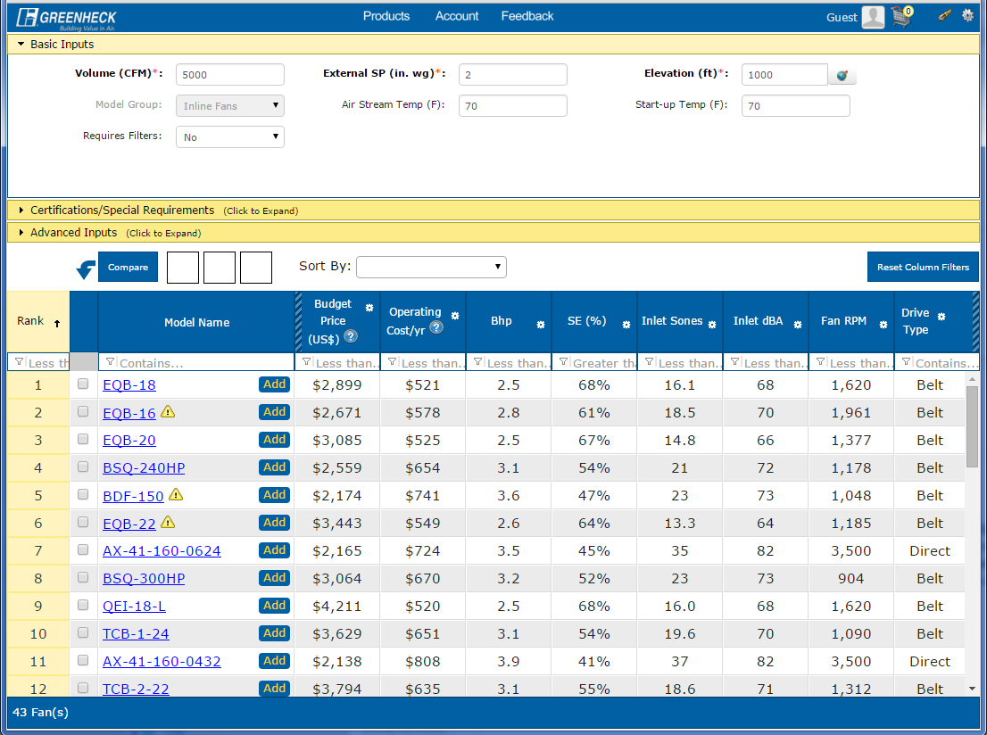
Top 10 Ranked Selections
Six different models
Price from $2,031 to $4,205
Static Efficiency from 45% to 68%
Sound from 13 sones to 37 sones
Notes:
Further example showing all the fans that fit the requirement, but a clear indication of the EQB superiority from a prospective or horsepower and sones. Although the EQB is $700 higher in budget price, the horse power is less (2.5 vs. 3.5) and the sound is less than half of the least-expensive fan option (AX) fan. Additionally, as eCAPS is always current via web-based updates, the ranking will ensure any new products will naturally appear and float to the top so engineers can be assured their receiving the most relevant, up-to-date selections.

Slide 6
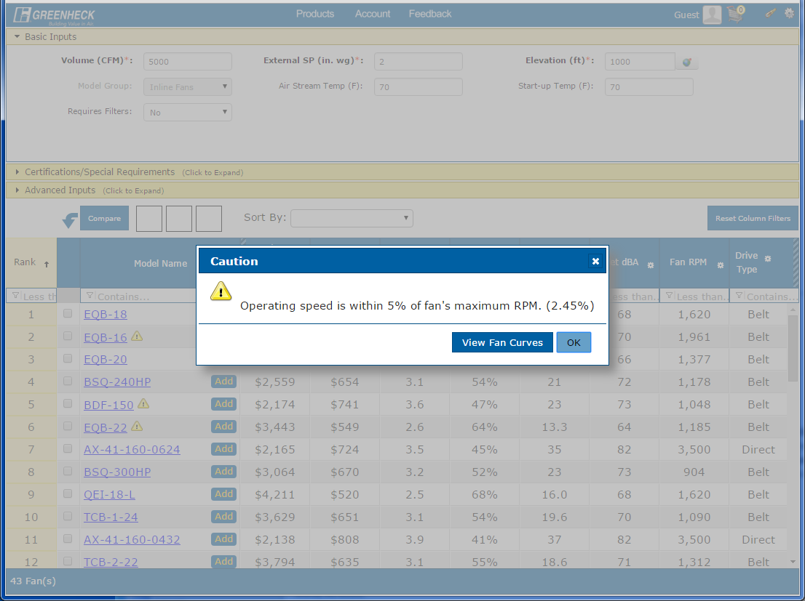
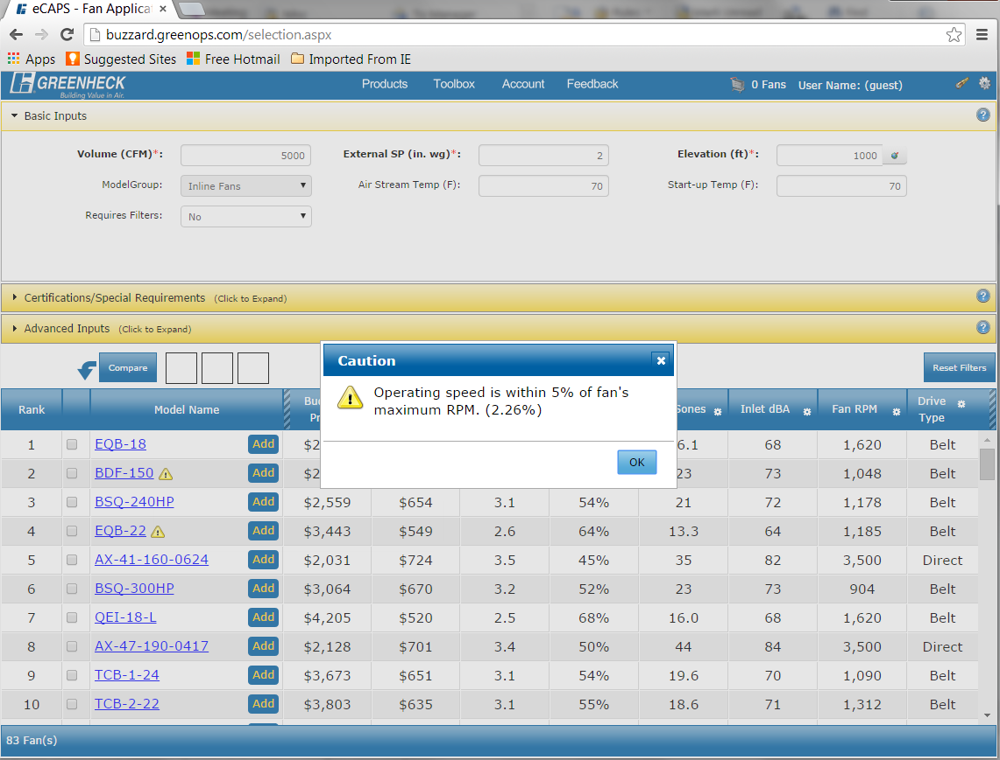
Notes:
Special safety criteria are also shown through caution signs. In this case, the RPM is within 5% of the fan’s maximum. This helps to keep engineers safe and prevents “bad selections”

Slide 7
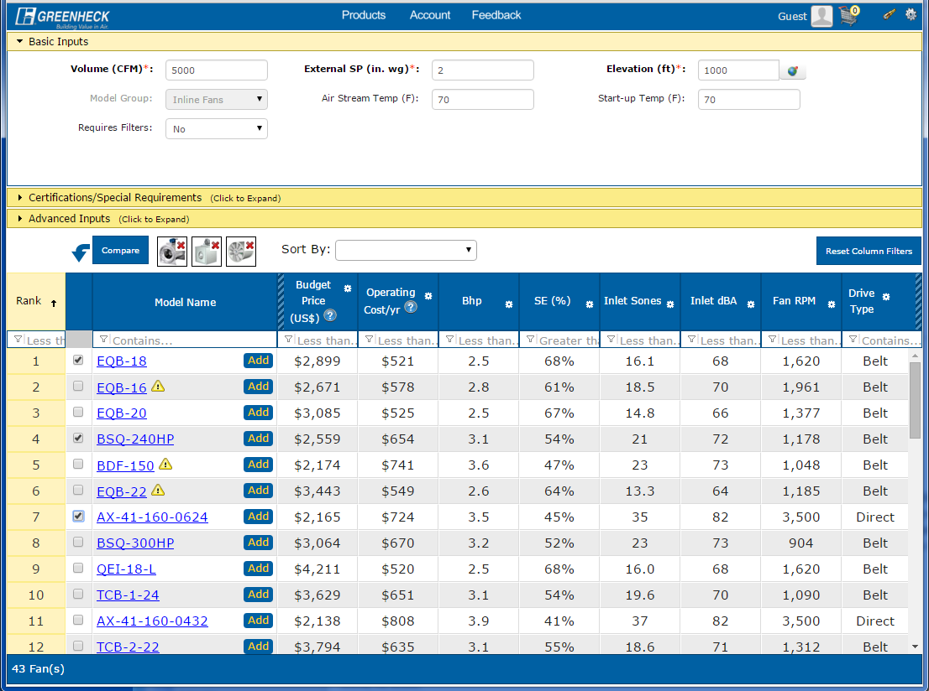
Notes:
A unique compare feature is available to provide further detail to ensure the right fan for the application. By clicking a checkbox next to the EQB, BSQ, and AX models, the compare feature will display a detailed breakdown of product characteristics.

Slide 8
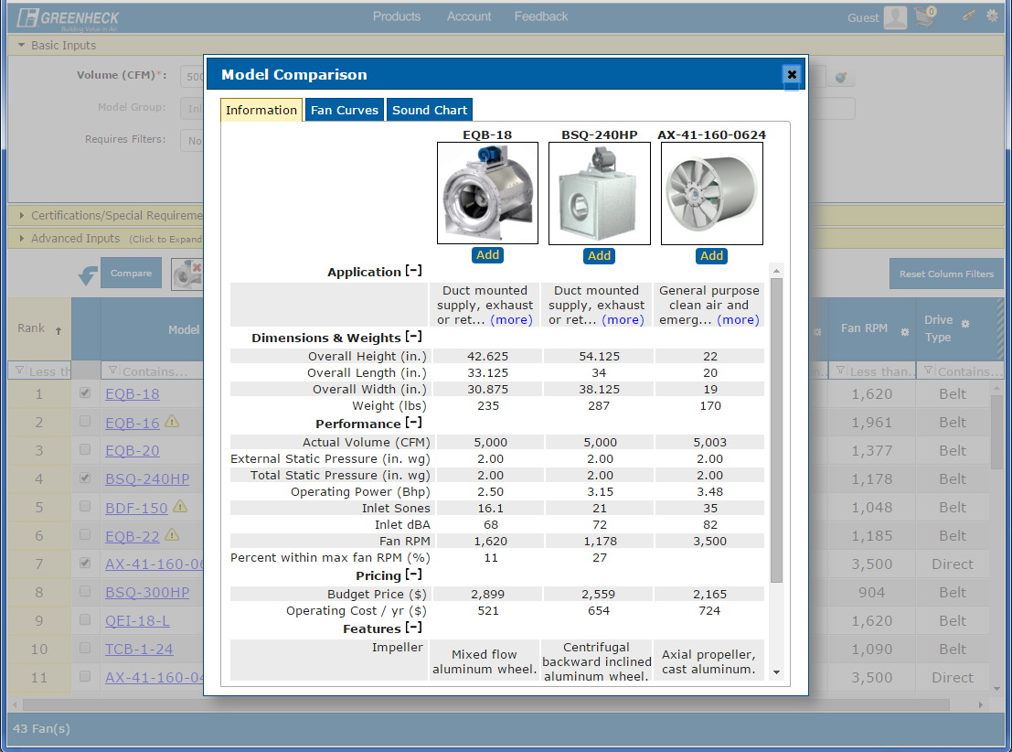
Notes:
The details include dimensions, performance, pricing, and other characteristics such as common applications and impeller types.

Slide 9
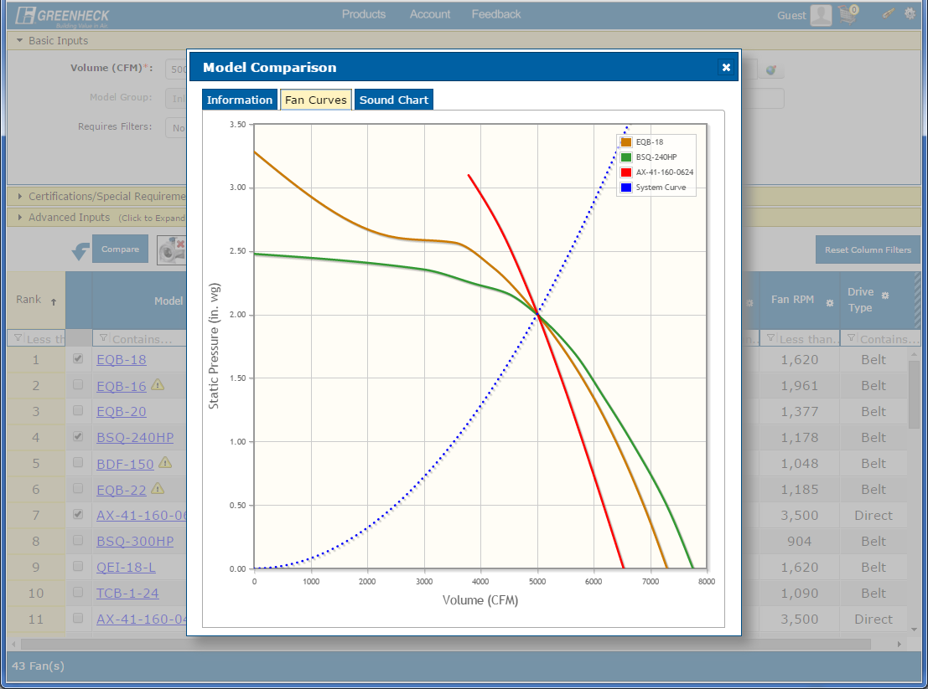
Notes:
Fan curves across multiple models insure the selection is meeting the most stable operating point.

Slide 10
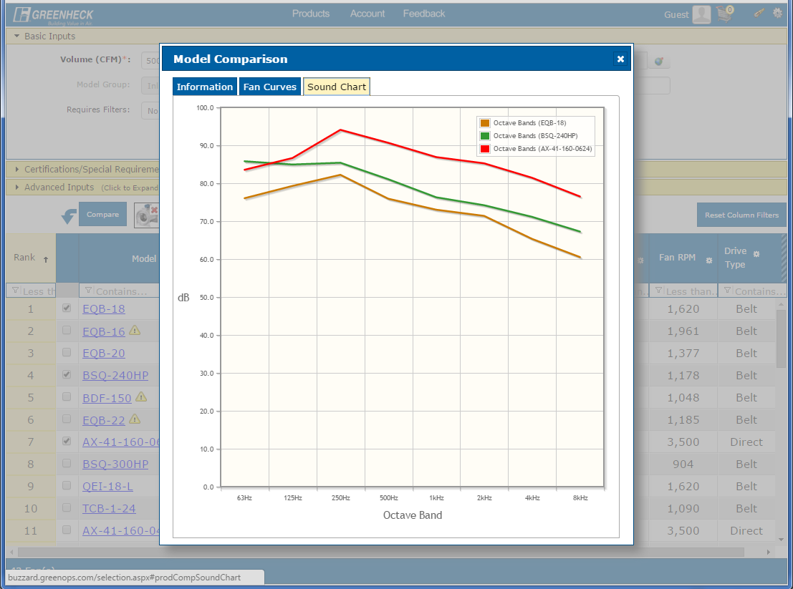
Notes:
Sound performance by octave band is available to provide guidance for sound attenuation (if required).

Slide 11
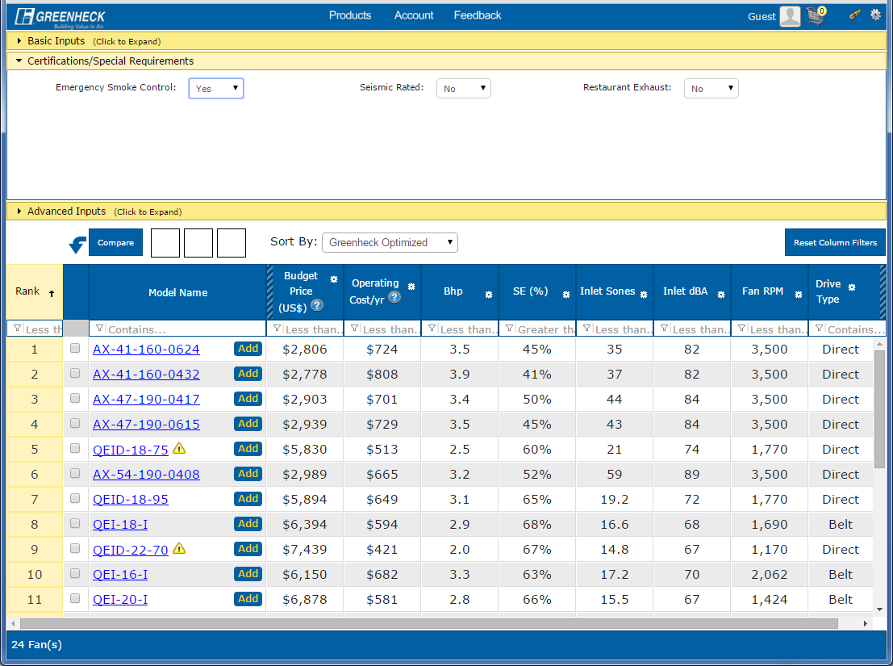
Notes:
Special certifications will filter out selections that don’t meet the required criteria, such as smoke control our grease ratings.

Slide 12
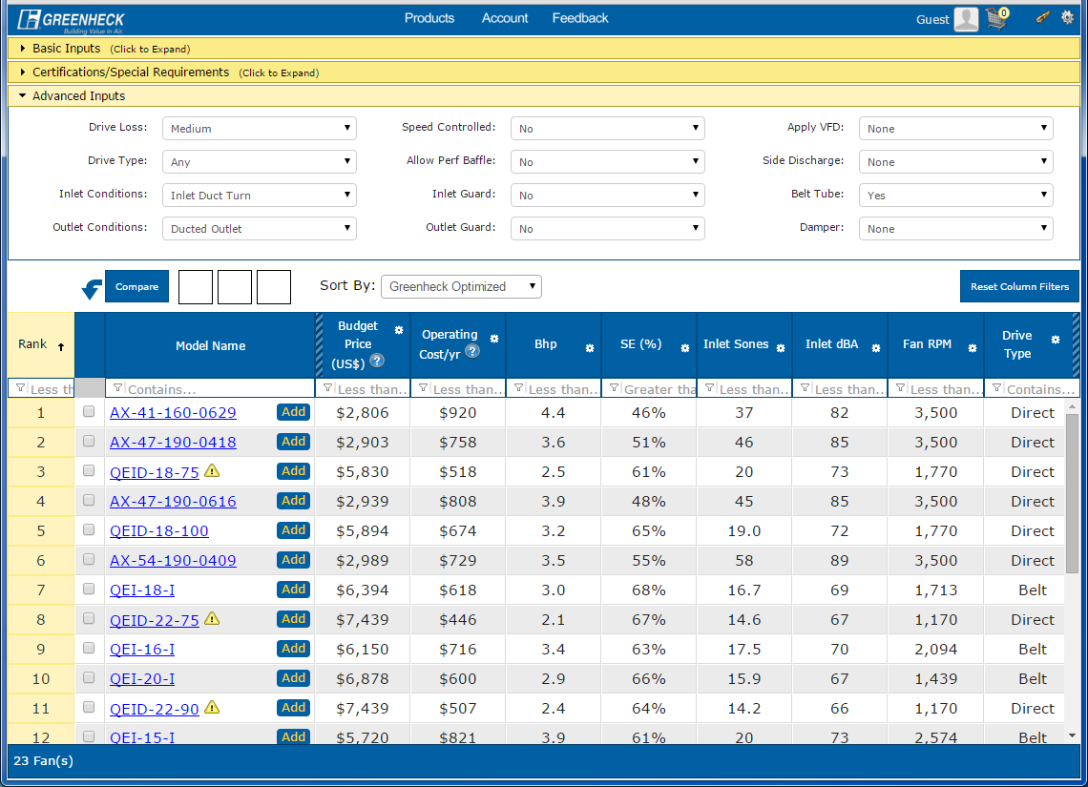
Notes:
Additional accessories such as inlet and outlet conditions can be updated in the “Advanced Inputs” option. This will allow for performance corrections for items like inlet and outlet guards and will re-rank the fans accordingly once the associated pressure drop is accounted for.

Slide 13
Notes:
Finally, several other tools are available for more information for the engineering community. As an example, a system effect calculator will allow engineers to understand the performance corrections required to overcome non-ideal inlet and outlet conditions. Simply click “System Effect Calculator”

Slide 14
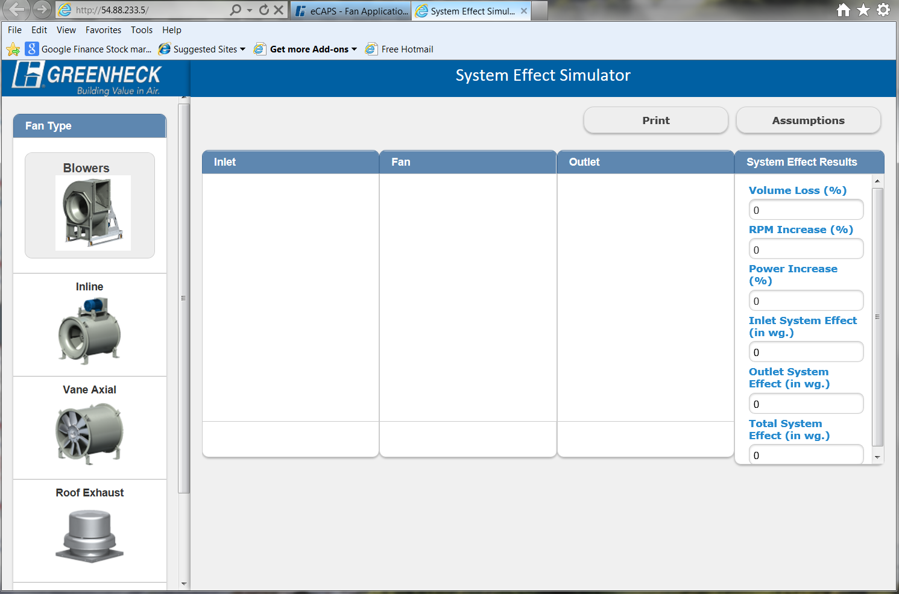
Notes:
Select the type of fan (in this example, a basic blower will be selected). This selection will show a base-line performance based on ideal testing conditions.

Slide 15
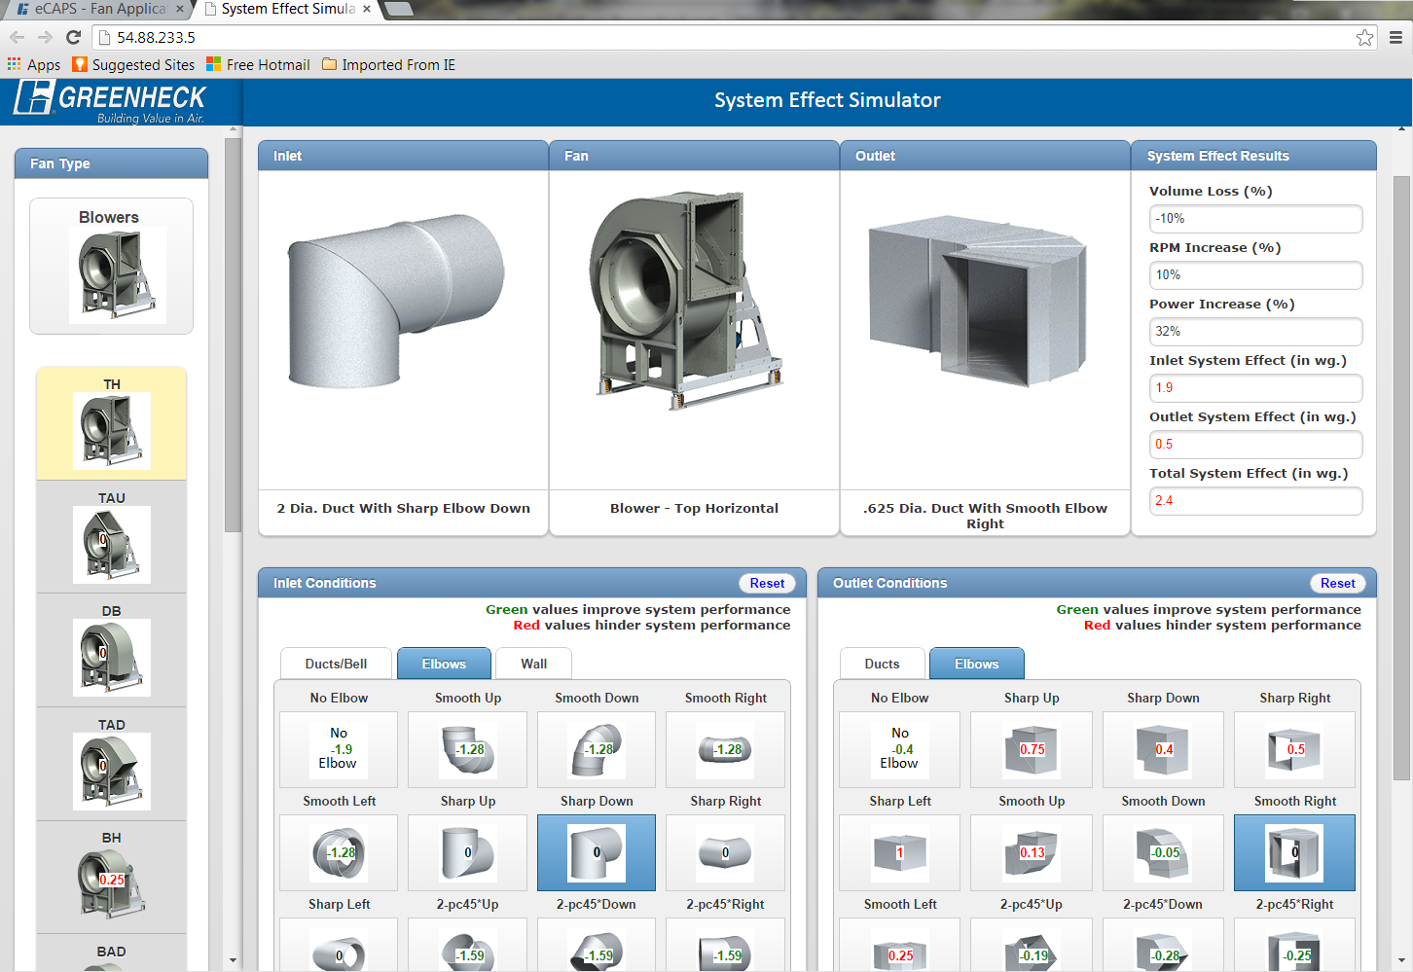
Notes:
And add inlet and outlet conditions to determine the RPM changes and associated power increase. This can be helpful for an engineer in regard to negotiating space for a building as the power increase is readily visible for the life of the fan. Additionally, if a balancing issue comes up on a project, the System Effect calculator will help a user to understand out to revise the ductwork to most efficiently meet the performance point.

Slide 16
Notes:
As of September 2016, eCAPS is available fan over 10,000 fan models and sizes. Louvers will be added to the software in Fall 2016. Remember, all eCAPS files are compatible with the full version of the CAPS software, so it’s easy to transfer information back and forth between engineers and sales reps!

Slide 17

The mission of Greenheck is to be the market leader in the development, manufacture and worldwide sale of quality air moving and control equipment with total commitment to customer service.

