Slide 1
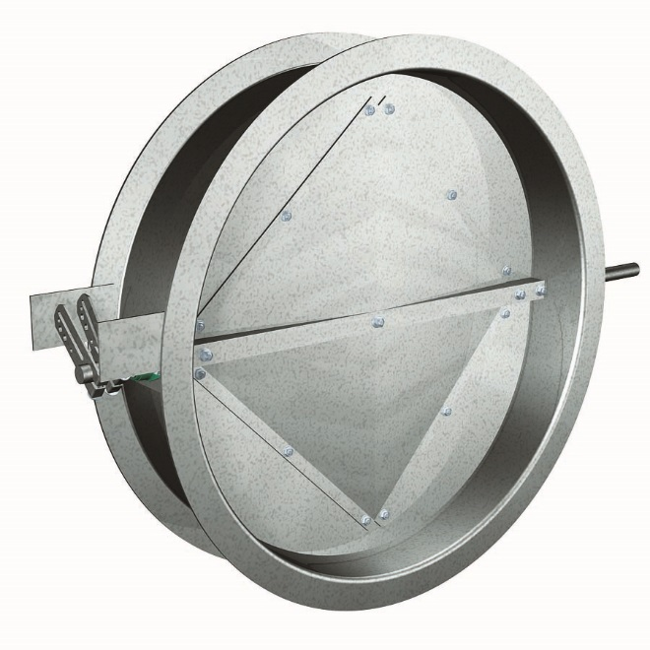
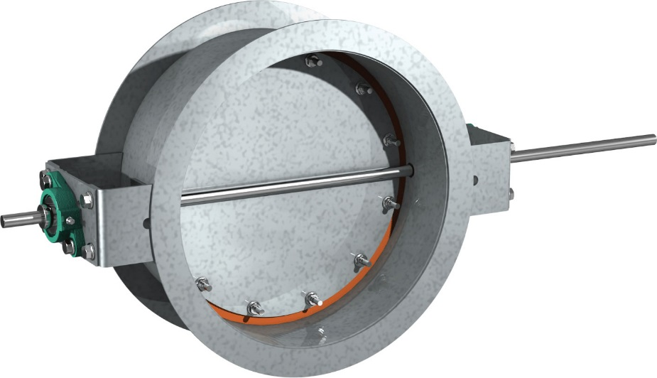
Bubble Tight and Isolation Dampers

Slide 2
Overview
What is an isolation/bubble tight damper
Where are isolation dampers used
Available Greenheck models
Greenheck factory testing procedures
Greenheck specification compliance
  (AMCA-500D, ASME-N509, ASME-N510)
CAPS Selection overview
Notes:
Read slide

Slide 3
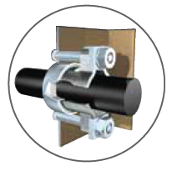
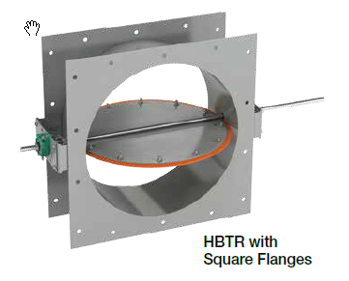
What is a Bubble Tight Damper?
A bubble tight damper is a heavy duty damper designed to meet the requirement for ZERO leakage
Construction
  Flanged frame damper
  Carbon steel or stainless steel frames, blades, and axles
  Silicone blade seal
  Double gland axle seals
  Round frame construction
  Square transitions available by SDR
Notes:
The bubble tight dampers are tested per AMCA 500-D test standard which is a visual test that looks for bubbles.

Slide 4
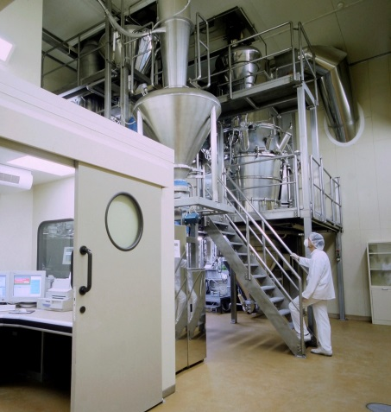
What Does It Do?
A bubble tight dampers primary function is to create a barrier to eliminate the probability of the air, and air stream particles, from escaping a zone
Provides a positive seal to seal up all ventilation paths for room decontamination, emission control system change out, shut downs, or testing
Notes:
Read slide

Slide 5
What Does It Do?
Ensures the safety of personnel working during shutdowns and change outs
Prevent contamination of research, consumer goods, etc.
Prevent exhaust of harmful contaminants to environment
NOTE: Bubble tight dampers should not be used as a means of controlling airflow
Notes:
Read slide

Slide 6

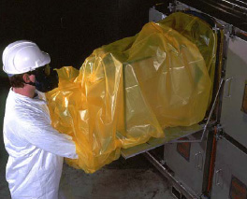
Where They Are Used
Generally used in critical and hazardous environments
  Nuclear Power Plants
  BSL3/BSL4 Laboratories
  Pharmaceutical Laboratories
  Chemical Laboratories
  Mining Industry
  Petro-Chemical Industry
  Chemical or Biological Filter Systems
  Food Processing Industry
  Defense Industry
Notes:
Here’s a list of common applications.

Slide 7

HBTR-151
Velocity
  Up to 3900 fpm
Pressure
  Up to 10 in. wg
Leakage
  Zero at 10 in. wg
Notes:
The HBTR-151 is zero leakage at 10 inches water gage.

Slide 8
HBTR-451
Velocity
  Up to 6500 fpm
Pressure
  Up to 30 in. wg
Leakage
  Zero at 30 in. wg
Notes:
The HBTR-451 is zero leakage at 30 in. water gage.

Slide 9
HBTR-551
Velocity
  Up to 6500 fpm
Pressure
  Up to 30 in. wg
Leakage
  Zero at 30 in. wg
Notes:
The HBTR-551 is zero leakage at 30 in. wg. This model was created to meet specification that call out Flanders bubble tight damper.

Slide 10
HCDR-351
Heavy Duty isolation damper designed to provide tight shutoff with very low leakage in HVAC or process control systems
Velocity
  Up to 6500 fpm
Pressure
  Up to 20 in. wg
Leakage
  .029 CFM per inch of perimeter @ 10 in. wg
Notes:
HCDR-351 is used in applications where you need tight shutoff.

Slide 11
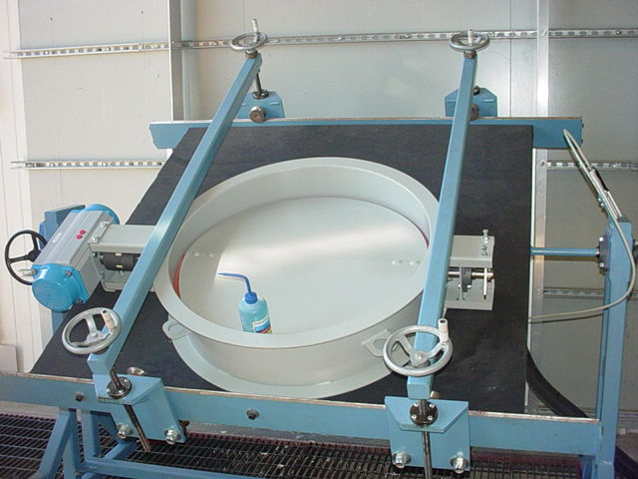
Factory Bubble Tight Testing
All bubble tight dampers are factory tested to AMCA 500-D for bubble tightness prior to shipment.
https://www.youtube.com/embed/lddL1vd5C14
Notes:
Click on you tube link to show video

Slide 12
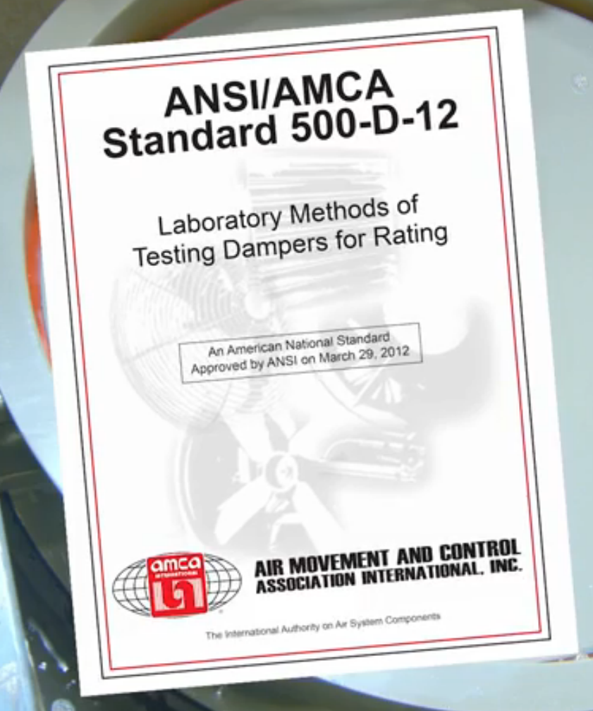
Factory Bubble Tight Testing
AMCA 500D (6.2.2.5.5)
  The size of the bubble formation shall also be recorded by noting if any bubbles exceed 1.6 mm diameter (1/16 in.) in 1 second or if any bubbles exceed 7mm (1/4 in.) diameter in 1 minute.
  Greenheck tests to zero bubbles, therefore we do comply, and surpass, the above requirements.
Notes:
Read slide

Slide 13
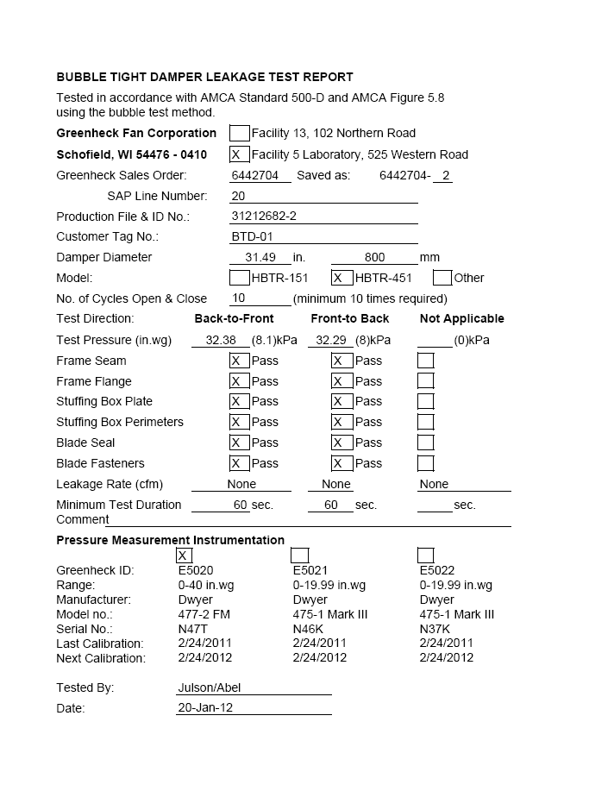
Factory Bubble Tight Testing
Sample Test Report
What We Test:
  All frame weld joints
  Axle penetration through the frame
  Blade seal at frame
  All fasteners protruding through the blade
Test in both directions
Notes:
Here’s an example of the test report that goes with every damper.

Slide 14

Specification Compliance
ASME N509 / ASME N510
  Both reference leakage criteria given by ASME AG-1
  AG-1 allows up to 1/16” dia. bubble in one second or 9/32” dia. bubble in 1 minute. If either of these is found, it is determined a leak exists.
  Greenheck tests to zero bubbles, therefore we do comply with the above requirements.
Notes:
The bubble tight dampers meet the requirements for nuclear power plants.

Slide 15
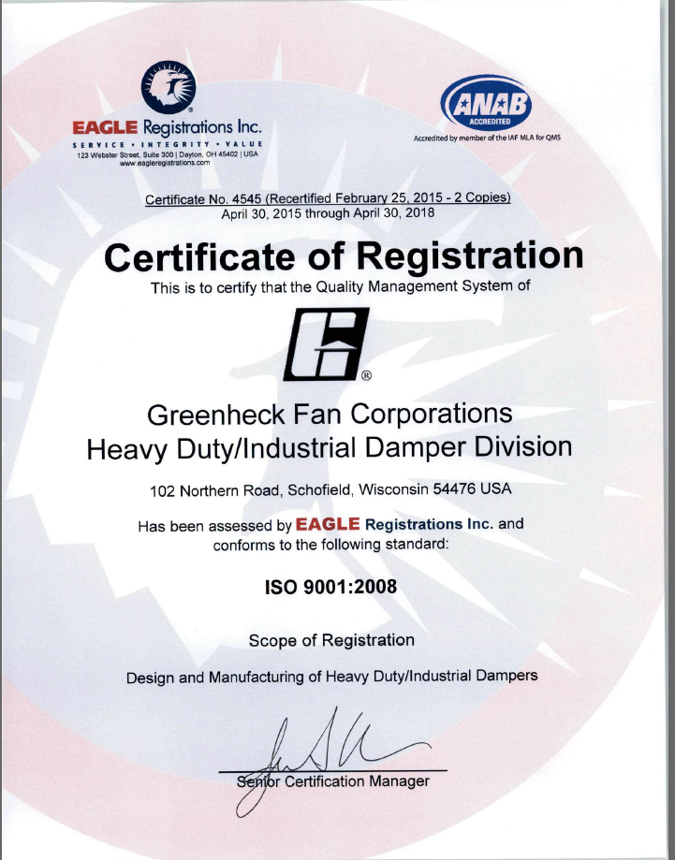
ISO 9001-2008
All Greenheck Industrial Dampers are manufactured under an ISO9001 Quality Assurance Program.
Industrial Dampers is the first business unit at Greenheck to pursue and obtain this certification
Notes:
The manufacturing facility is certified to ISO9001.

Slide 16
Specification Compliance
For an overview of the most common specifications, and an in depth look at the specifications, please visit www.Greenheck.com and visit our HBTR FAQ’s
HBTR FAQ's
Notes:
You can find information on bubble tight and isolation dampers at www.Greenheck.com .

Slide 17
The mission of Greenheck is to be the market leader in the development, manufacture and worldwide sale of quality air moving and control equipment with total commitment to customer service.

