Slide 1
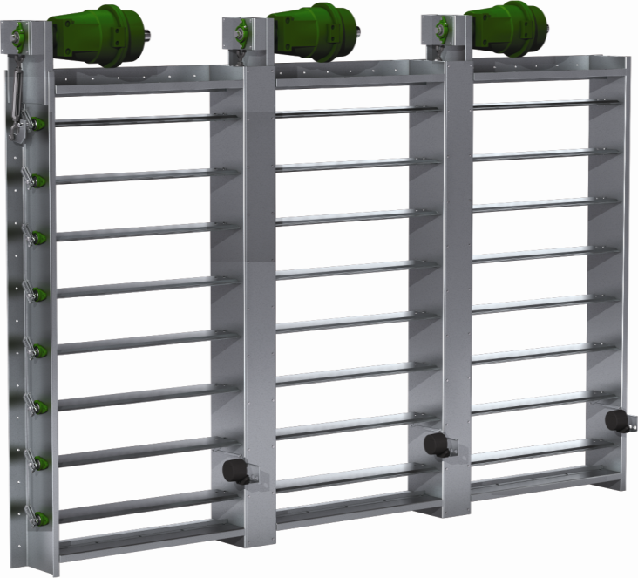
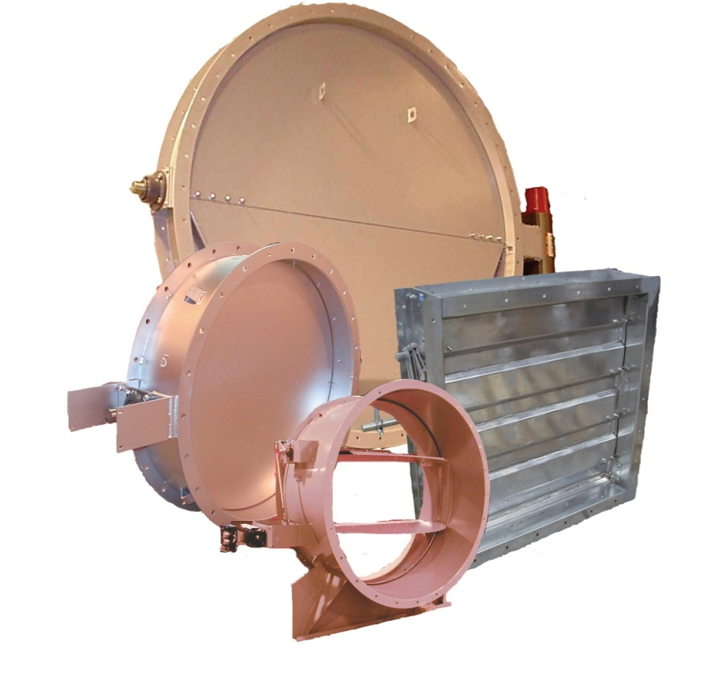
Heavy Duty/Industrial Dampers

Slide 2
Heavy Duty/Industrial Dampers
Standard Products
Options & Accessories
Custom Products & SDR's
Notes:
Greenheck offers a extensive line of heavy-duty and industrial products from standard to custom design products. We offer a wide range of bearings, axle seals, and actuators.

Slide 3
Integrity
Notes:
This slide shows the pressure capacity of heavy duty dampers versus commercial type damper. The black line is commercial damper. The green line shows our pressure on our standard heavy duty dampers and the red line shows what range we can do on custom design products.

Slide 4
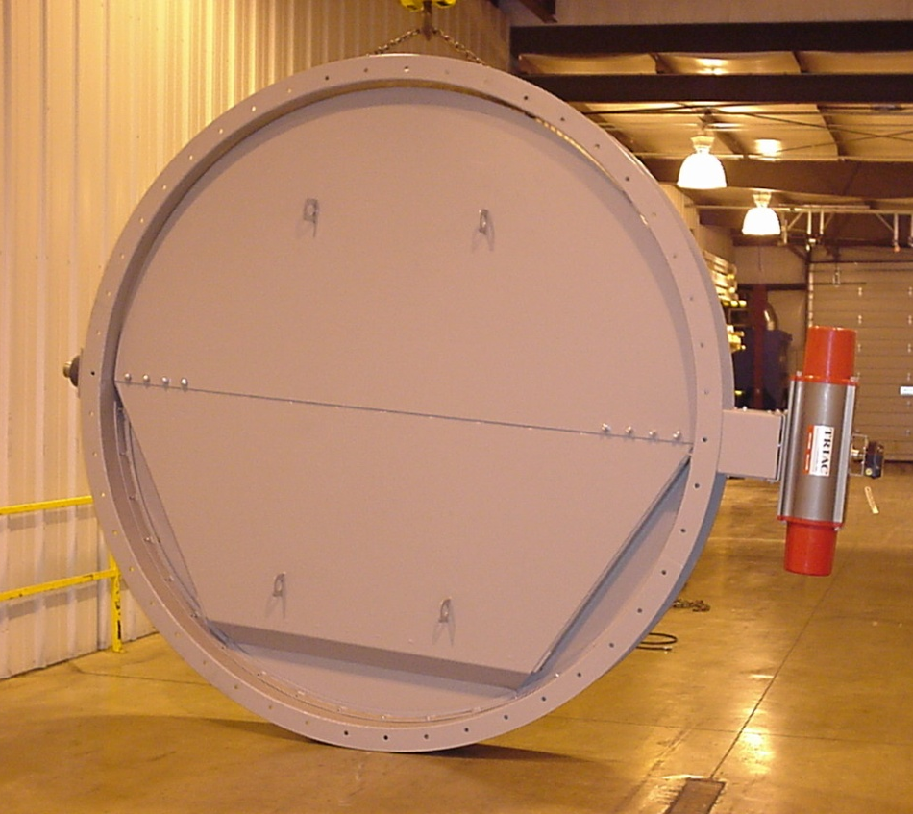
Integrity
High Temperatures - Up to 1200° F
High Velocity - Up to 6500 FPM
Size
  Standard rounds up to 72 in. DIA
  Custom rounds up to 120 in. DIA
  Standard rectangular up to 72 in. wide
  Custom rectangulars 250+ in. wide
Notes:
On heavy duty dampers, we can design up to temperatures as high as 1500 degrees and velocities up to 6500 feet per minute. We have manufactured as large as 120" diameter.

Slide 5
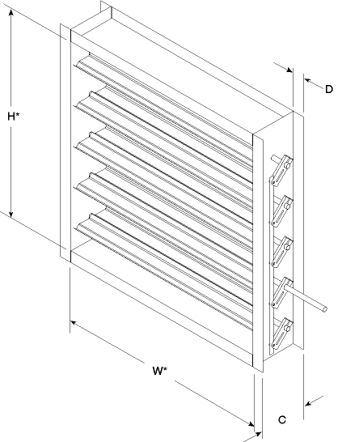
Construction
Channel Frame
Flange Mounted
HD dampers use actual inside dimensions
Up to 2 in. diameter axles
Up to ¼ in. thick frame material
Notes:
The frame is a c- channel and is available in 8 or 10 inches standard depth. This depth keeps the linkage inside the frame and outside the airstream. The flanges are available in widths from 1 ½ inches to 2 ½ inches. The wide mounting flanges can be ordered with bolt holes customized to match your requirements. Heavy duty dampers are different than most commercial dampers because they are flange mounted versus insert type. Because they are flange mounted, these dampers are sized based on actual inside dimensions.

Slide 6
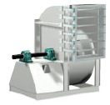
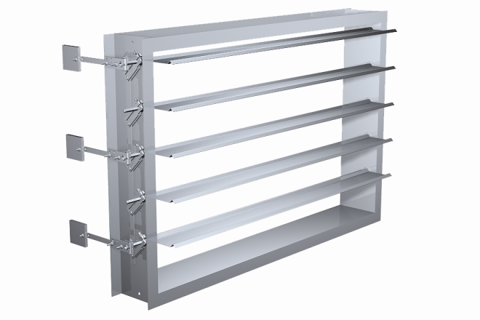
Gravity Operated Dampers
Backdraft
  Gravity operated
  Airflow in one direction only
  Six standard models
    HB series
    HBR series
  20 in wg. max pressure
  6,400 ft/min max velocity
  Blower outlet applications
Notes:
Heavy duty/Industrial backdraft dampers are designed to prevent backflow at pressures up to 20 in. wg. and velocities up to 6400 fpm. Counterbalance weights are mounted externally for easy adjustment and balancing in the field. One of the applications for a HB is mounting to the blower outlet for isolation.

Slide 7
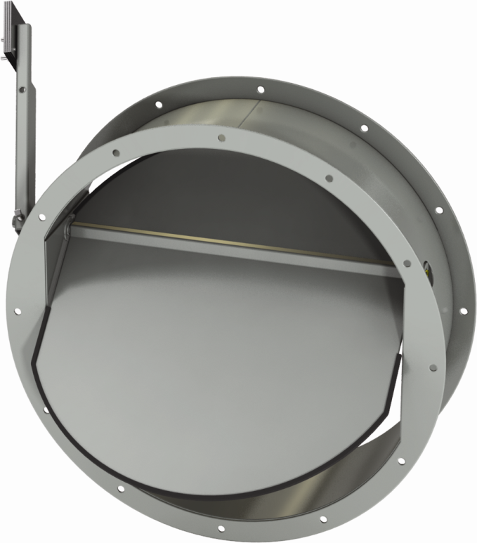
Gravity Operated Dampers
HBR-050
  Gravity operated
  Airflow in one direction only
  6 in wg. max pressure
  4000 ft/min max velocity
  Wide mounting flanges with customizable bolt holes
Notes:
The HBR-050 is a true round backdraft damper with flanged style frames. It allows air to drawn into a draft relief application or prevent backflow in an HVAC or a process application.

Slide 8
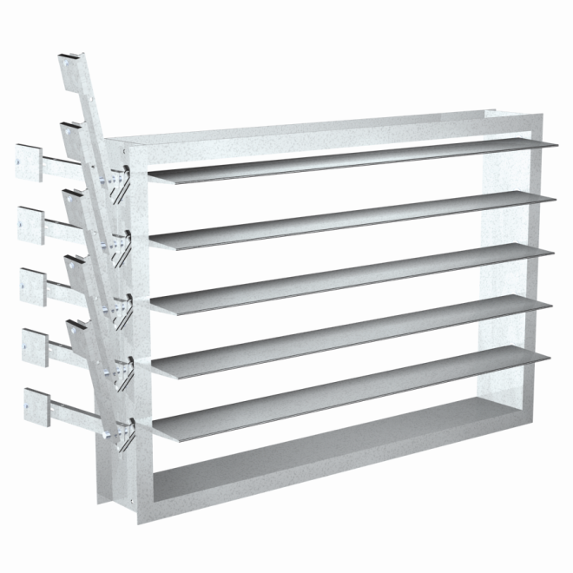
Gravity Operated Dampers
HPR
  Gravity operated
  Airflow in one direction only
  Does not open until pressure reaches start-to-open pressure
  Three standard models
    HPR series
  0.10 – 6.00 in wg. start-to-open pressure
  20 in. wg. max pressure
  6,400 ft/min max velocity
Notes:
HPR series is our pressure relief dampers that is a backdraft damper having an adjustable start-open pressure. Pressure relief dampers do not open until pressure reaches the start to open pressure. Counterbalance weights are mounted externally for easy adjustment and balancing in the field. A pressure relief damper is generally used as a safety or controlling device.

Slide 9
Gravity Operated Dampers
HB – 2 3 0
Product Family
HB = Backdraft
HPR = Pressure Relief
HBR = Round
Backdraft
Pressure Class
0 = up to 6 in. wg
1 = up to 8.5 in. wg.
2 = up to13.5 in. wg.
3 = up to 20 in. wg.
Blade Style
10 = Aluminum
20 = 2-V
30 = Steel Airfoil
40 = Aluminum Airfoil
50 = Round Butterfly
Notes:
This slide shows what the model number means.

Slide 10
Rectangular Control Dampers
HCD
  Rectangular control damper
  Actuator or manual operator required
  Ten standard models
    HCD series
  45 in wg. max pressure
  6,000 ft/min max velocity
Notes:
Heavy duty/Industrial control dampers have a heavy duty flanged frame designed to regulate airflow and provide shutoff in HVAC or industrial process control systems. These dampers are designed for applications with pressure up to 45 in. wg. and velocities up to 6000 feet per minute. With ten standard models, a wide variety of blades and other options such as actuators or manual operators are available.

Slide 11
Rectangular Control Dampers
HCD – 2 30
Product Family
HCD = Control
Pressure Class
1 = up to 8 in. wg.
2 = up to 15 in. wg.
3 = up to 25 in. wg.
4 = up to 35 in. wg.
5 = up to 45 in. wg.
Blade Style
20 = 3-V
30 = Steel Airfoil
35 = Insulated Airfoil
40 = Aluminum Airfoil
Notes:
Model naming

Slide 12
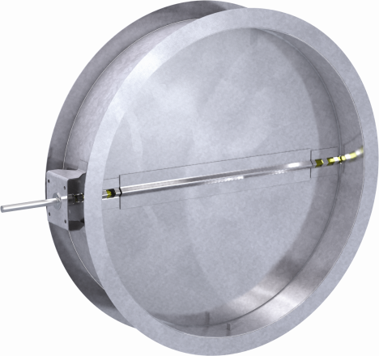
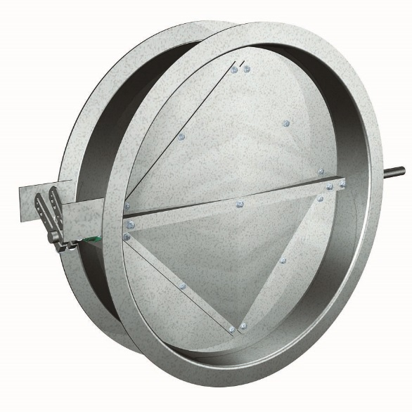
Round Control Dampers
HCDR
  Round control damper
  Actuator or manual operator required to open / close damper
  Five standard models
    HCDR series
  20 in wg. max pressure
  6,400 ft/min max velocity
Notes:
HCDR series are round control damper that is designed for pressures up to 20 in. wg. and velocities up to 6400 feet per minute. HCDR-351 is an isolation damper that provides very low leakage in HVAC or process control systems. Actuators or manual operators are available.

Slide 13
Round Control Dampers
HCDR – 3 5 0
Product Family
HCDR = Round
Pressure Class
0-1 = up to 6 in wg.
2 = up to 13.5 in. wg.
3 = up to 20 in. wg.
Blade Style
50 = Standard Round
51 = Low Leakage
Notes:
Damper models

Slide 14
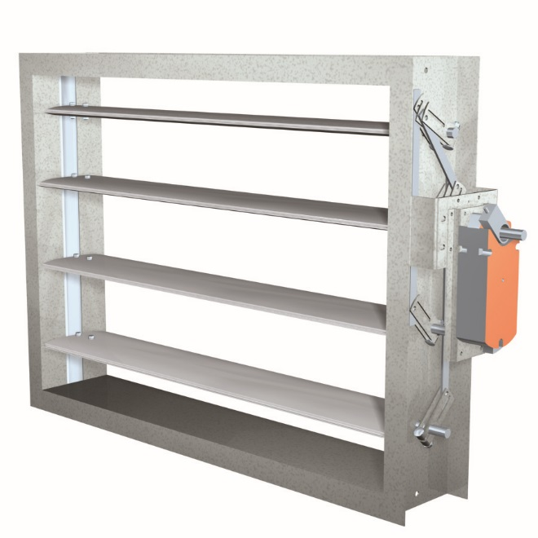
Smoke Damper
HSD-401
  UL555S Listed
  6 in wg. max pressure (UL listing)
  15 in. wg. structural pressure
  3,000 ft/min max velocity
  Largest Size in the Industry
    up to 240 x 120
Notes:
HSD-401 is a UL555S classified smoke damper. Its UL listed for pressures up to 6 in. wg. but structurally sound to 15 in. wg.. Each damper is constructed with the same flange mount frame as the HCD series, allowing for easy mounting to a fan outlet.

Slide 15
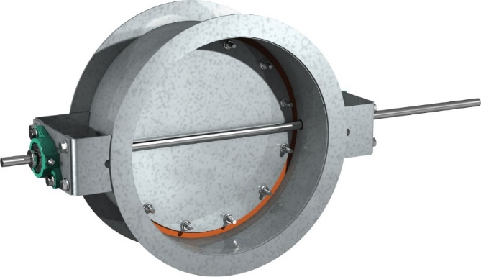
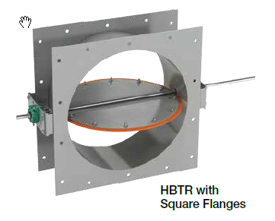
Bubble Tight Dampers
A bubble tight damper is a heavy duty damper designed to meet the requirement for ZERO leakage.
Creates a barrier to eliminate the probability of the air and air stream particles from escaping a zone.
Provides a positive seal to seal up all ventilation paths for room decontamination, emission control syste change out, shut downs, or testing
Notes:
Read the slide

Slide 16

Bubble Tight Dampers
HBTR-151
  3900 fpm
  10 in. wg
HBTR-451
  6500 fpm
  30 in. wg
HBTR-551
  6500 fpm
  30 in. wg
Notes:
Bubble tight dampers are isolation dampers designed for isolation and decontamination applications. The silicone blade seal and double gland axle seals provide bubble tight performance up to 30 in. wg. differential pressure. The HBTR-151 is design for pressure up to 10 in. wg and the HBTR-451 and HBTR-551 is design for pressure up to 30 in. wg.

Slide 17
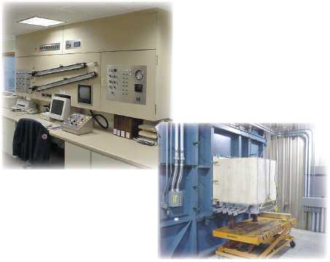
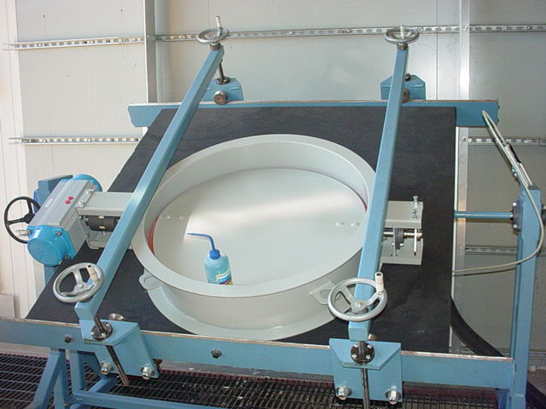
Bubble Tight Dampers
Factory Tested
  Every HBTR is leakage tested before it ships
  AMCA Standard 500-D
  Nuclear Standards
    ASME N509-2002
    ASME N510-2007
    ASME AG-1
Notes:
Every bubble tight dampers is leakage tested in accordance with AMCA 500-D figure 5.8 before it leaves the factory to ensure bubble tight performance

Slide 18
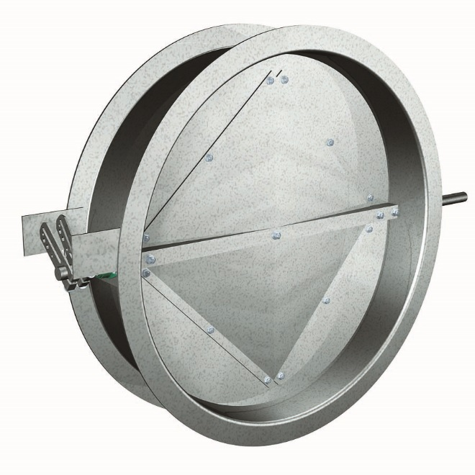
Isolation Damper
HCDR-351
  Heavy Duty isolation damper designed to provide tight shutoff with very low leakage in HVAC or process control systems
    6500 fpm
    20 in. wg pressure
    .029 CFM per inch of perimeter at 10 in. wg
Notes:
HCDR-351 is used in applications where you need tight shutoff.

Slide 19
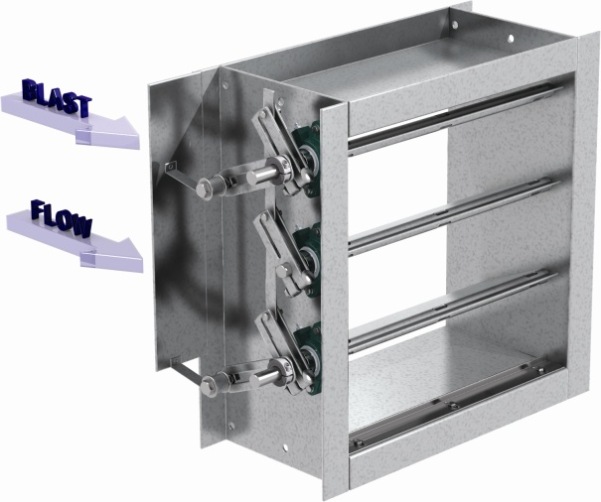
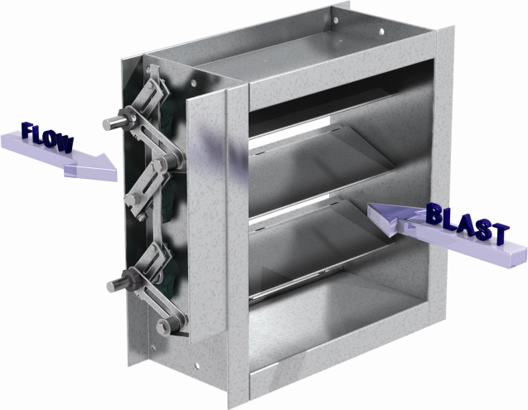
Blast Dampers
Protect against blast & rapid pressure changes
HBS-330/331
  5.77 psi blast load
HBS-430/431
  15 psi blast load
HBS-330/430
HBS-331/431
Notes:
Blast Dampers protect against blast and rapid pressure changes. HBS-330 and HBS-430 blades close in the same direction as normal flow.
HBS-331 and HBS-431 blades close opposite direction as normal flow.

Slide 20
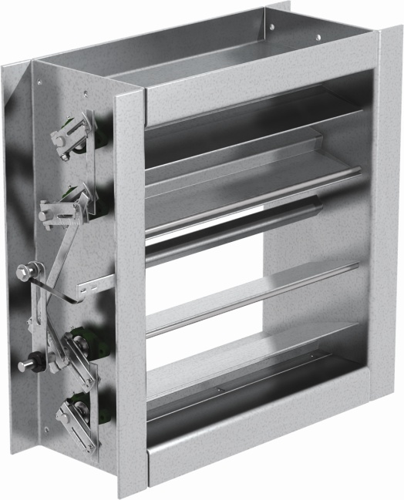
Tornado Dampers
Protect against tornadoes & rapid pressure changes
HTOD-330
  Close in the same direction as normal flow
HTOD-331
  Close opposite direction as normal flow
Notes:
Tornado dampers protect against tornadoes and rapid pressure changes.

Slide 21

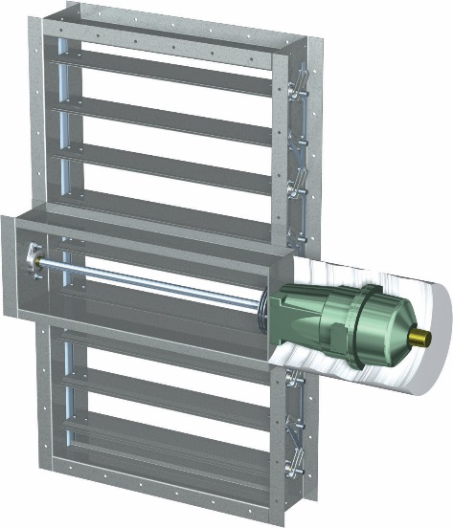
Tunnel Dampers
Meets rigorous environment of a transit tunnels
Withstand the stresses and pressures of that environment
Meets standards
  NFPA-130
  NFPA-502
  UL-555S
  BS476
Notes:
Read the slide

Slide 22
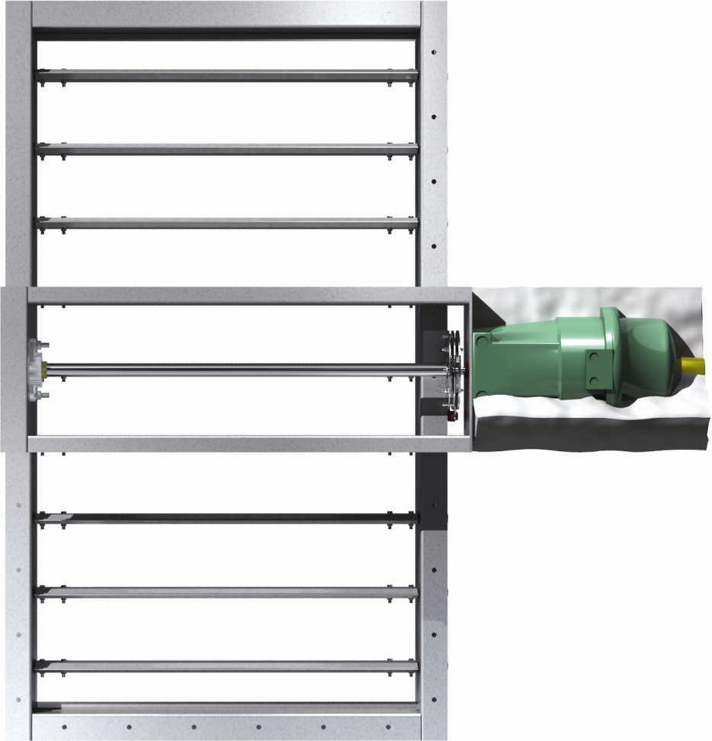
Tunnel Dampers
HTD-630
  24 in. wg
  Steel airfoil blade
HTD-636
  24 in. wg
  Fire rated steel airfoil blade
HTD-640
  24 in. wg
  Aluminum airfoil blade
Notes:
HTD-630 is rated for 482°F for 2 hours which meets NFPA 130 and 502 requirements. HTD-636 is rated for 482°F for 2 hours which meets NFPA 130 and 502 requirements. It has been tested to BS476 for two hours and is approved for fire partitions of 4 hours or less where British Standards are required. HTD-640 is rated for 482°F for 1 hour which meet NFPA 130 requiremetns.

Slide 23
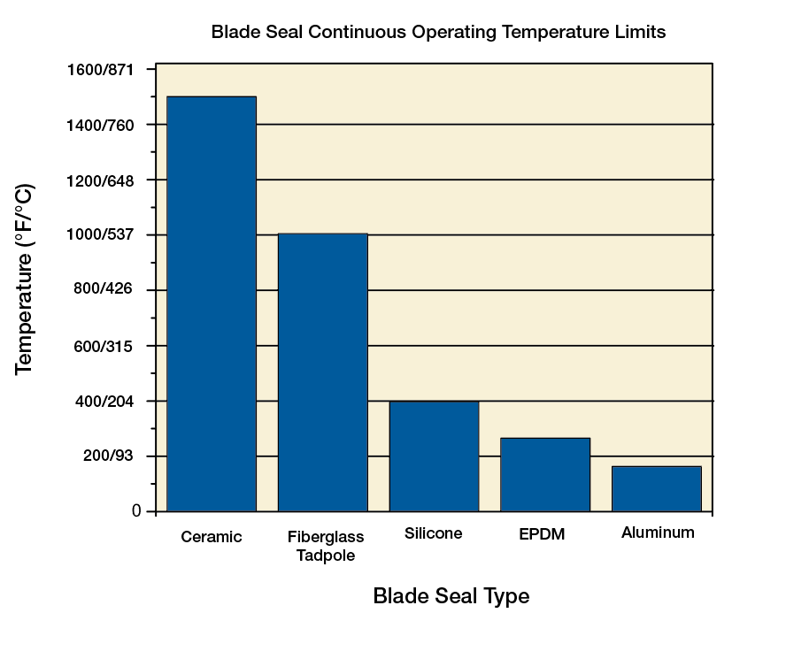
Heavy Duty Accessories
Stainless steel jamb seals
Blade Seals
  Vinyl
  EPDM
  Silicone
  Mechanically fastened silicone
  Fiberglass
Notes:
Type stainless steel jamb seals are used to prevent air from leaking between the ends of each blade and frame.
Wide variety of blade seals are available for low leakage performance.

Slide 24
Heavy Duty Accessories
Bearings
  Galvanized ball
  Acetal with stainless steel ball
  316SS ball
  Bronze sleeve
  Relubricable ball
  Carbon Graphite
Notes:
Greenheck offers a variety of bearings for operation in extreme temperatures, high pressure, high velocities and chemical or corrosive environment.
Galvanized ball bearing offer a dependable operation for this general purpose bearing at temperatures up to 500°F.
Acetal bearings offer excellent corrosion and chemical resistance for applications up to 180°F.
Bronze sleeve is general purpose bearing that has maximum operating temperature of 400°F.
Relubricable ball bearing is bolted externally to the damper frame. This bearing can be applied in applications with high pressure or velocity. Seals protect the bearing's balls from the environment, making this bearing a better choice for application in dirty environments.
Carbon graphite bearing can be used in 700°F to 1200°F operating conditions. The bearing is flange mounted externally to the damper frame.

Slide 25
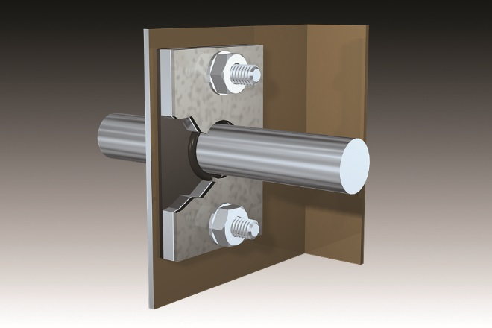
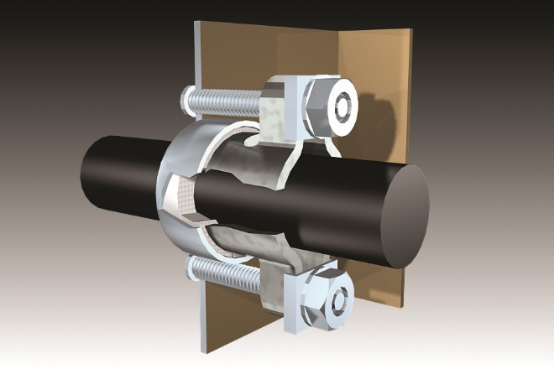
Heavy Duty Accessories
Axle seals
  O-ring
  Double gland stuffing box
Notes:
To ensure that the medium in the duct stays there, two axle seal options are available: o-ring seal and double gland stuffing box. The o-ring is ideal for clean air applications. The double gland stuffing box uses a packing gland impregnated with Teflon or carbon/graphite for superior seal. The double gland stuffing box is recommended for dirty air, high temperature or low leakage applications.

Slide 26
Heavy Duty Accessories
Actuators
  Manual quadrants
  Worm gears with manual operators
  Extensive actuators offering
    Commercial or industrial grade
    Electric or pneumatic
    Contact factory for actuator selection assistance
Notes:
Greenheck offers a wide selection of actuators for use with our dampers. Greenheck can assist with specifying the correct actuator for your project, and we will design and fabricate the custom hardware for mounting the actuator.

Slide 27
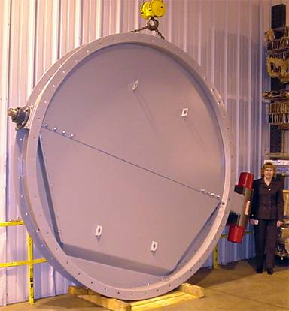
Custom Heavy Duty Products
110 in. diameter HCDR
20 in. wg. max pressure
11,000 in-lbs actuator
Industrial dust collection system
Notes:
This damper was designed for dust collection system at construction equipment manufacturer. We used 4 x 4 welded square steel tube to fabricate space frame, transferring both logitudinal and transverse loads to axle. Weld blade skins on each side to create balanced and extremely rigid structure.

Slide 28
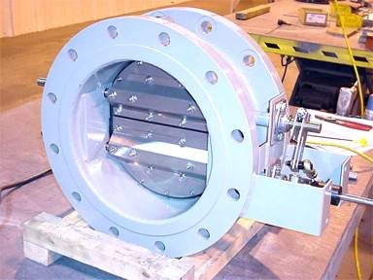
Custom Heavy Duty Products
Two blade HCDR
Opposed blade operation
ANSI B16.5 150 pound weld flange
Nuclear waste site
Notes:
This damper was designed for use in nuclear waste clean up site. Customer requested a rectangular damper with very tight leakage requirements, and transitions having 150 lb. weld flanges. This damper was built as a multiple blade HCDR-351. We eliminated transitions by building a round damper with 150 lb. flanges to minimize axial length and leakage through the frame. We used rod end linkage for opposed blade action.
Multiple blade HCDR's with opposed blade operation are ideal for modulating applications where high level of control is required.

Slide 29
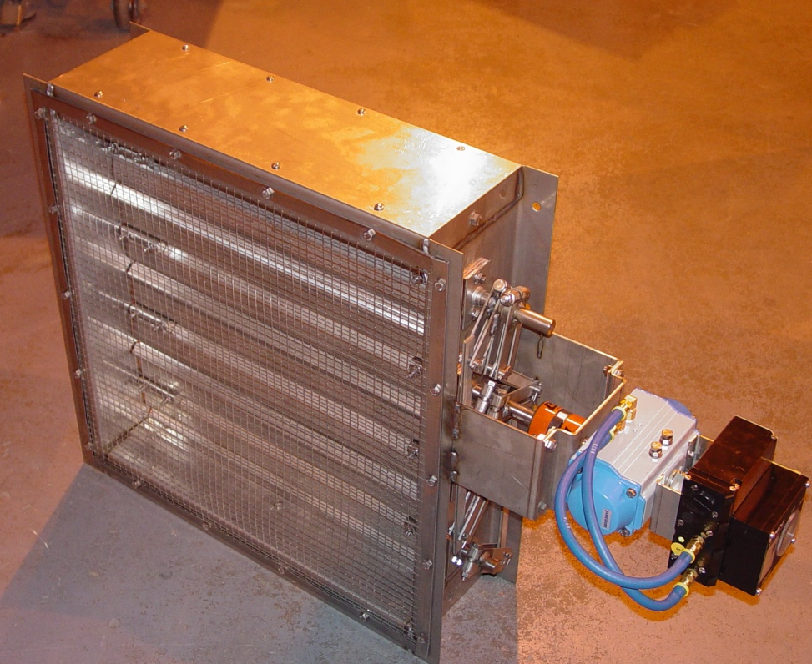
Custom Heavy Duty Products
HCD-230
316 stainless steel construction
Bird screen
Pneumatic actuator with solenoid and feedback module
Highly corrosive environment
Notes:
This damper was designed for a processing plant. 316SS was required because of the corrosive enivronment. Plate was provided on the top of the damper to prevent pooling of water.

Slide 30
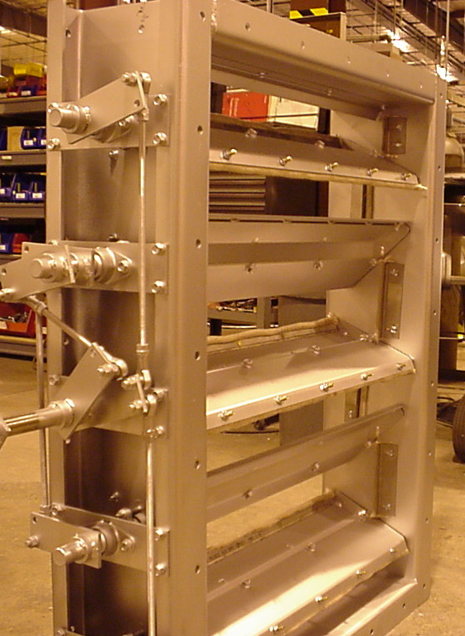
Custom Heavy Duty Products
HCD-530
Designed for continuous operation a 1000°F
High temperature coating
Fiberglass seals
High temperature blade
Notes:
This damper was design for a furnace exhaust that required continuous operation at 1000 degrees. The special blade design was designed to minimize warping through efficient heat transfer.

Slide 31
Questions
?

