Slide 1
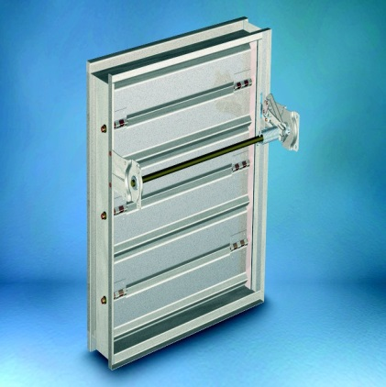
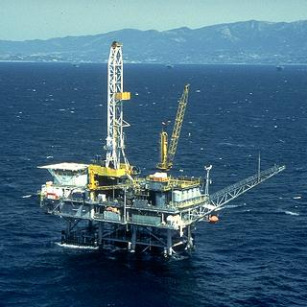
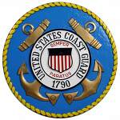


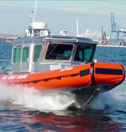
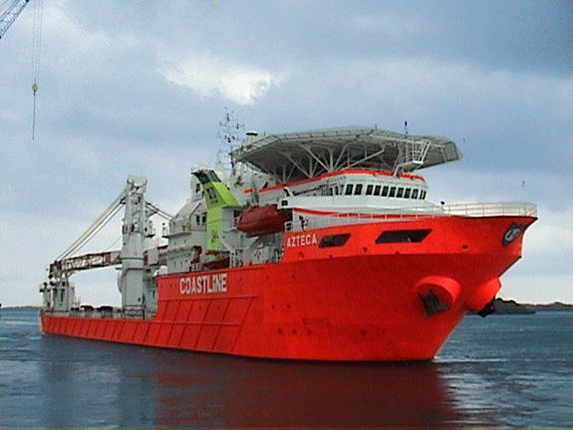
Greenheck Marine
Dampers

Slide 2
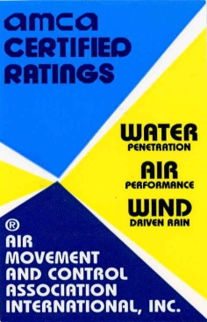

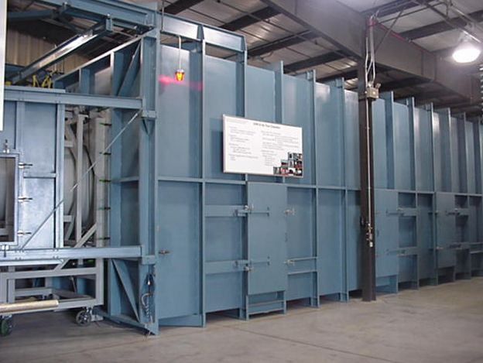
What makes Greenheck different from other Damper Manufacturers?
• Broadest line of Damper
products in the industry
• Extensive laboratory and
testing facilities
• Ongoing product improvement
and testing program
• Most UL classified dampers
• Most AMCA-licensed dampers
Notes:
Greenheck dampers bring the same quality engineering and manufacturing that has earned
Greenheck its position as an industry leader over the past 60 years.

Slide 3

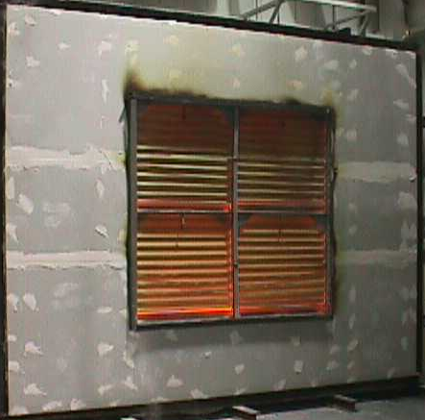

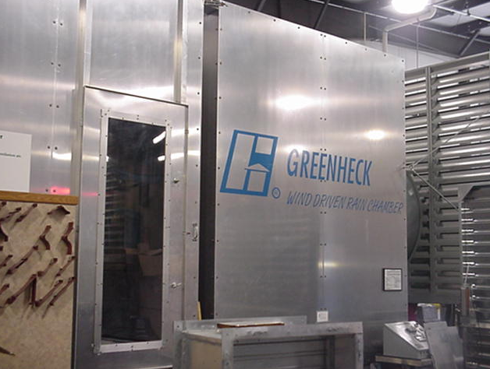
Unparalleled In-House Testing
On-Site State-of-the-Art Testing Capabilities
UL 555 & 555S:
  - Greenheck is the only Damper Manufacturer
  with Two UL-Certified Test Furnaces
AMCA 500 & 511:
  Three AMCA-Registered Air Chambers
New Products Qualified More Quickly!
Notes:
Our state of the art testing facilities allow us to be on the cutting edge of product development. These facilities greatly reduce new product to market time.

Slide 4
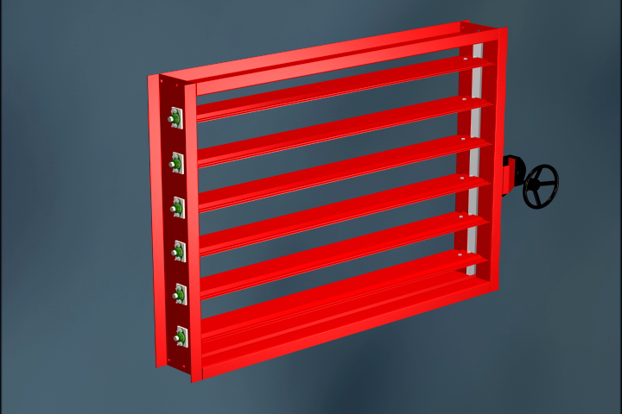
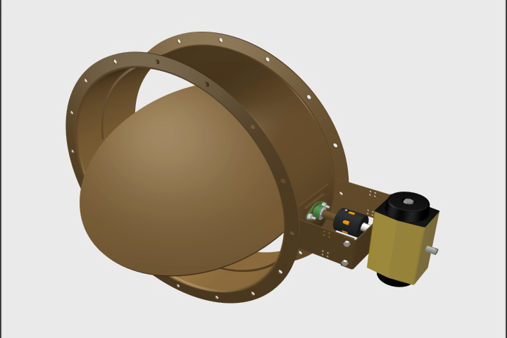

Greenheck’s Design Features

Slide 5
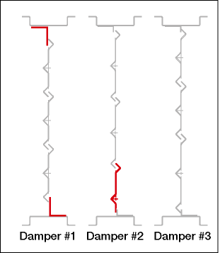
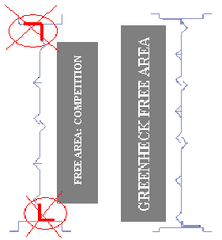
Design & Construction
Low profile frame
  Used on 432mm height or less
  Higher free area
  Less pressure loss
VSB technology
  Variable symmetrical blades
  Maximizes free area
  Minimizes pressure drop
  4 blade sizes
  Center-pivoted
Notes:
Greenheck uses a low profile frame on dampers 17 inches high or less. The advantage of this frame is higher free area and less pressure drop.
Variable blade spacing gives Greenheck an advantage over our competitors because blades are symmetrical which reduces actuator torque and increases free area. Greenheck uses 4, 5, 6, or 7 inch blades which allows us to reduce the blade stop height where our competitors would use an oversize blade stop. This allows the dampers to be mounted in either direction of airflow.

Slide 6
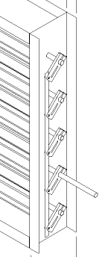
Design and Construction
Linkage Is In Jamb
  Prevents added resistance to airflow
  Provides protection for the linkage
  Provides precision blade to blade operation (no sloppy linkage)
  Reduces noise associated with airflow
Linkage Materials
  Plated Steel (Standard)
  Stainless Steel (Corrosive environments)
Notes:
Advantage of linkage in the jamb:
Prevents added resistance to airflow
Provides protection
No sloppy linkage-precise blade to blade operation
Reduces noise associated with airflow

Slide 7
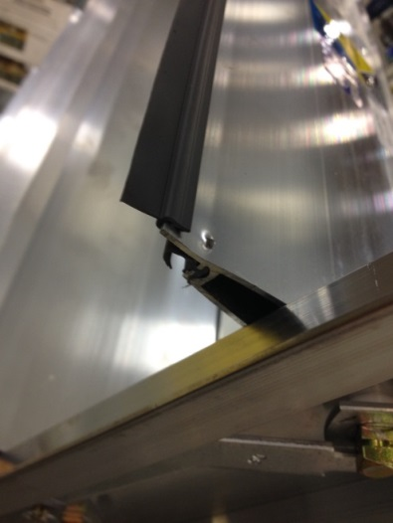
Design and Construction
Blade Seals
  TPE
  Silicone
Jamb Seals
  Stainless Steel
Notes:
Blade and jamb seals are used for low leakage application.

Slide 8
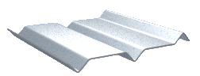
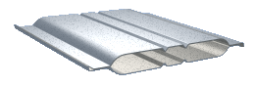
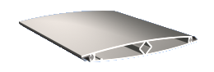
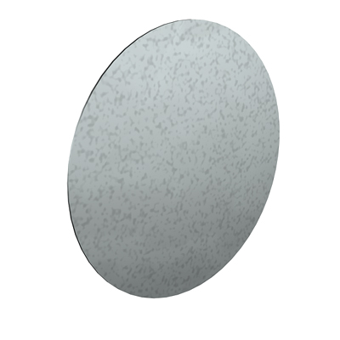
Blade Styles
3-V blade
Fabricated airfoil
Extruded airfoil
Round
Notes:
3V blades are good for velocities up to 3,000 fpm and 5 inches water gauge. 3V models are VCD-20 and VCD-23.
Steel airfoil blades are good for velocities up to 4,000 fpm and 10 inches water gauge. Models are VCD-33, VCD-34 and VCD-42.
Aluminum airfoil blades are good for velocities up to 6,000 fpm and 10 inches water gauge. Model is VCD-43.
VCD-40 is good up to 6,000 fpm and 6 inches of water gauge.

Slide 9
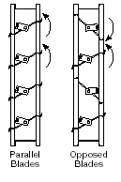
Design and Construction
Blade operation
  Parallel
    Damper makes up significant portion of the total system pressure loss.
    Greater control is required
    Systems requiring two position operation
  Opposed
    Damper doesn’t make up significant portion of the total system pressure loss
    Necessary to maintain even air distribution of air downstream
    Best selection for ducted outlets
Notes:
Read Slide

Slide 10
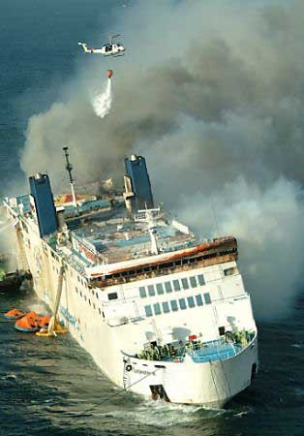
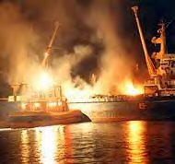
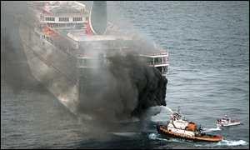
Greenheck Marine Dampers
Are your Dampers USCG & ABS Approved?

Slide 11
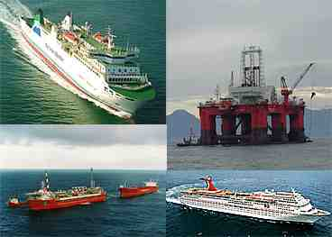
Marine Dampers
Typical Uses
Ships
Ferries
Tug Boats
Offshore Oil Rigs
Cruise Ships
Other Marine Applications
Construction
Galvanized or Stainless Steel
50% lighter than competition
Notes:
Marine dampers are typically used on ships, ferries, tug boats, off shore rigs,
cruise ships, and other marine applications. Greenheck is the first US manufacturer
with US Coast Guard Class A-60 division approval. The marine dampers were tested
at Underwriters Laboratories (UL) in accordance with International Maritime Organizations
(IMO) Fire Test Procedure code. They are also American Bureau of Shipping (ABS) approved.
Weight is always a concern on a ships and boats. Most of our competitors used a heavy duty
type damper, out of 10 ga or 12 ga. material. The biggest advantage Greenheck has we modified
our existing combination fire smoke and fire dampers to meet the requirements for marine applications.
Compared to our competitors, Greenheck marine dampers are 50% lighter.
These models are IMO and SSIMO series.

Slide 12

IMO-310 / SSIMO-310 Marine Dampers
Galvanized or Stainless Steel Construction
Flange Mounted
Manual Quadrant
USCG for A-60 Divisions
UL555 Approved
ABS Approved (PDA)
AMCA Certified
2000 fpm (10.2 m/s)
4 in. wg (1 kPa)
Notes:
IMO-310/SSIMO-310 dampers are used in applications where only a fire rating is required. They are designed to be flange mounted.

Slide 13
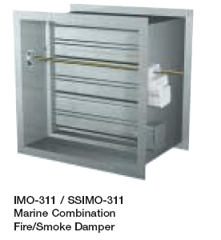
IMO-311 / SSIMO-311 Marine Dampers
Galvanized or Stainless Steel Construction
Fire & Smoke Rated
Flange Mounted
Actuated
USCG for A-60 Divisions
UL555 Approved
ABS Approved (PDA)
Leakage Class 1
AMCA Certified
3000fpm
4 in. wg (1kPa)
Notes:
IMO-311 and SSIMO-311 dampers are rated for fire and smoke applications.
These models are also flange mounted.

Slide 14
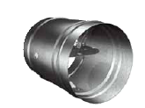
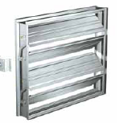
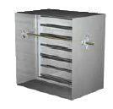
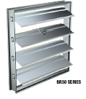
Severe Environment Dampers

Slide 15
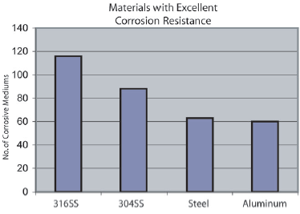
Severe Environment Dampers
Why 316 stainless steel?
When tested against 140 corrosive mediums, 316 stainless steel received an excellent rating for 115 of those mediums
Notes:
Greenheck was the 1st manufacturer to have a complete line of dampers made from
316 stainless steel material as a standard product offering. 316 Stainless steel
receives an excellent rating on 115 of the 140 corrosive mediums.

Slide 16

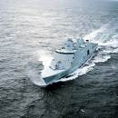

Severe Environment Dampers
Made of entirely 316 SS
Application
  Corrosive Environments
    Paper mills
    Wastewater treatment plants
    Swimming Pools
    Food processing plants
    Labs
    Coastal
    Maritime Applications
    Computer Clean Room
Notes:
This line of products offer excellent corrosion resistance in the applications listed on this slide.

Slide 17
Severe Environment Dampers
Models Available in Entirely 316SS Construction
  Fire Dampers
  Smoke Dampers
  Fire/Smoke Dampers
  Commercial Control
  Marine Dampers
  Pressure Relief
  Heavy Duty/Industrial
  Special Designs Available!
Notes:
We have a wide range of products available from control to life safety dampers.

Slide 18

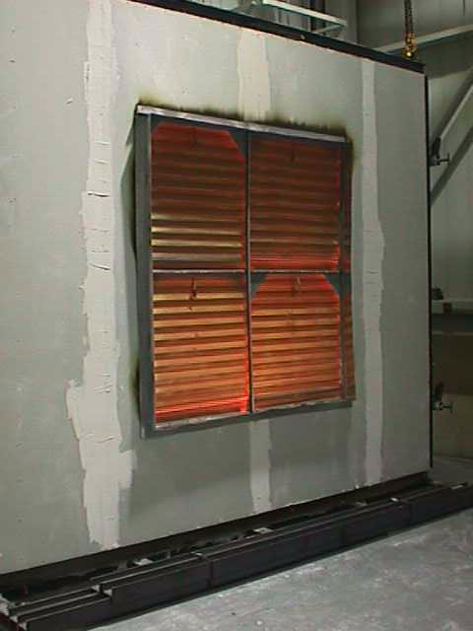
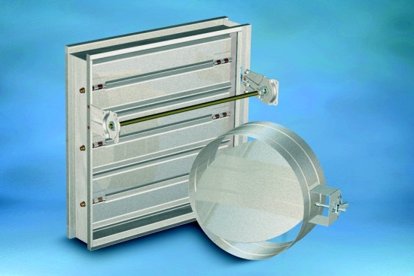
Other Damper Models Available
Fire Dampers - UL555 Approved
Smoke Dampers - UL555S Approved
Fire/Smoke Dampers - UL555 & UL555S
Access Doors
Commercial Control Dampers
Backdraft Dampers
Pressure Relief Dampers
Marine Dampers - USCG & ABS Approved
Severe Environment Dampers
Notes:
Here's a list of products available for your marine application.
The models that are distinguished as 316SS start with SE (example SEFSD-211).

Slide 19
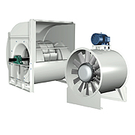
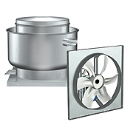
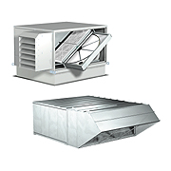
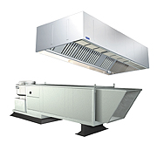
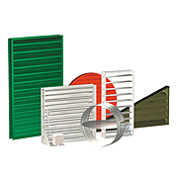
Number one in air movement and control.
Centrifugal and Vane Axial Fans
Fans and Ventilators
Energy Recovery Ventilators & Make-Up Air Units
Kitchen Ventilation Systems
Dampers and Louvers
Visit our web site @ greenheck.com

