Slide 1
Spun Aluminum Axial
Roof Exhaust & Supply Fans
April 2019
Notes:
This presentation contains an overview of Greenheck’s spun aluminum axial roof exhaust and supply fans, models AE and AS.

Slide 2
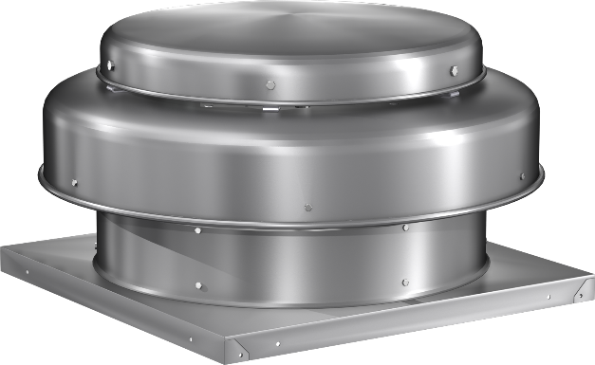
Spun Aluminum Models AE & AS
Spun aluminum construction
Up to 6,000 cfm
Direct drive
Seven fan sizes available from 10 – 24 in.
Applications
  Roof exhaust & supply
  General clean air
  Economic low volume/low pressure applications
Notes:
AE stands for Axial Exhaust while AS stands for Axial Supply. Both of these fans are constructed with a spun aluminum housing and an axial impeller. They are direct drive fans only with performance capabilities up to 6,000 CFM and 1.0 inch of static pressure. Available in 7 fans sizes from 10 inches to 24 inches, these fans are ideal for economically exhausting or supplying general, clean air.

Slide 3
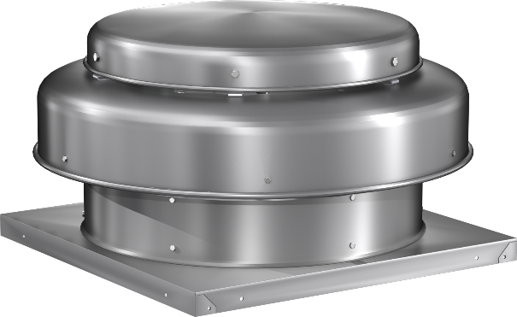
Axial Downblast Exhaust/Supply
Model AE
Model AS
Performance
  Sizes 10” through 24”
  Up to 6,000 cfm
  Up to 1.0 in. wg.
For exhaust applications
Performance
  Sizes 10” through 24”
  Up to 5,700 cfm
  Up to 1.0 in. wg.
For supply applications
Notes:
Model AE (Axial Exhaust) is used for exhaust applications. Available in sizes 10 inches to 24 inches, this model can be used to exhaust up to 6,000 CFM and 1.0 inch of static pressure.
Model AS (Axial Supply) is used for supply applications. Also available in sizes 10 inches to 24 inches, this model can be used to supply up to 5,700 CFM and 1.0 inch of static pressure.

Slide 4
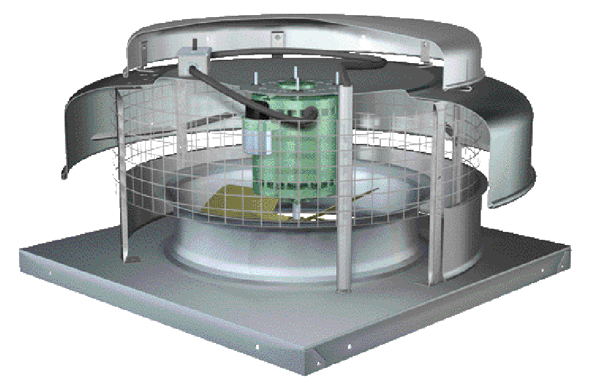
AE & AS Features
Stainless steel hood fasteners
for rust free access to motor compartment
Disconnect switch
for quick and easy servicing
1/2” X 1/2” rigid birdscreen
for protection of fan components
True vibration isolation
for years of quiet operation
Heavy-gauge aluminum housing
for added strength and rigidity
Shroud brace
For added strength
Aluminum name plate
for easy identification
Fabricated aluminum propeller
balanced for long life and quiet operation
Internal conduit chase
for wiring to motor compartment
Notes:
Models AE and AS are constructed with many different features designed for improved quality and performance. The NEMA 1 disconnect switch is standard on every AE and AS fan, mounted under the hood. It allows for the fan to quickly be shut down for servicing. Additional NEMA rated disconnects are available for selection to meet the needs of your specific application. The aluminum name plate is permanently affixed to the housing for easy identification that will not fade over the years. The impeller is a fabricated aluminum axial propeller that is statically and dynamically balanced for a long life of quiet operation. The heavy-gauge aluminum housing is resistant to impact and flexing and is held in place with stamped bracing for added strength and rigidity. The hood is attached using stainless steel fasteners, preventing rust buildup from allowing access to the motor compartment. Also included is an internal conduit chase for wiring power to the motor and ½ inch rigid birdscreen, protecting the fan components from foreign objects such as birds, squirrels, and or debris. Finally, every AE and AS have true vibration isolation, meaning there is no metal-to-metal contact through the isolators. This prevents any noise or vibration from the motor compartment to transmit through the duct into the space serviced by the fan. The easiest way to determine if there is metal-to-metal contact through an isolator is by checking for an additional ground wire. If there is metal-to-metal contact through the isolator, there is no need for an additional ground wire as the system is grounded through the isolators.

Slide 5
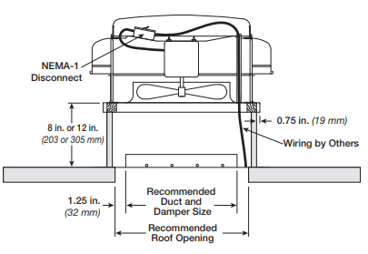
Typical Installation
Notes:
For either supply or exhaust applications, these fans are typically mounted to a roof curb. Roof curbs are selectable in many heights, but most commonly you will see them as 8, 10, or 12 inches tall. Inside the roof curb a backdraft damper, gravity or motorized, may be installed. Backdraft dampers help prevent outside air and weather (rain, snow, etc.) from accessing the building when the fan is not running. Power wiring for the fan can be ran up the duct, through the conduit chase provided, and into the hood where the disconnect switch is located.

Slide 6

Options & Accessories
Disconnect switches
  NEMA-1 standard; NEMA 3R, 4, 4X optional
Birdscreen
  Galvanized standard; aluminum optional
Coatings
Backdraft dampers
Roof Curbs
Notes:
Models AE and AS have several options and accessories available. The first is additional NEMA rated disconnect switches to meet the needs of any application. Every AE and AS comes standard with galvanized birdscreen, however, aluminum is also available as an option. Backdraft dampers are also available for selection to help prevent weather and airflow from entering the building while the fan is not running. Since these fans are also typically mounted to roof curbs you are able to select many types and sizes of roof curbs with models AE and AS. Finally, both of these models have coating options, whether you need to protect the metal in a more corrosive environment or simply want a decorative color, we have an option for you.

Slide 7
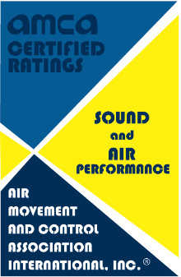
One Step Further…
Models AE & AS have 3rd party certification
  Licensed to bear AMCA Sound & Air Performance seal
  UL/cUL 705 for electrical

Slide 8
Thank you for your time.
Questions?

Slide 9
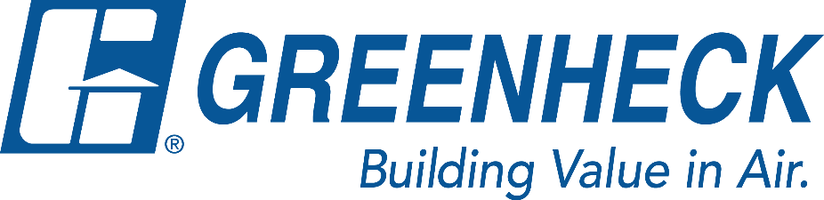

The mission of Greenheck is to be the market leader in the development, manufacture and worldwide sales of quality air moving, control and conditioning equipment with a total commitment to customer service.

