Slide 1
Overview of Warehouse & Distribution Center Design

Slide 2
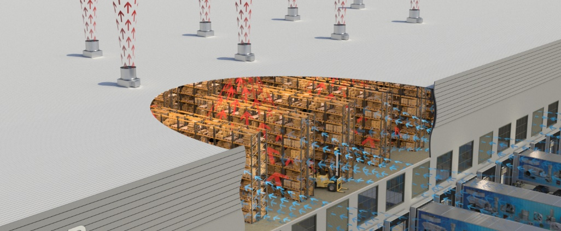
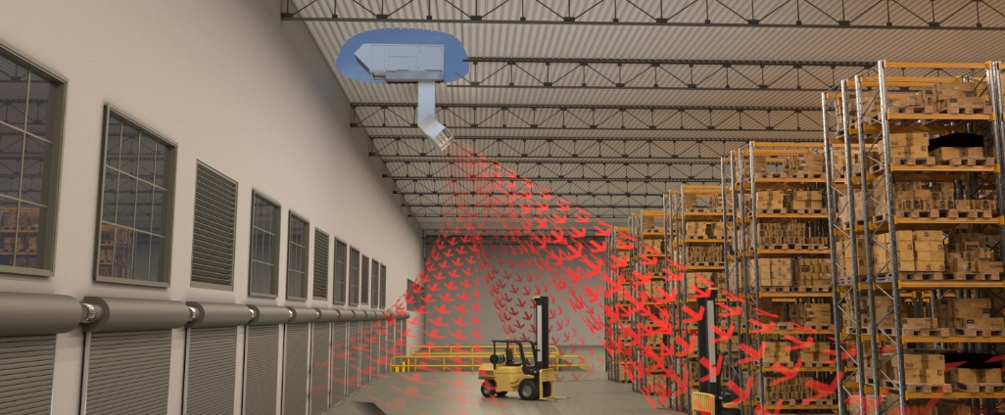
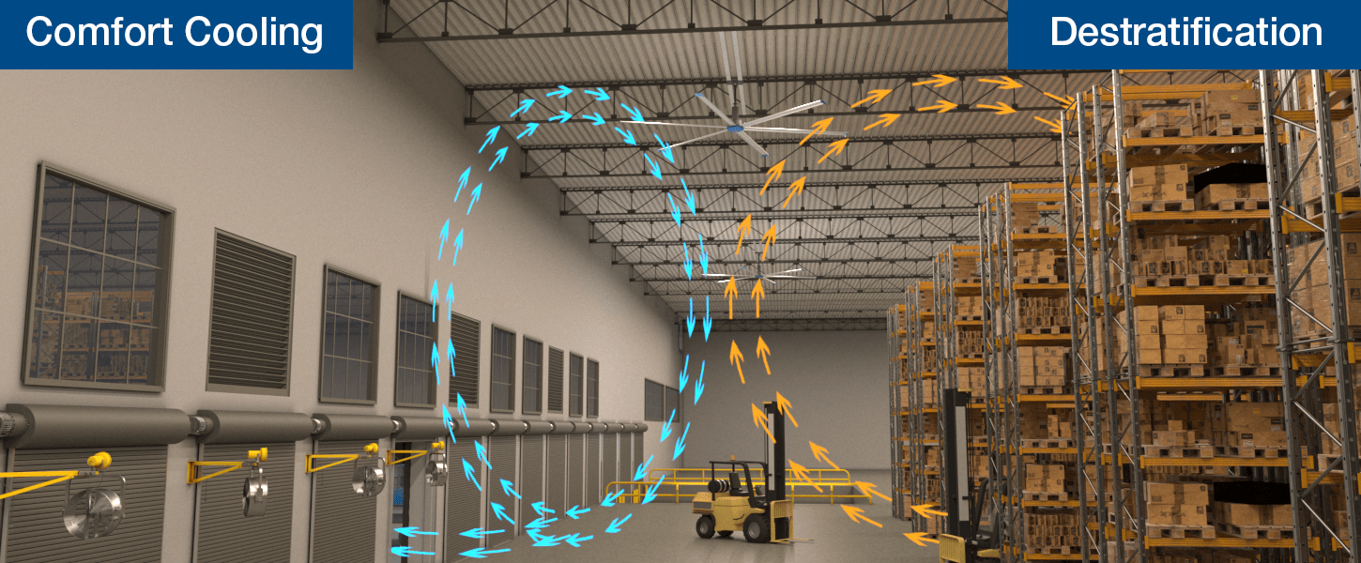
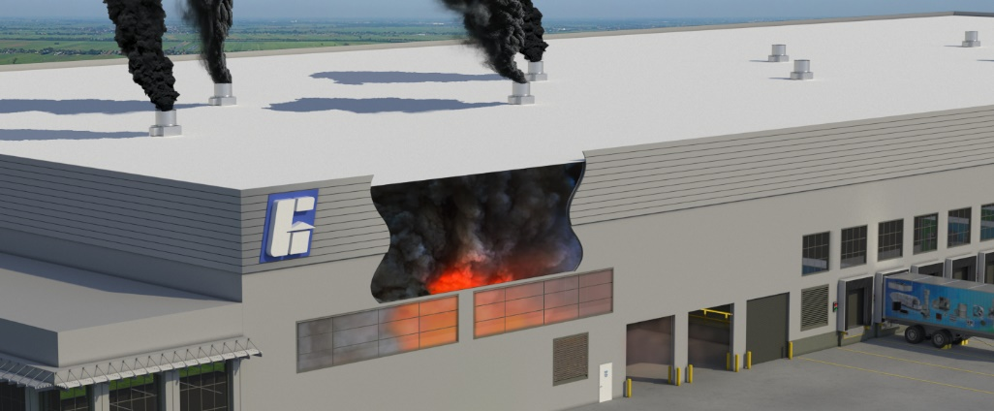
Typical Warehouse Systems
Summer Ventilation
Space Heating
Circulation
Smoke Exhaust
Notes:
In typical warehouse and distribution centers we see 4 primary systems. The summer ventilation system which heat from the building and replaces it with large amounts of outside air. In the winter the space heating system keeps the building warm. Air circulation provides air movement for a cooling effect in the summer and mixes the air in the building to prevent stratification in the winter. And in certain situations smoke exhaust is required to remove smoke from the building in the event of a fire. This presentation will cover each of these systems and considerations for the products that are used in each instance.

Slide 3
Summer Ventilation

Slide 4
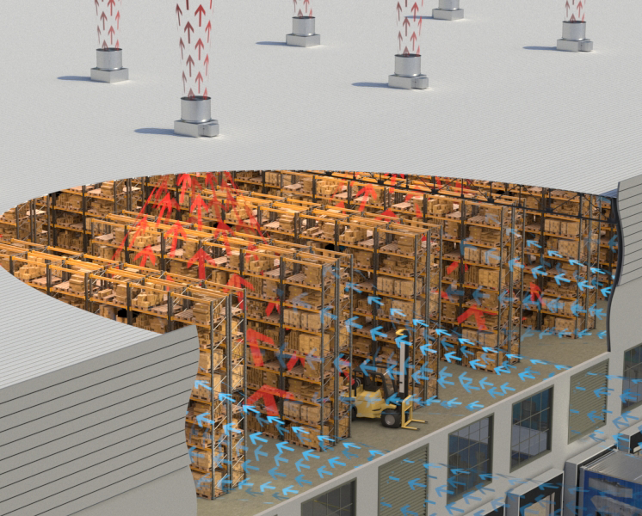
Summer Ventilation
Exhaust fans and intake louvers are utilized to:
Remove heat from the building
Replace with fresh outdoor air
Provide air movement throughout the facility
Common ventilation rate: 1–3 Air changes per hour (ACH)
Notes:
When warehouses are not cooled, Summer ventilation systems consisting of exhaust fans and intake louvers are utilized to exhaust heat from the building, replace it with outside air and provide air movement throughout the facility. In many cases these airflow rates are sized for 1-3 air changes per hour usually higher in warmer climates and lower in cooler climates.

Slide 5
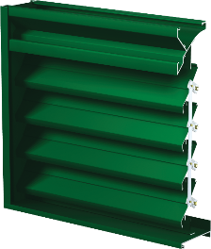
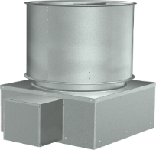
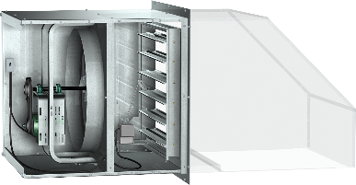
Intake Louvers vs Powered Supply
Example: 30,000 CFM
Louver Budget Price: $4826
Exhaust Fan Budget Price: $4323
Exhaust Fan Op. Power: 4.1 hp
Total Cost = $9149
Total Op. Power = 4.1 hp
Supply Fan Cost: $6133
Supply Fan Op. Power: 6.0 hp
Exhaust Fan Cost: $4323
Exhaust Fan Op. Power: 3.5 hp
Total Cost = $10,456
Total Op. Power = 9.5 hp
Notes:
One common question that comes up is why use intake louvers and not powered supply fans or make-up air like we use in a lot of other applications. One reason is that these systems only operate in the summer so we wouldn’t have to heat that air like we would with typical make-up air and exhaust systems for process applications. Additionally, the intake louvers are generally a more cost effective and efficient solution. A quick example helps demonstrate this. When sizing the exhaust fan in combination with an intake louver we need to account for the pressure drop through the louver resulting in slightly higher operating power but overall it is the same as the exhaust fan in the powered supply system. Where the difference comes is that the powered supply fan costs more than a typical intake louver and the overall powered supply system requires more than double the HP. The one disadvantage to using the intake louvers however is that the space will always be at a negative pressure, whereas with a powered supply system you can maintain neutral or positive pressure in the space. This may be important for certain applications to help prevent dust, insects and other contaminants from entering the building through dock doors.

Slide 6
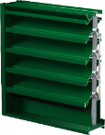
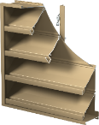
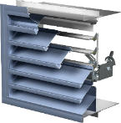
Louvers
Type of Louver | Adjustable Blade Louver | Combination Louver/Damper | Stationary Louver + Damper
Louver Picture
Cost | $ | $$ | $$$
Leakage | 8.7 CFM/ft² @ 1 in wg. | 4 CFM/ft² @ 1 in wg | Class 1A: <3.0 CFM/ft² @ 1 in wg
Appearance | Closed blade appearance may be undesirable | Maintains fixed blade appearance | Fixed blade appearance
Miami Dade Rating Available | No | Yes | Yes
Notes:
When selecting louvers for warehouse applications there are a variety of options to choose from. In most climates this system needs to be disabled in the winter and the intake openings closed off to prevent unwanted cold air form entering the building. This can be done by using a stationary louver and a damper or an operable louver product.
The most cost effective option is to use an adjustable blade louver. These louvers are designed such that the entire louver blade rotates – in the open position the blades are positioned at an angle providing the appearance and functionality of a louver, in the closed position the blades rotate and close which can sometimes create an undesirable appearance.
To address this a slightly more expensive combination louver/damper can be used. Combination louver/dampers uses a fixed front blade with an operable rear blade which allows it to maintain a fixed blade appearance in the closed position. Combination louver/dampers are also available with high wind ratings for coastal applications.
Generally, the most expensive option is to use a stationary louver in combination with a damper. This provides the most flexibility with louver design and architectural options as well as various damper options, including insulated options for situations where better thermal performance is desired. Additionally, using a damper provides the best leakage performance meeting class 1A requirements. These will need to be sleeved to put the louver and damper together the sleeve can be factory provided on the louver or damper if desired.

Slide 7
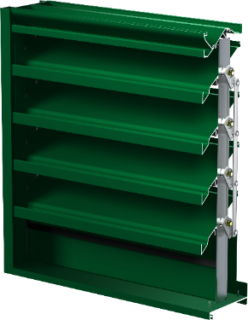
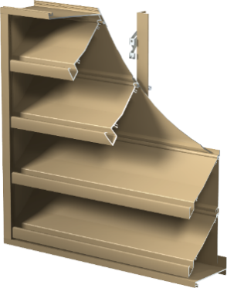
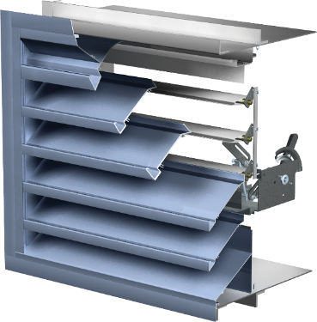
Louver Summary
Most common way of controlling the intake of air is EAD-635 (adjustable blade louver)
  Lowest cost solution for intake of air
Best performing for intake of air is ESD-635 (stationary louver) with ICD-45 (thermally broken blade and frame damper)
  Sleeve available on the louver or damper
  Used with large temperature differentials between outside and inside environments
  Highest first cost
Louvers boast tiered product offering!
Notes:
When looking at Greenheck’s product offering the cost effective solution for intake is the EAD-635 adjustable blade louver. This louver has a very high free air and beginning point of water penetration allowing for the highest intake airflow capacity in its class and is the lowest $ / CFM solution for air intake on a warehouse.
On the other end of the spectrum when thermal performance is important a ESD-635 stationary louver and an ICD-45 damper can be an excellent choice. The ICD-45 damper has thermally broken blade and frame which helps prevent condensation and frost buildup on the inside of the damper in cold climates.
Greenheck’s wide louver product portfolio has all the options in between as well with a louver for any budget or project requirement.

Slide 8
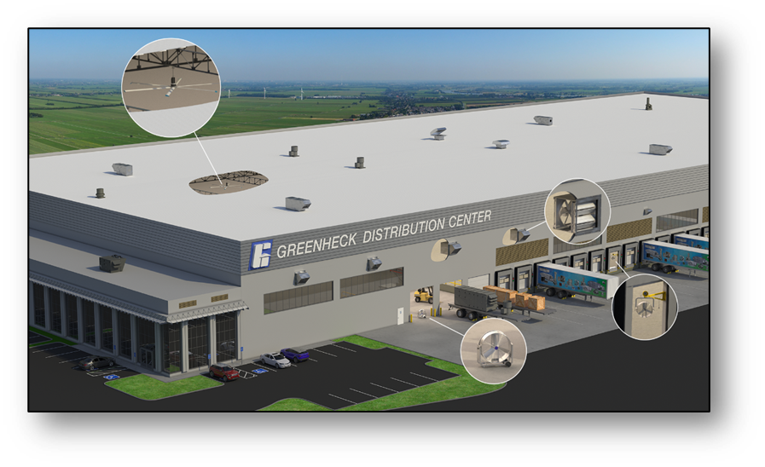
Roof Exhaust Fans
Notes:
Roof exhaust fans are the most common option for exhausting air in a summer ventilation systems

Slide 9
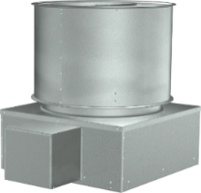
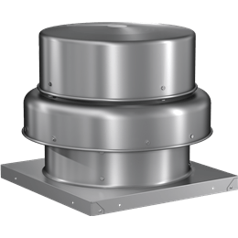
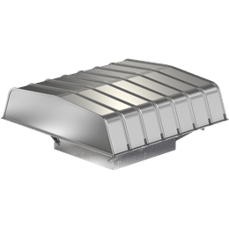
Roof Exhaust Fans
Axial Upblast
Most used exhaust fans in warehouse applications - Best $$/CFM
Spec: Up to 68,000 CFM and 1 in of static pressure
Certifications: High temperature and seismic rating available
Spun Aluminum
Used for general clean air warehouse applications
Centrifugal wheel results in higher operating power
Spec: Up to 44,700 CFM and 3.25 in of static pressure
Certifications: High Wind, high temperature and seismic available
Hooded Axial
Used for exhausting clean air in warehouse applications
Spec: Up to 82,283 CFM and 1.5 in of static pressure
Certifications: High Wind and Seismic ratings available
Notes:
There are many options to choose from when selecting a roof exhaust fan for a warehouse application.
Axial upblast style fans are most often used in warehouses because they provide great performance and are available at the lowest price. These fans can exhaust up to 68,000 CFM and provide the best $/CFM when compared to any other fan option. One disadvantage of these fans is that they typically need to be applied with a condensate pan underneath the fan. In the winter when the fans are disabled warm moist air has the potential to condense on the underside of the butterfly dampers and inside of the fan housing which can drip into the building. Other fan options like spun aluminum or hooded axial fans are available with dampers in the curb that prevent air from entering the fan housing and condensing.
Spun aluminum fans are probably the most commonly used roof exhaust fan in the industry for and can also be used in warehouse applications for general exhaust. These fans use a centrifugal wheel rather than an axial propeller which results in higher operating power in low static pressure operating points required in warehouse applications. Additionally, the housing design provides excellent protection against wind and rain to keep water out of the building.
Hooded axial fans combine the housing rain resistance of spun aluminum fan with the performance of an axial propeller. One disadvantage of these fans is that the hoods require field assembly increasing install time and cost compared to other options.

Slide 10
Sidewall Propeller Fans
Notes:
Sidewall fans can be an excellent option for summer ventilation on metal buildings with standing seam roofs that create challenges for curb installation and serviceability as well as other situations where it is desirable to avoid roof penetrations.

Slide 11
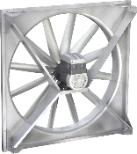
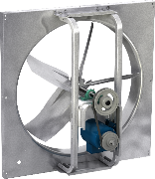
AER
CHARACTERISTICS
SBE
Direct
DRIVE TYPE
Belt
20-60”
PROPELLER SIZE
20-72”
Cast Aluminum Blades
CONSTRUCTION
Fabricated Steel Blades
78,600 CFM
MAX CFM
86,850 CFM
2.45 in. wg
MAX STATIC PRESSURE
1.0 in. wg
AMCA Air & Sound
OSHPD Certified
UL/cUL 705
CERTIFICATIONS
AMCA Air & Sound
OSHPD Certified
UL/cUL 705
Notes:
The 2 most utilized sidewall exhaust fans from Greenheck are the model AER and SBE. The AER is our “Cadillac” sidewall exhaust fan. These are all direct drive and utilize cast aluminum blades available in various blade pitches and quantities to maximize efficiency at any given operating point. For cost sensitive applications the model SBE is a belt driven option that uses a fabricated steel propeller construction and is available in sizes up to 72”.

Slide 12
“Greener” with AER
Vari-Green (EC) offering now up to and including 10 hp (single and three-phase options)!
  IE5 efficiency options → Lower cost of operation!
  Smaller NEMA motor frames → Easier installation!
  Drives integrated with motor → Easier setup and serviceability!
    Drives come pre-programmed from the factory minimizing field setup time!!
    Bluetooth option available
  Standard ECM filter → Protection from harmonics and overheating!
Notes:
Slide Note: Want to push the new Vari-Green technology and how it can benefit the end-user and installer. Previous EC technologies were limited to 2hp.
Talking Points:
- The most expansive EC options in the market just got better. Look no further than the AER Vari-Green packages. This includes mounted drive with special options including:
IE5 efficiency → Most efficient motors in the world! → Lower the cost of operation!
Smaller motor frames means easier installation as-well-as less labor to install!
Drives integrated with the motor means less wiring, easier setup, and simple maintenance!
Onboard ECM filter protects from voltage harmonics and overheating
Question that may arise: How does motor handle freewheeling/flying start?
Inject DC that locks up rotor at 100% torque. If its spinning slowly with windage it should get it. If its spinning too fast it will trip the drive. No circuit monitoring.
12

Slide 13

Emergency Smoke Exhaust
Notes:
In warehouse applications smoke exhaust is generally only required in special circumstances.

Slide 14
Emergency Smoke Exhaust
Two typical types of smoke exhaust:
Smoke Control (IBC 909)
  Special warehouse projects
Smoke and Heat Removal (IBC 910)
  Driven by local codes
Notes:
Smoke exhaust systems can be classified into to categories which are defined by different sections of the International Building Code (IBC). One category is smoke control systems defined in IBC 909. These systems are intended to remove smoke to allow occupants a safe path to exit the building. Many times, these are used in stairwells are large open atriums, etc. In warehouse applications they are typically only required in special projects such as buildings with oversized mezzanines or other situations that prevent the building from complying with typical prescriptive life safety building designs.
Smoke and heat removal systems are the other category of smoke exhaust system defined in IBC 910. These systems are intended to be activated to help emergency personal clear smoke from the building. Most warehouse applications use early suppression fast response (ESFR) sprinklers and IBC does not require smoke and heat removal with ESFR sprinklers however there are certain situations where ESFR may not be able to protect the commodities stored. Additionally, there are certain local codes that will strike the ESFR exception from the IBC requiring smoke and heat removal in all warehouses in those areas.

Slide 15
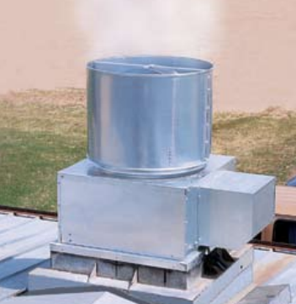
Axial Upblast Fans
Certifications
  AMCA Air & Sound (All Models)
  UL/cUL–705 (All Models)
  High-Temp / UL 793 UL-Smoke/Heat (RBUMO)
  OSHPD Seismic (RBUMO)
UL-793 w/High-Temp (RBUMO)
  500°F (Minimum of 4 hours)
    Spec for IRI Requirements
  1000°F (Minimum of 15 minutes)
    To meet electrical temperature requirements
  Snow Load Test (Butterfly Dampers)
Notes:
When you need a smoke exhaust fan the RBUMO is axial upblast fan is you go to model. These fans are available with a UL high temperature listing. One thing to note is that the UL standard for high temperature provides a testing methodology but the manufacturer specifies what temperatures and for what time period to test to. Most commonly manufacturers list for 2 criteria:
500F for 4 hours which came from an old Industrial Risk Insurers (IRI) requirement – IRI no longer exists but this specification is still used today in many situations.
1000F for 15 minutes which is used to meet some of the electrical temperature requirements in the IBC
Additionally the RBUMO has a UL-793 rating on the butterfly dampers which includes snow load testing for the butterfly dampers to ensure they will spring open in a fire while loaded with snow.

Slide 16
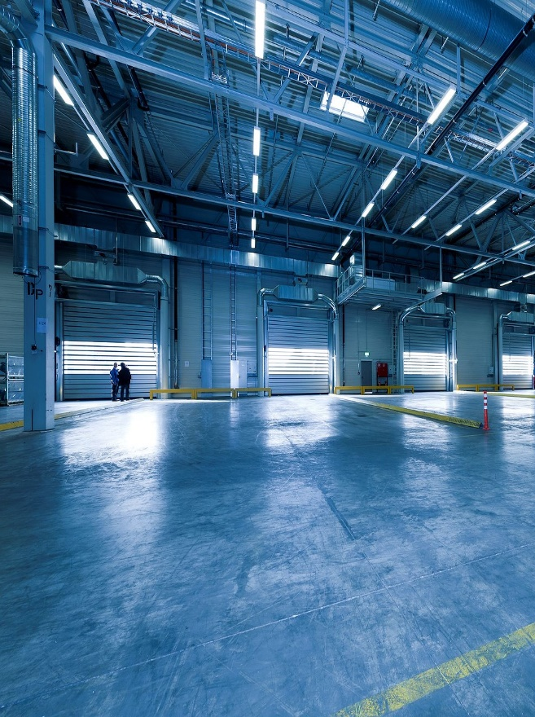
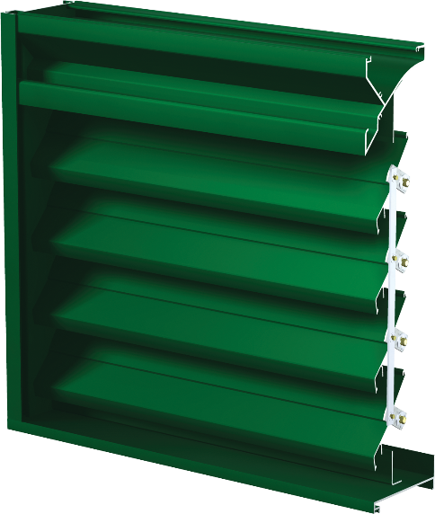
EAH-690
Adjustable blade louver commonly used for emergency smoke exhaust
  Blades open to a full 90-degree position
Extremely high free area when in the open position
  68% Free Area
Highly configurable with a wide variety of options available
As shown with 120v electric actuator for tight closure
  Actuator set in the fail-open position
Notes:
Now if we are exhausting smoke and air from the facility, we need to provide intake for fresh air as well. Typically, this is handled with louvers in a warehouse. Any of the louvers we discussed previously in the summer ventilation section can be used for this application but Greenheck also has a particular model designed specifically for these applications. The EAH-690 is a adjustable blade louver that is designed to allow the blades to open to a full 90 degrees maximizing the amount of free area, reducing velocity and pressure drop through the louver. Lower pressure drop corresponds to smaller fans and motors needed to provide the smoke exhaust and overall a more cost effective system. At 90 degrees fully open the louver doesn’t do a great job of keeping water out of the building, however in a during a fire that generally is not too much of a concern.
One other consideration when dealing with smoke exhaust louvers is that generally it actuators need to be set to the fail-open position so that in a loss of power they will open and allow airflow.

Slide 17
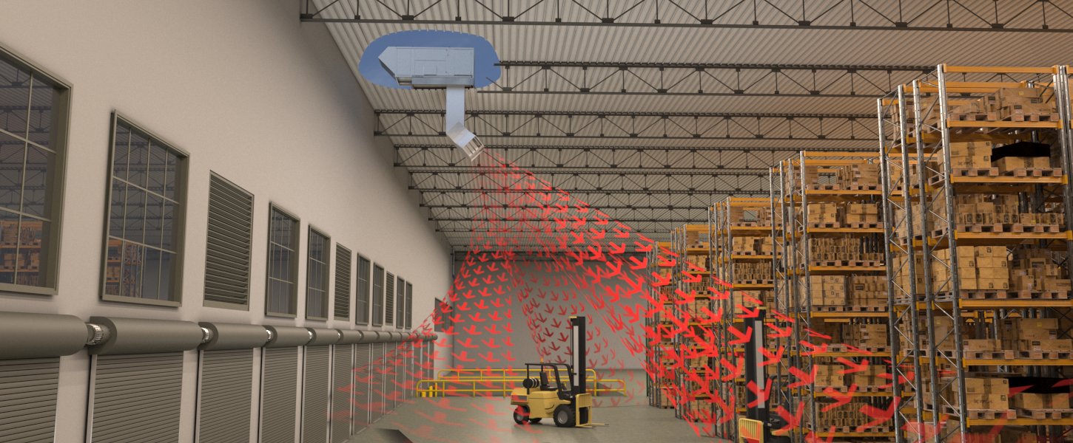
Space Heating
Notes:
Heating warehouses can be a bit challenging. Typically, these are large spaces with racking that makes heat distribution difficult. Numerous dock doors result in high amounts of cold air infiltration also create cold drafts and drive up heating loads.

Slide 18

Space Heating
Commonly utilized direct gas fired (DGX) units positioned around perimeter of building
  100 outside air (OA) units
  80/20 reciculating units
Typically around 100,000 ft² max /unit
Units applied with high discharge temperatures (100°+)
OA pressurizes the space to offset cold-air infiltration
Notes:
Greenheck’s solution for heating warehouses is to use direct gas fired units. These units are a very cost effective solution for heating warehouses and extremely efficient using with a 92% efficient burner. Typically we place these unit around the perimeter of the building near the dock doors to provide heating in the coldest spots of the facility. They are applied in 2 configurations 100% outside air with high temperature dichsrge temperatures and 80/20 recirculating configurations. In both cases outside air is supplied to pressure the building and offset the cold-air infiltration.

Slide 19
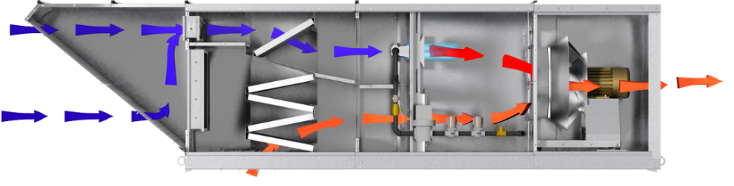
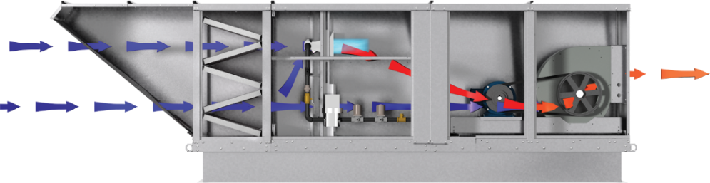



80/20
100% OA
Adjust the amount of OA required to heat the space
Maximize amount of heating delivered to the space
Max discharge temp of ~100 degrees
Max discharge temp of ~140 degrees
Adjustability of OA results in lower operating costs and higher efficiency
Provide lowest initial cost solution for heating large warehouses and distribution centers
OA is modulated to control building pressure and maximizes indoor comfort levels
OA pressurizes space to minimize infiltration and maintain ventilation for IAQ requirements
Notes:
100% outside air and 80/20 systems both have their advantages:
100% outside air systems heat the air up to high temperatures of around 140F maximizing the amount of heat delivered to the space per CFM and creates the lowest first cost solution for heating large warehouses and distribution centers. The outside air provides needed ventilation to the space and offsets infiltration through dock doors and the high discharge temperature provides heating to handle the building heat load.
Recirculating direct gas fired units commonly referred to as 80/20 units have the ability to deliver varying amounts of outside air from 20 – 100% with the remainder being recirculated from the space. Typically the outside air is controlled on building pressure to prevent cold drafts and maximize indoor comfort levels. Generally these systems are more efficient than 100% outside units because the OA can be controlled to exactly the amount you need for the application minimizing energy consumption. Because these units recirculate the air safety standards limit the discharge temperature to around 100F, this means they need to provide more airflow to provide the same amount of heating resulting in larger more expensive units than 100% outside air units.

Slide 20
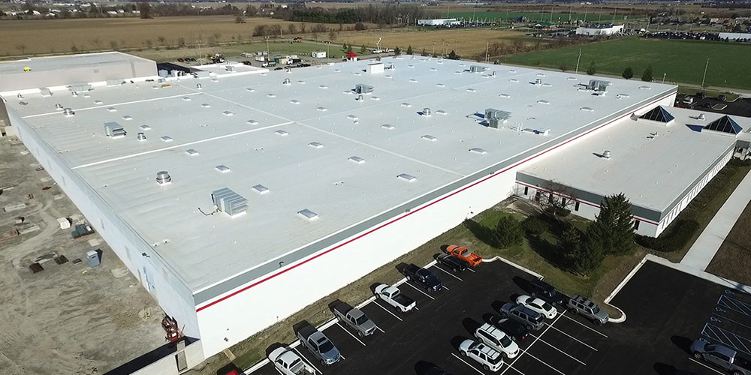
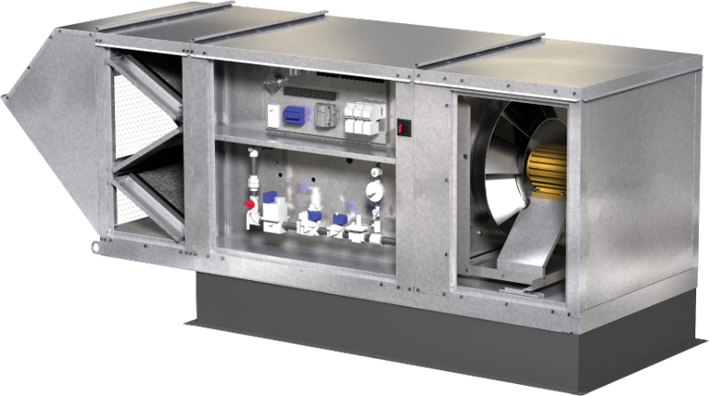
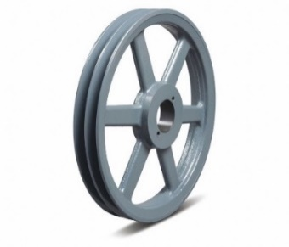
MUA with Forward Curve Blower
Estimating (specifically over-estimating) external static pressure happens all the time
    Contingencies for filter loading, duct design / system effects, belt slip / stretching
    Solution to moving too much air?
Notes:
One of the challenges we typically run into on warehouse applications is over-estimating static pressure. We see units ordered with 0.5 in of external static pressure for a straight drop to a diffuser that is probably providing 1/8 in wc of resistance. With traditional forward curved fans that are used in MUA equipment causes them to move to much air and overamp. And to address this we are talking pulley and belt changes usually on multiple units for a warehouse and all of this costs time and money. That’s where our mixed flow fan options for make-up air can help.

Slide 21
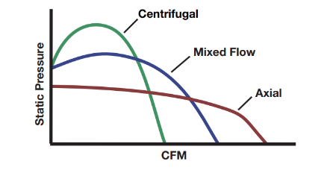
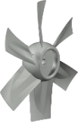
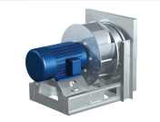
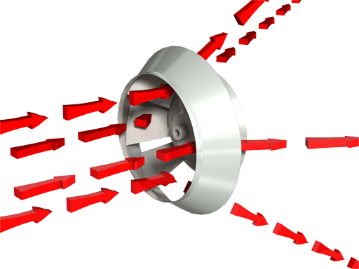
MUA with Mixed Flow Wheel
Hybrid impeller that has the best characteristics of an inline prop and centrifugal wheel
Non-overloading wheel design vs. forward curve/squirrel cage
Efficient, low sound, best performing wheel
Notes:
Mixed flow fans are a hybrid design between an axial propeller and a centrifugal wheel. This creates a fan that performs extremely well at pressure from 1-2 in wc perfect for the typical MUA applications. Additionally they are a non-overloading design meaning at a constant RPM BHP remains the same or drops as pressure is reduced and airflow increases unlike traditional forward curved style fans. This helps to prevent issues with overamping in the field.

Slide 22
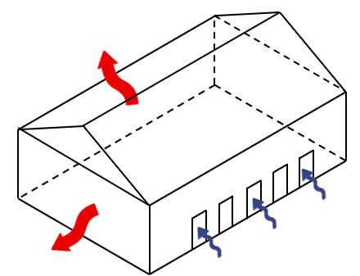
Warehouse Example
Design Parameters
420,000 ft² mixed-use warehouse and garage
MUA run at low speed for space heating
Two speed exhaust and MUA to meet minimum ventilation and demand control ventilation (CO & NO2)
Quantity 18 DGX-H35’s at 18,000 CFM
Categories | DGX-122-H35 | DGX-P130-H35-MF2
Supply Fan Type | Forward Curve | Mixed Flow
Operating Power | 14.86 hp | 7.83 hp
Fan Motor Size | 20 hp | 10 hp
Unit Weight | 2,904 lbs. | 2,680 lbs.
Unit Relative Cost | 1.00 | 0.95
Est. Annual Electrical Costs | $59,616 | $31,413
$28,203 annual savings in electrical operating costs!
Notes:
In this example, we have a 420,000 square foot mixed used warehouse/garage that was designed with a ventilation system to deliver minimum ventilation of 25,200 cfm, maximum DCV ventilation of 315,000 cfm and space heating. The DCV is engaged based on CO and NO2 sensors, which engage as vehicles are idling inside.
Based on the ventilation requirements and heating requirements, eighteen DGX-H35’s were selected, operating at 18,000 cfm each. If we compare forward curve and mixed flow options, we can see that by using mixed flow fans, we see lower operating HP, smaller motor sizes, lighter units, lower costs and the owner saves over $28,000 annually in electrical costs.

Slide 23
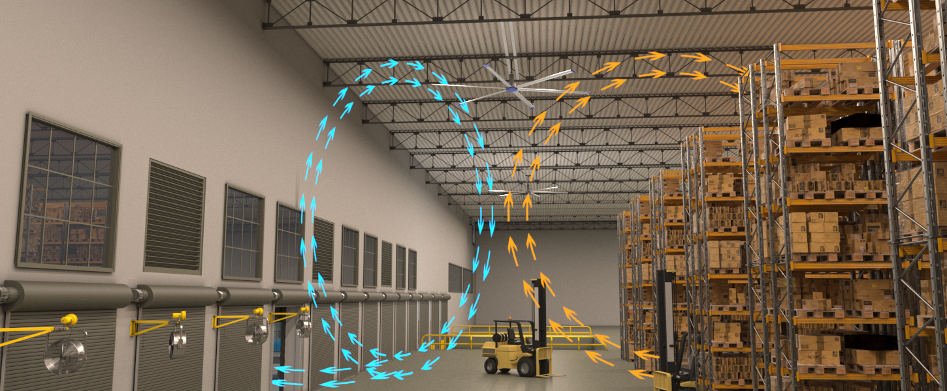
Air Circulation

Slide 24


Overhead Fan (HVLS) Benefits
Improve occupant comfort & productivity
  Evenly distribute air for uniform temperatures
  Studies show 1% productivity loss for every 1°F of discomfort
Lower first-cost for HVAC
  Fans provide cooling effect, reducing the need for A/C
Reduce energy costs
  Save up to 30% on cooling costs by running A/C less or increasing set point
  Save up to 25% on heating costs by conserving heat through destratification
All Greenheck AMPLIFY overhead fans are AMCA certified
Performance based selections and data you can trust
Notes:
Talking Points:
Explain that HVLS fans are gaining popularity with building owners and developers due to the variety of benefits that they provide
Primary benefit of HVLS fans is that they can improve occupant comfort and productivity by evenly distributing air
In the summer, HVLS fans can be run in the forward-direction (air blowing down) to provide a cooling effect for building occupants by increasing the evaporation rate of sweat. This is commonly called comfort cooling.
In the winter, HVLS fans can be run in the reverse-direction (air pulled up) to bring warm air down from the ceiling without creating a draft/breeze on building occupants. This process is called destratification.
Why is comfort important in a building? A University of California-Berkeley study has shown that there is a 1% productivity loss for every 1 degree of discomfort that workers feel. https://escholarship.org/content/qt45g4n3rv/qt45g4n3rv.pdf
HVLS fans can also lower HVAC system costs by reducing the need for other equipment (lowering first costs) or by supplementing other equipment to save energy
In summer – use HVLS fans for cooling and turn air conditioning off or increase temperature set point on thermostat
In winter – use HVLS fans to keep heat at floor level, resulting in the thermostat calling for heat less frequently

Slide 25
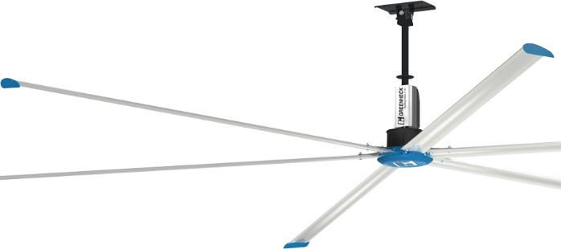
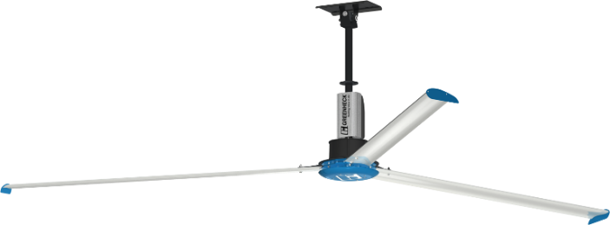
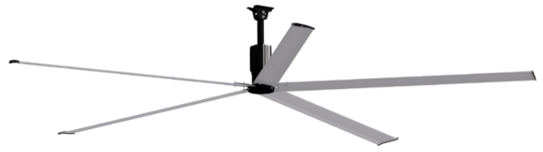


AMPLIFY Overhead Fan Product Family
DS-6
DS-3
Performance
DC-5
Medium to Large Spaces
Medium to Large Spaces
Small to Medium Spaces
Price

Slide 26
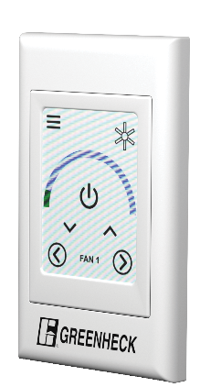
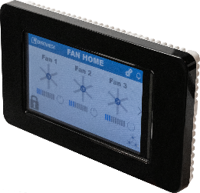
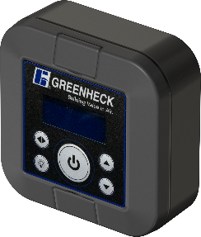
AMPLIFY Overhead Fan Controls Family
NEW controller coming in August 21’ CAPS release – 20 fan controllability!
Advanced Touchscreen
Up to 10 fans
Individual or grouped fan operation
BACnet integration
Optional temp/humidity sensors
Standard Touchscreen
1, 3, 5, or 10 fans
Individual fan operation
Fits 2x4 junction box
Features
Keypad
1, 3, 5, or 10 fans (1 model)
Grouped fan operation
Simple interface
Price

Slide 27
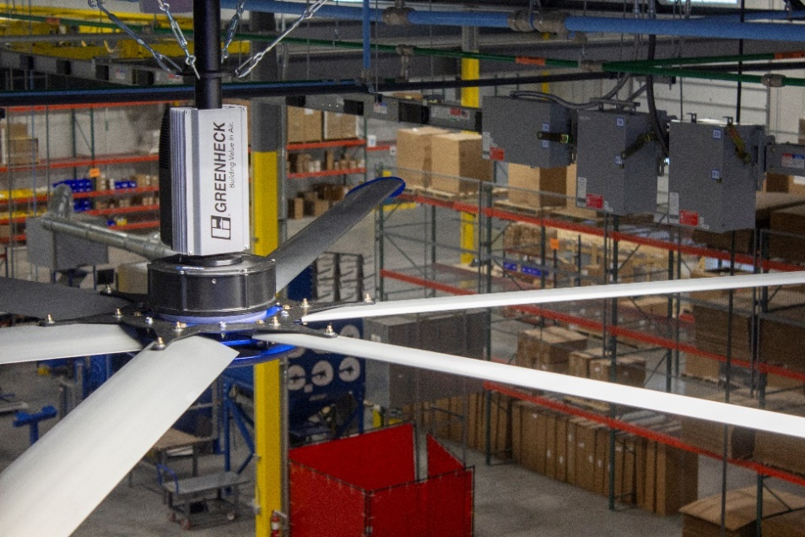
HVLS in Application: Case Study
FedEx Distribution Center
  Competitor XYZ selection: Qty(12) 16 ft. fans
  Greenheck selection: Qty(9) 16 ft. fans
Contractor familiar with installation of Competitor XYZ fans
  Planned for 3 days of labor
    (2.5-3 hours per fan)
  Greenheck fans installed in 1.5 days
    (1-1.5 hours per fan)
Results
  Over $15,000 in first-cost savings!
  Over $1,200 in labor savings!
Notes:
$25/hour, 4 person crew
$5000/fan cost to contractor

Slide 28
Greenheck System Solutions
We can provide the entire system:
Fans, dampers, louvers, MUA, HVLS & circulators, DOAS
No other “one stop shop” manufacturer
Designed and tested to work as an engineered system
Tiered product offering to fit any budget

Slide 29
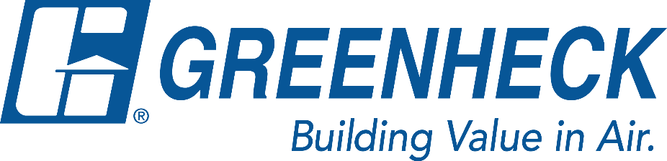

The mission of Greenheck is to be the market leader in the development, manufacture and worldwide sales of quality air moving, control and conditioning equipment with a total commitment to customer service.

