Slide 1
Warehouse Heating Design with Greenheat Jennifer Butina – Application Engineer II Taylor Dane – Principal Application Engineer
Notes:
Jen Hannon

Slide 2
What is “Greenheat”?
Model DGX make-up air units optimized for space heating
Direct gas fired heating (92% efficient)
100% outside air
140F max temp rise and leaving air temp
Fixed sizes that optimize cost per BTU
How do they work?
Generally cycle on demand like a unit heater or home furnace
Outside air pressurizes the building to offset cold air infiltration
High temperature heats the building

Slide 3
Space Heating Design
Roof Conduction Losses
Usable Heat
Considerations
Skin Load – conduction losses
Usable Heat – energy available to heat the air inside of the building
Infiltration – cold air gain
Heat distribution – both across the space and floor to ceiling (stratification)
Infiltration
Wall & Door Conduction Losses

Slide 4
Skin Load
Skin load – heat lost by conduction through the exposed building envelope
Affected by:
Exposed surface area
Insulation values
Outdoor and indoor temperatures
Example:
483,000 ft²
Perimeter 2932 ft
Height 36 ft
0°F Winter Design
Case 1:
R-15 Roof
R-2 Walls
Case 2:
R-20 Roof
R-8 Walls
Accurate building information is critical to equipment selection!

Slide 5
Usable Heat
Total heating capacity of a Greenheat unit includes heating the outside air to space temperature
Air supplied at the same temperature as the space doesn’t heat the building
Heating to higher temperature provides heat we can “use” to heat the building
Example:
60F space temperature
Usable Heat > Skin Load

Slide 6
Infiltration
Air leaking into the building through doors, windows, cracks, dampers, etc.
Effects of infiltration
Increases stratification
Reduces space comfort
Increases heating loads
Warm air forced to ceiling
81°F
Open dock Door
Cold Air Infiltration
`
63°F

Slide 7
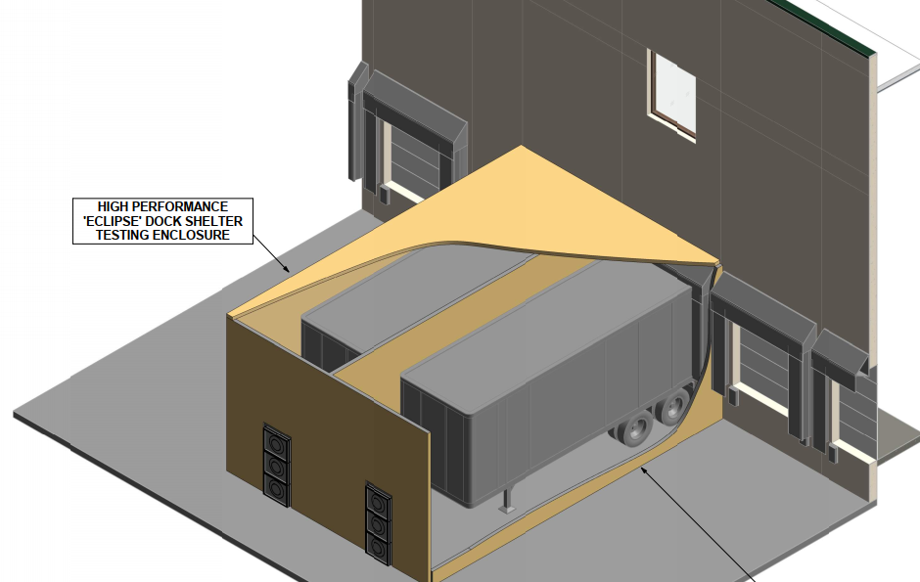
Combating Infiltration
Combat infiltration by building pressurization
Introducing outside air pressurizes the building to offset infiltration
Example “blower door” infiltration testing

Slide 8
Calculating Infiltration
Infiltration is difficult to calculate some methods include
Air changes / hour method (rule of thumb)
Crack method (CFM / linear ft of crack)
CAPS estimates infiltration based on
Building size
Number of dock doors and overhead drive in doors
Total Load = Skin Load + Infiltration Load
Left over usable heat that haven’t used on the skin load can heat the cold infiltration air
The outside air we heated to space temperature offsets the remainder of the infiltration load
Total Heat Output > Total Load
Notes:
There isn’t a tried and true method for calculating infiltration. There are so many factors that influence infiltration that are difficult to control for some of which include: wind speed, wind direction, construction quality, etc. making infiltration loads more of an estimate that a sure value. Therefore there are a few methods used to estimate the infiltration rate such as the Air Changes per hour method or the crack method. To address infiltration we used feedback from the industry to develop an infiltration calculation in CAPS that combines these methods to calculate infiltration based on the building size, number of dock and overhead doors. Once an infiltration load is calculated it can be added to the skin load to determine the total heating load for the building.
To address that heating load any left over usable heat that isn’t used on the skin load will heat the cold infiltration air that comes into the building and the outside air we heated to space temperature also offsets the remainder of the infiltration load. Therefore we just need to make sure that our total heat output is greater than our total load on the building.

Slide 9
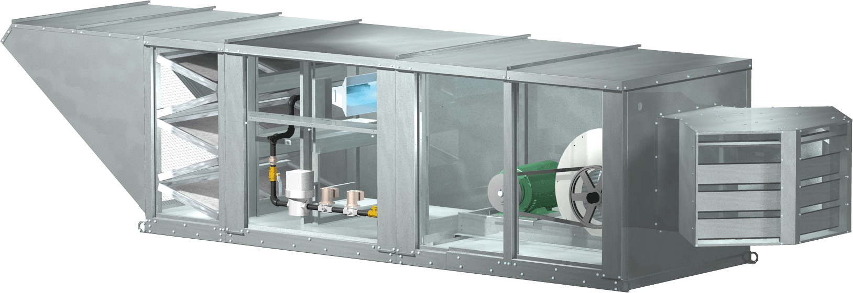
Heat Distribution
How to distribute the heat in a warehouse?
Ductwork?
Large air volumes?
High Volume Low Speed (HVLS) Fans
High Velocity Discharge
“Throws” the heat
Induces airflow
Notes:
Now that we have addressed heating the building how do we distributing the heat? Heat distribution in a warehouse can be challenging. Ductwork like we use in other applications isn’t a realistic option . Large air volumes significantly increase the size and cost of equipment so generally cost prohibitive. Probably the best option is to HVLS fans for heat distribution. 24 ft HVLS fans can move up to 243,000 CFM creating great air turnover in the building and excellent heat distribution when we can use them. However in many applications we are looking for the most cost effective option, which is where high velocity discharge can be effective. With this method we effectively throw the heat into the building, which creates air turnover.

Slide 10
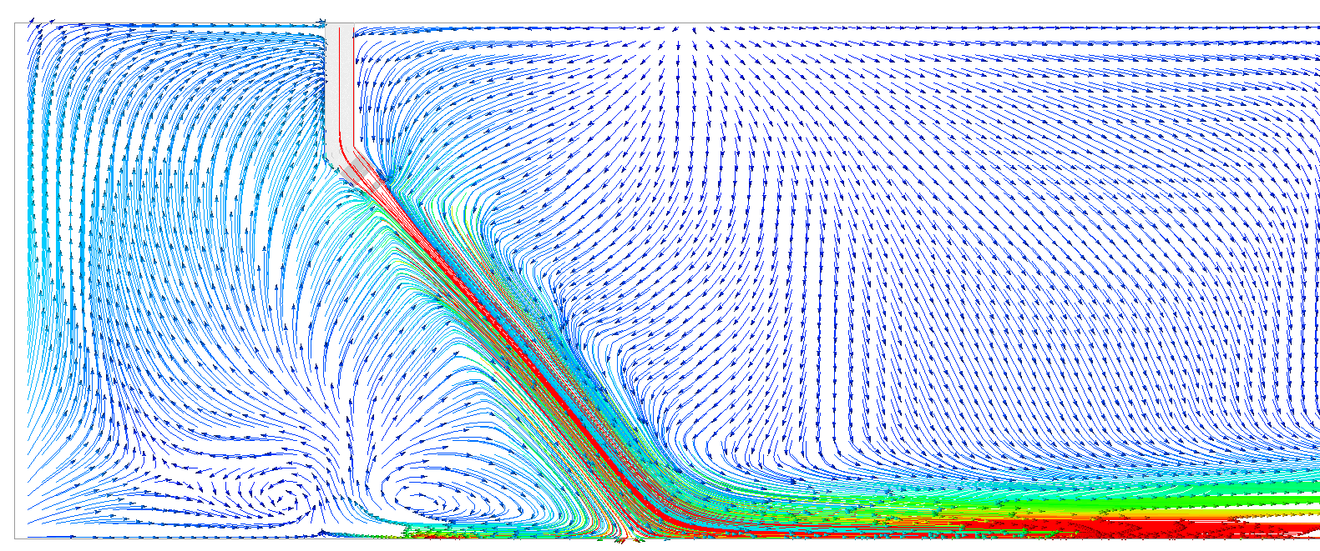
High Velocity Discharge
Example – Computational Fluid Dynamics (CFD) Analysis
10,000 CFM supply air
1200 FPM diffuser velocity
Diffuser
Notes:
To show how high velocity discharge creates air turnover we are using Computational Fluid Dynamics (CFD) which models air movement in the building. In this case we are showing the air being supplied down through a duct into our 3 way diffuser. The image you are seeing is a slice through the center of the diffuser. The arrows represent the air velocity and direction (blue being low velocity, red being high velocity). As you can see the air is directed down to the floor from the diffuser. As the air moves through the building it pulls the stagnant air into the air jet creating air movement in the building.

Slide 11
High Velocity Discharge
Example – Computational Fluid Dynamics (CFD) Analysis
10,000 CFM supply air
1200 FPM diffuser velocity
Creates air rotation
325ft
Notes:
Now zooming out from the previous slide we can see the air being discharged down to the floor of the building where it moves along the floor. As it loses its velocity the heated air rises to the ceiling resulting in air rotation. This can be very effective at creating even heating and minimizing stratification, however we need to make sure we meet 2 key requirements:
The discharge needs to be directed at the floor, if discharged horizontally out of the diffuser the heat will stay up at the ceiling causing stratification
The air needs to be directed into an open area in the facility which can be difficult in warehouse applications with the racking.

Slide 12
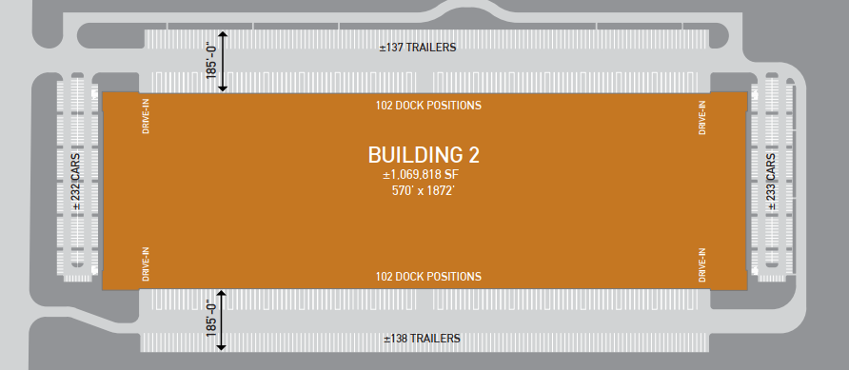
Typical Warehouse Layout
Heat load concentrated near dock doors
Racking
Notes:
With typical warehouse layouts we will see dock doors along the long side of the building. This slide shows a “cross dock” warehouse with docks on both sides of the building. Generally racking will be placed in the center of the facility leaving “speed bays” on either side near the dock doors. These bays are typically 60-70 feet wide between the exterior wall and the first column line in the building and are an excellent open area in the building to distribute the heat. Additionally we want to target the heating to these areas because:
The heat load is concentrated in these areas with all the infiltration through the dock doors
Most of the activity in the warehouse occurs in these areas as people load, unload and stage trucks in these bays.
Ideal is to position the units such that the left and right discharge out of the 3 way diffuser is directed down these open bays. The center discharge out of the diffuser is generally directed to the center of the building so that it travels down the aisles between the racks provides some air movement into the center of the building.

Slide 13
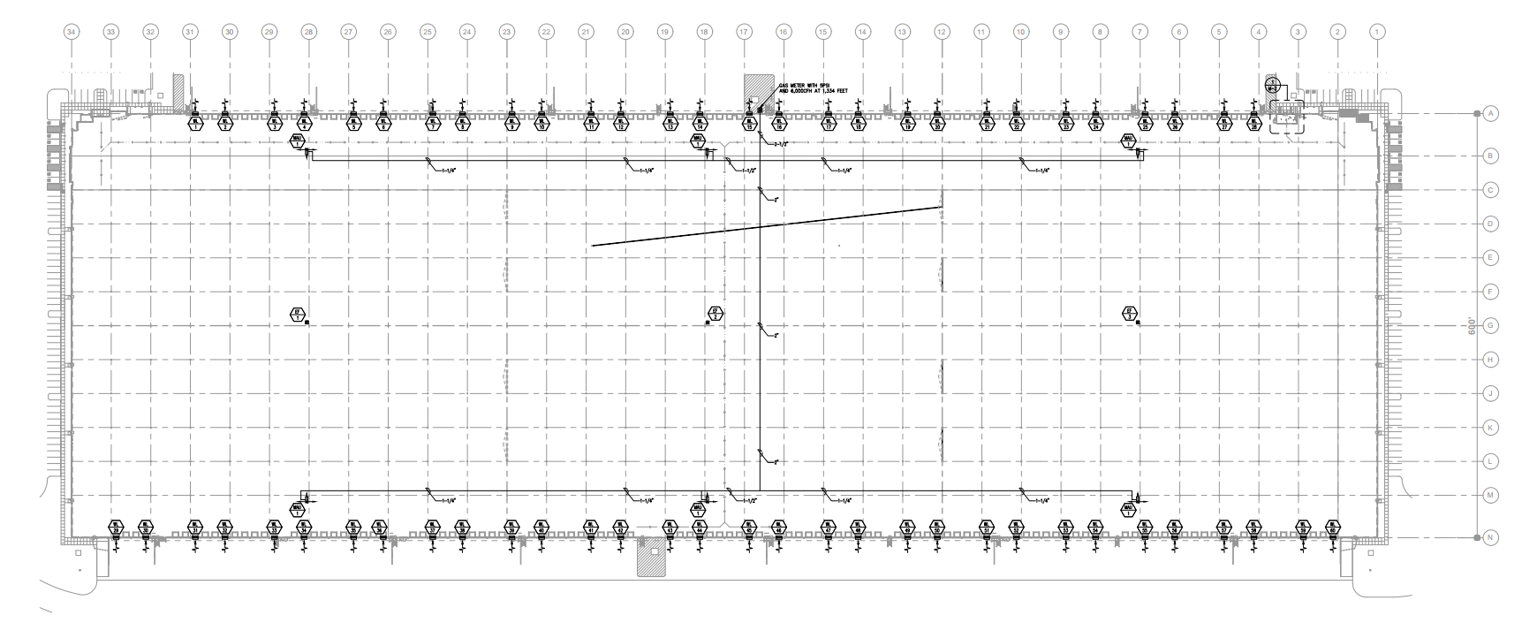
Typical Layouts
Notes:
This is an example of a cross dock facility with 6 Greenheat units positioned on the either side of the facility in the speed bays.

Slide 14
Typical Layouts
Notes:
This is an example of a facility with docks on 1 side with 4 units in the speed bay on one side of the facility.

Slide 15
Warehouse Design Summary
Accurate heat loads are critical to providing the most cost effective system
Calculation is only as accurate as the information provided
Usable heat > skin load
Total heat output > total load
Direct air to the floor in open areas of the building
Generally placed in the speed bays of a warehouse
~100,000 ft²/unit is a good rule of thumb
Reduce this for smaller buildings <300,000 ft²
Can Increase this for large buildings >600,000 ft²
CAPS will provide a recommendation for min QTY
Notes:
Leverage CAPS to help select units for these applications but remember. The selection is only as accurate as the information provided

Slide 16
Questions?
Contact TAP Customer Support
TAP@greenheck.com
1-800-240-0870

